Slide 1

Session #3: Forms, Multimedia

Slide 2

First with forms…(Chapter 7)
Forms are exceptionally important because:
They collect information from visitors
They help ensure that the data entered is easily done by the user
They help ensure that the data collected is as accurate as possible

Slide 3
What we must learn…
How to create a form?
How are the input types different and what information can they collect?
What does HTML5 offer for modern form controls?
How forms for mobile and desktop differ?

Slide 4
The most common form elements are….
Notes:
Source: Page 148 (HTML & CSS, Design and Build Websites)

Slide 5
How forms work…
Notes:
Source: Page 149 (HTML & CSS, Design and Build Websites)

Slide 6

Creating a form

Slide 7
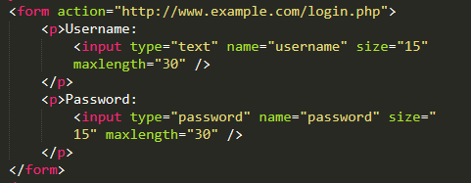

Adding input types

Slide 8

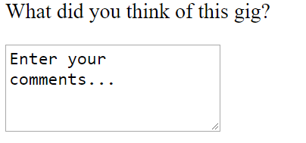
Adding a textarea….
For larger amounts of text input

Slide 9
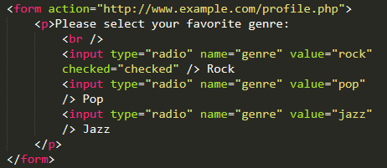

Radio Buttons

Slide 10
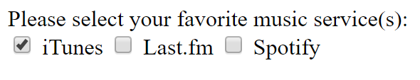
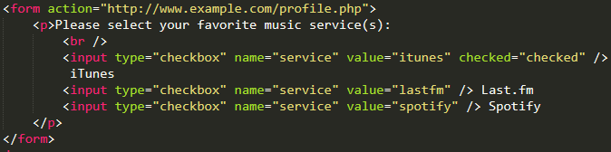
Checkboxes

Slide 11
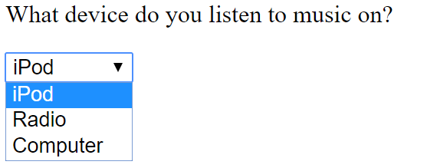
Dropdown List Box

Slide 12
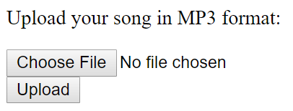

File input
For uploading files

Slide 13

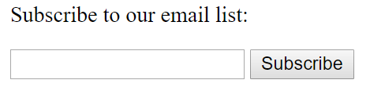
Submit Button

Slide 14


Using an image as a button

Slide 15
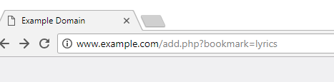
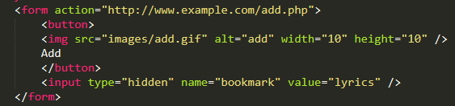

Button and Hidden Controls

Slide 16
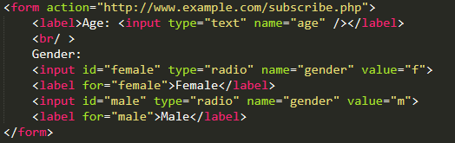
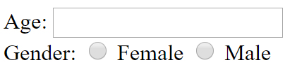
Labelling Form Controls

Slide 17
Grouping Form Elements

Slide 18
HTML5 Form Elements
Validation
Required fields
Special inputs
Mobile inputs

Slide 19
Date Input
Notes:
Note: the super cool calendar is Chrome’s rendering….it won’t look the same in other browsers!

Slide 20
Email and URL inputs

Slide 21
Placeholder

Slide 22
Examples

Slide 23
Summary
Whenever you want to collect information from visitors you will need a form, which lives inside the <form> element.
Information from a form is sent in name/value pairs.
Each form control is given a name, and the text the user types in or the values of the options they select are sent to the server.
HTML5 introduces new form elements which make it easier for visitors to fill in forms.

Slide 24
A bit about Chapter 8 – Extra Markup
Doctypes
Comments
Id’s
Classes
Block Elements
Inline Elements

Slide 25
Doctypes
Notes:
Source: Page 181 (HTML & CSS, Design and Build Websites)

Slide 26
Comments <!-- -->

Slide 27
Id’s

Slide 28
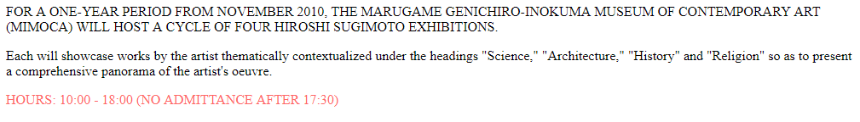
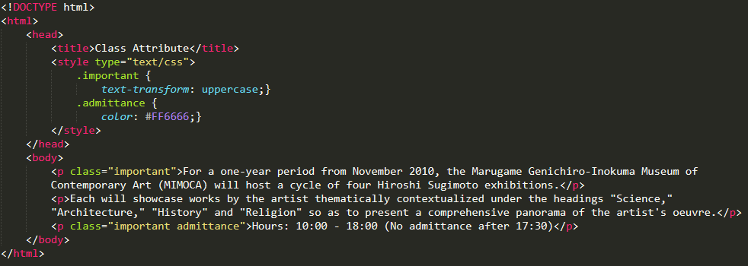
Classes

Slide 29
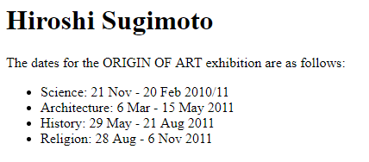
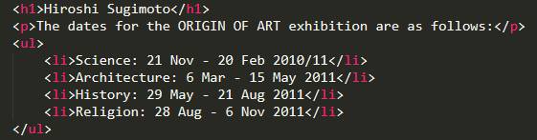
Block Elements

Slide 30

Inline Elements

Slide 31

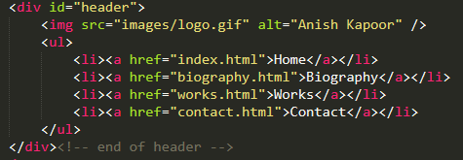
Grouping inside a block element

Slide 32
Multimedia (Chapter 9)
A bit about Flash
HTML5 <video> and <audio>
Acceptable formats (mp4 and webm)

Slide 33
Preparing Video
Easiest to use youtube or vimeo
Easily embedded using their code
To reach as many browsers as
possible, you should provide the
video in the following formats:
H264: IE and Safari
WebM: Android, Chrome,
Firefox, Opera

Slide 34
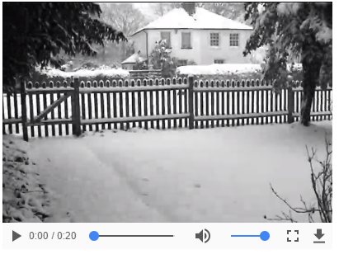
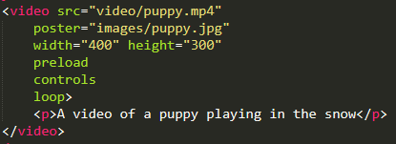
Adding Video Using HTML 5

Slide 35

Multiple Video Sources

Slide 36


Adding Audio

Slide 37
Summary
Moving forward, ignore Flash
Use HTML5 or external embed code (youtube or vimeo)
Use multiple sources if possible

