Slide 1

Session #7: Responsive Web Design

Slide 2
A Definition
Responsive web design (RWD) is an approach to web design aimed at crafting sites to provide an optimal viewing experience—easy reading and navigation with a minimum of resizing, panning, and scrolling—across a wide range of devices (from desktop computer monitors to mobile phones).
Wikipedia

Slide 3
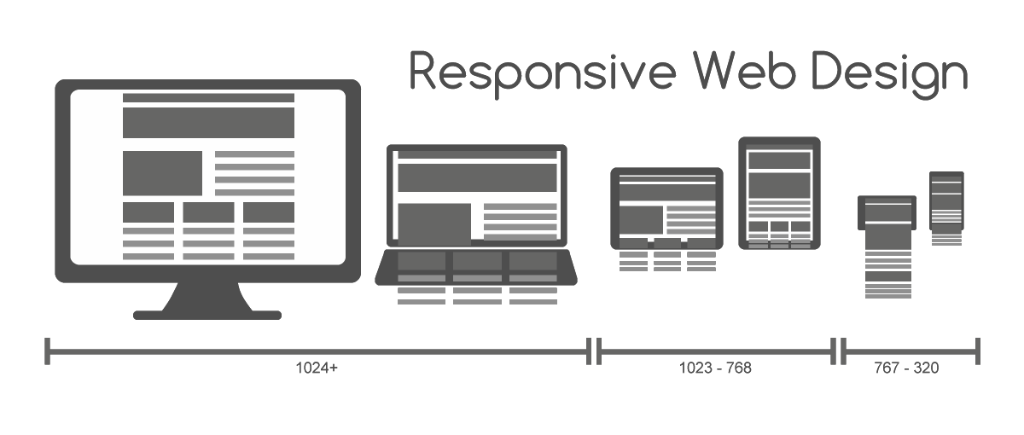
Visual Example
Image Wikimedia Commons license – MRafizeldi

Slide 4
Responsive Design Strategies
Start with mobile
Finger size links for mobile
Single column/Multiple Column
Hide, Show and Hint
No hover state in mobile
Image resizing
Let your content guide breaks
Work with grids

Slide 5
Responsive Navigation Patterns*
Top Nav or “Do Nothing” Approach
The Footer Anchor
The Select Menu
The Toggle
The Left Nav Flyout
The Footer Only
The “Hide and Cry”
*From Brad Frost.com

Slide 6
Key Points
Design/Layout adapts to Display size
Layout defaults to “natural” device width
Simplifies scrolling on handhelds
Avoids pinch, zoom and move
Hierarchy and content value

Slide 7
Reasons to Use
Better User Experience
Less website maintenance
One domain (no mobile.sitename.com)
Better SEO (Google likes you)
Flexibility for Future

Slide 8
Multi-Device Layout Patterns*
Mostly Fluid
Column Drop
Layout Shifter
Tiny Tweaks
Off Canvas
*From LukeW Ideation and Design

Slide 9
Elements of Responsive Design
Horizontal or Vertical Layout
Flexible Grids
Flexible Image Sizing
Focus on Platform Strengths
Enabled via Media Queries

Slide 10
Media Queries for RD
Viewport Setting (HTML Head)
Media Queries
Goes in CSS
Create default CSS for smallest display
One query for each display size change
Changes or additions only
Use Chrome Developer to check

Slide 11
Building Blocks of RD
HTML5
CSS3
Javascript & jQuery
Skeleton
Bootstrap
Foundations

Slide 12
Viewport syntax
Goes inside HTML head tag
<meta name="viewport" content="width=device-width, initial- scale=1.0">
All pages

Slide 13
Media Query Syntax
Goes in CSS style sheet
Put after mobile/default CSS
@media (min-width:980px) {
changes to CSS go here
}

Slide 14
Media Query Example
article {width:100%}
@media (min-width:980px) {
article { width:60%; float:left;
}
}

Slide 15
Viewing Results
Use Google Chrome
View > Developer > Developer Tools
Select “phone” icon
Select display types from dropdown
Remember to save
Remember to refresh

Slide 16
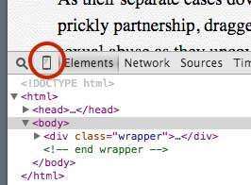
Viewing Results

Slide 17
Non Responsive Design
Desktop (1200 x 900)

Slide 18
Handheld (320 x 568)
Non Responsive Design

Slide 19
More Info and Examples
9 GIFS That Explain Responsive Design
Responsive Web Design:50 Examples

Slide 20
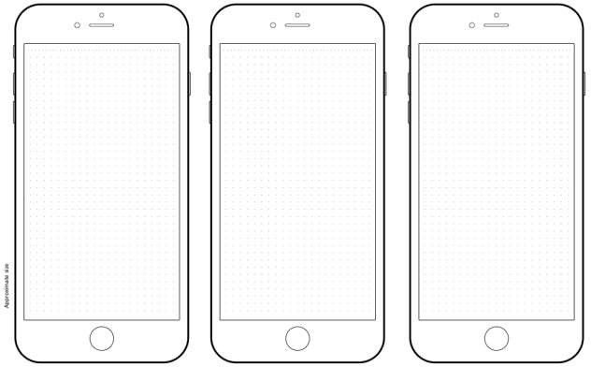
iPhone Template (3 w Grid)

Slide 21
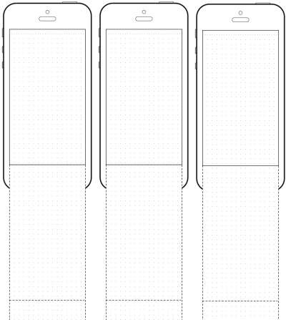
iPhone Extended (3 w Grid)

Slide 22
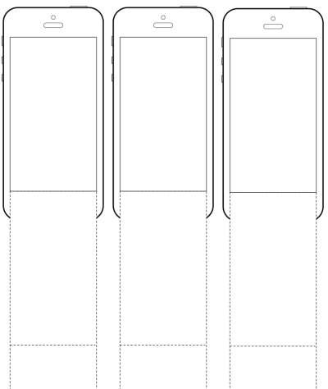
iPhone Extended (no grid)

Slide 23
Summary
First CSS will “cascade” until changed
Last property/value written wins
Write all default first
Write all media query changes second
Add additional media queries for even more control
Use Chrome Developer Tools to view

Slide 24
Further Reading and Research
Multi-Device Layout Patterns from Luke Wroblewski
Responsive Navigation Patterns from BradFrost.com
Gallery of Visual Examples from MediaQueries.es

