Slide 1
Chapter 11

Slide 2
Objectives

Slide 3
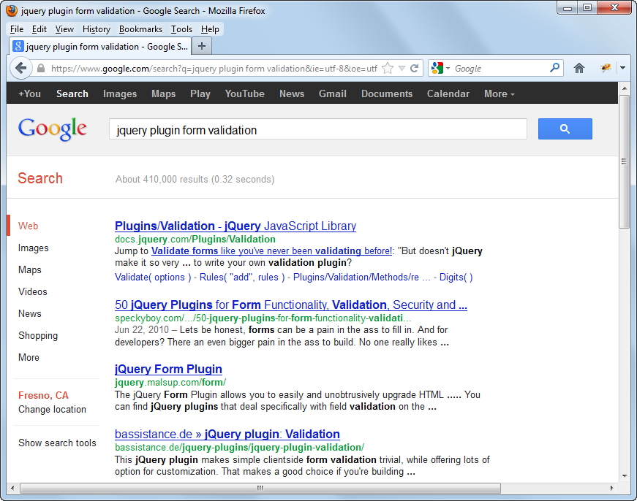
A Google search for validation plugins

Slide 4
Web sites for finding jQuery plugins

Slide 5
Plugins for displaying images

Slide 6
Plugins for slide shows, carousels, and galleries

Slide 7
Plugins for text layout

Slide 8
Plugins for forms

Slide 9
Plugins for interface design

Slide 10
Plugins for mobile development

Slide 11
General steps for using a plugin

Slide 12
Two cautions when using plugins

Slide 13
The script elements for the jQuery library and the bxSlider plugin

Slide 14
The HTML used by the bxSlider plugin

Slide 15
The jQuery for using the bxSlider plugin

Slide 16
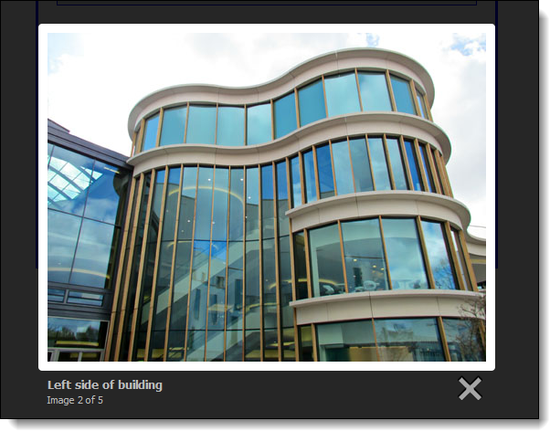
A Lightbox plugin

Slide 17
The HTML for the Lightbox plugin

Slide 18
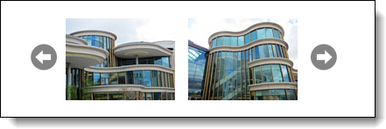
A bxSlider plugin used for a carousel

Slide 19
The HTML for the bxSlider plugin

Slide 20
The jQuery for using the bxSlider plugin

Slide 21
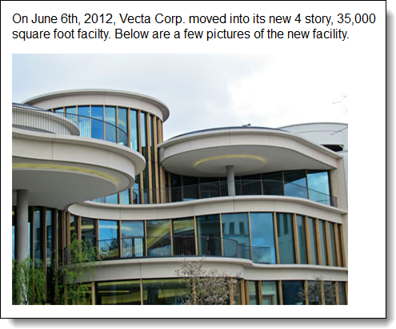
A Cycle plugin used for a slide show

Slide 22
The HTML for the Cycle plugin

Slide 23
The jQuery for using the Cycle plugin

Slide 24
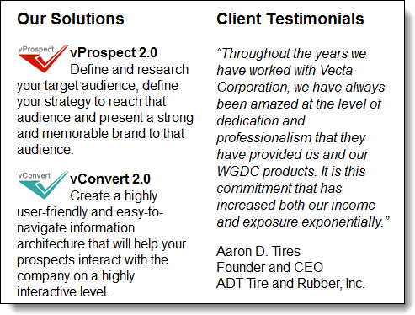
A jLayout plugin used to create two columns

Slide 25
The HTML for the jLayout plugin

Slide 26
The jQuery for using the jLayout plugin

Slide 27
The structure of a plugin

Slide 28
A simple Selection plugin

Slide 29
Naming conventions for plugin files

Slide 30
The API standards for plugins

Slide 31
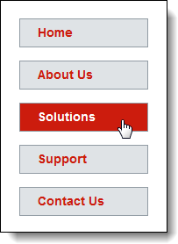
A menu that is highlighted by the highlightMenu plugin

Slide 32
The HTML for the menu

Slide 33
The highlightMenu plugin in a file named jquery.highlight.js

Slide 34
Code for using the highlightMenu plugin

Slide 35
The highlightMenu plugin with options

Slide 36
The highlightMenu plugin with options (cont.)

Slide 37
jQuery that sets two options of the highlightMenu plugin

Slide 38

The page layout for a page that uses two plugins
Slide show
Highlighted menu

Slide 39
The script elements for the page that uses plugins

Slide 40
The HTML for the plugins

Slide 41
The jQuery that uses the plugins

Slide 42
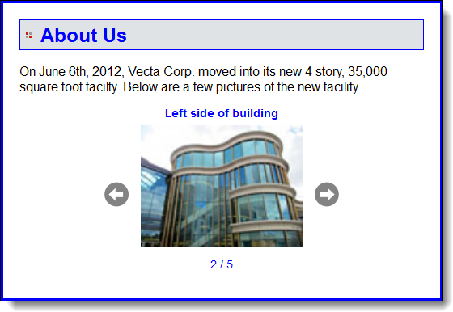
Extra 11-1: Modify the Carousel application

Slide 43
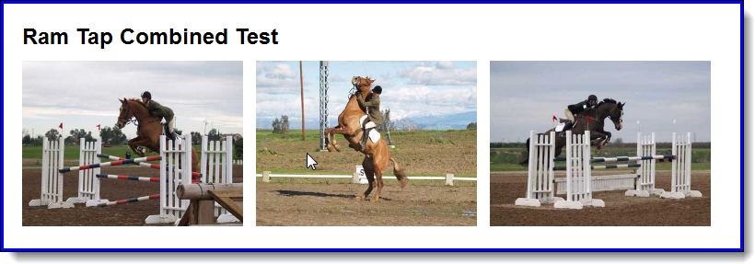
Extra 11-2: Create a rollover plugin

Slide 44
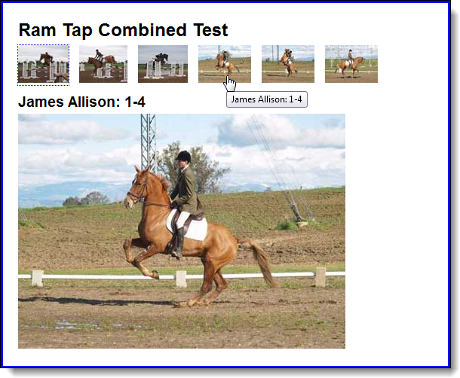
Extra 11-3: Create an image swap plugin

Slide 45
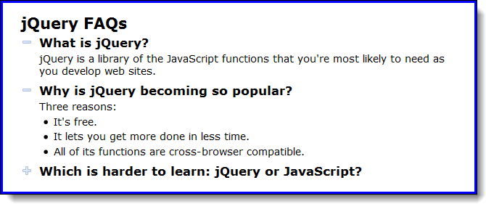
Short 11-1: Create a FAQs plugin

