Slide 1


Session #1: Intro and Life Cycles

Slide 2
Objectives of this course
Applying a usability engineering life cycle
Contextual inquiry and analysis
Requirements extraction and design-informing models
Conceptual and detailed design
Iterative prototyping and evaluation
Understanding and applying interaction design guidelines

Slide 3
The User Experience Process
This course is about the user experience process. If you are here, you probably know the following;
1. User Experience is important
2. User Experience is expensive
But you probably do not know how arduous the process is
Notes:
For UX to be valuable it has to cover every possibility

Slide 4
Use of the term “UX”
Almost ubiquitous term
Refers to most things that have to do with designing for a high-quality user experience
Broad usage: the UX field, UX work, UX practitioner, UX team, UX role, UX design, or UX design process.
Notes:
Its ubiquity makes it more complicated than ever. And it is constantly changing.

Slide 5
Why worry about UX?
Ubiquitous interaction
Usage by very young to really old
Rise of demand for usability
Changing concept of usability
Notes:
Usability and User Experience are very societal dependent and constantly changing

Slide 6
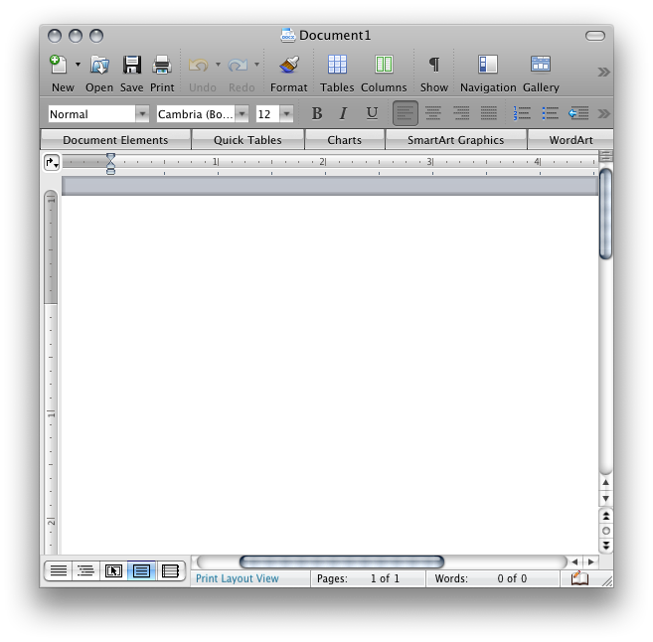




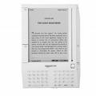





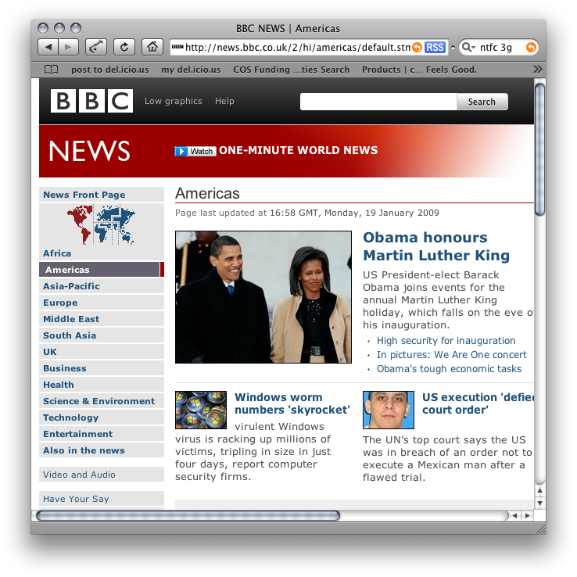
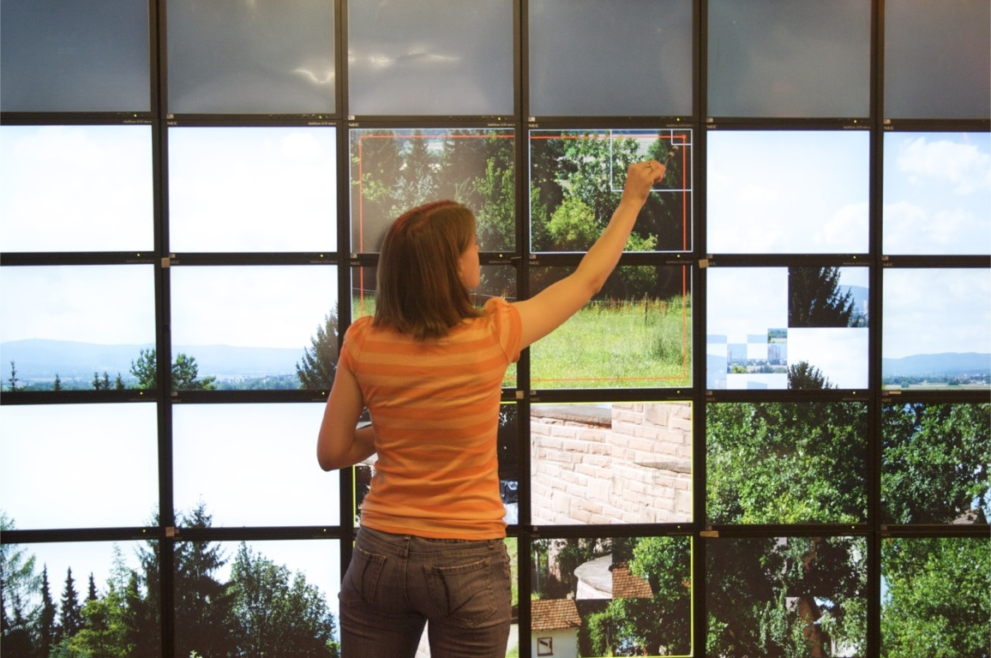

Changing concept of computing
Notes:
We tend underestimate the many types of digital products that necessitate heavy ux testing

Slide 7
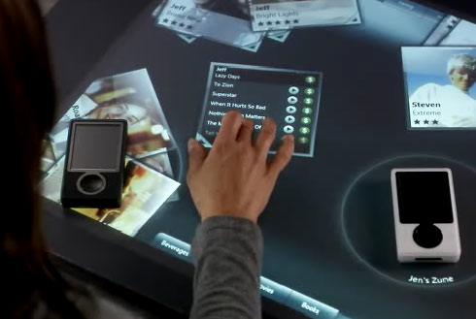

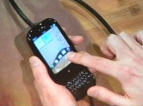

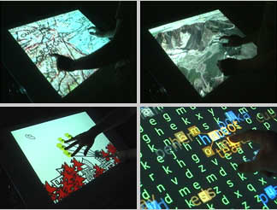
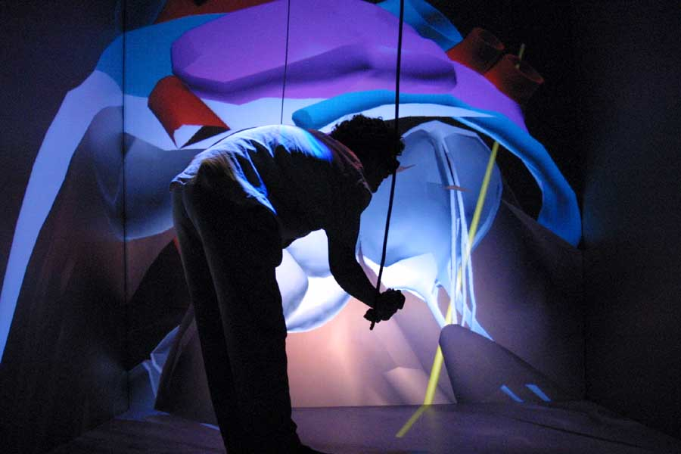

Changing concept of interaction
“The world is not a desktop” — Tscheligi, 2005 (paraphrasing Mark Weiser)
Notes:
Desktop focus? Not so much.

Slide 8
Interaction
Adapted from Dictionary.com: mutual or reciprocal action, effect, or influence
Interaction involves an exchange
Definitely not limited to computer systems
Notes:
User Interaction->Expectation…hopefully.

Slide 9
Term “interaction” is broad
Embraces
Seeing, touching, and thinking about system or product
Admiration and anticipation before any physical interaction
Entire experience during interaction
Savoring memory after interaction

Slide 10
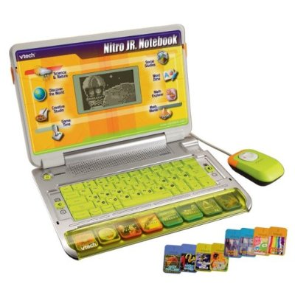
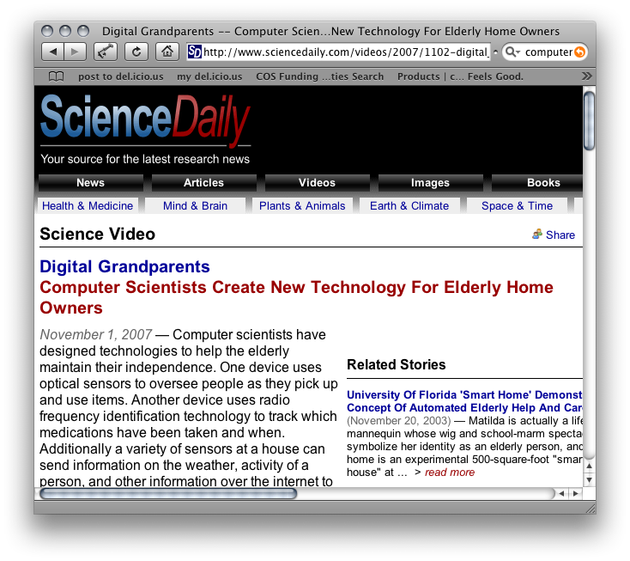
Very young to really old
Age of youngest effective computer user?
Age of oldest computer user?

Slide 11
From usability to UX
Progression of a maturing discipline
From narrow focus on task performance to overarching characteristics of entire user experience
Emotion, social and cultural implications
Fun, style, art
Branding, reputation
Political, social, personal connection

Slide 12
From usability to UX
Usability has always been about
Helping novices perform like experts
Helping experts achieve their potential
Usability is an issue for expert users, too
Natural
Transparent
Powerful
Notes:
Adobe’s Flash is a great example of a UX failure where experts failed to utilize the tool properly.

Slide 13
From usability to UX
Usability has always been about
Making usage easy for everyone
Making everyone productive in usage
Next logical step, include components for
Usefulness
Pleasure and emotional satisfaction
And you get the full user experience
Notes:
Only after achieving easy, productive usage, should usability extend the experience.

Slide 14
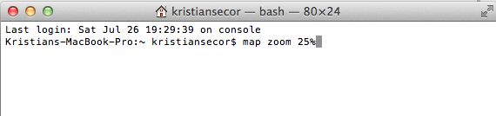
From usability to user experience
The progression of thinking about usability
An example: User to zoom in on map image
Old days, command language input

Slide 15

From usability to user experience
Command, via pull-down menu

Slide 16

From usability to user experience
Direct manipulation, click on “+” or “-” icon

Slide 17
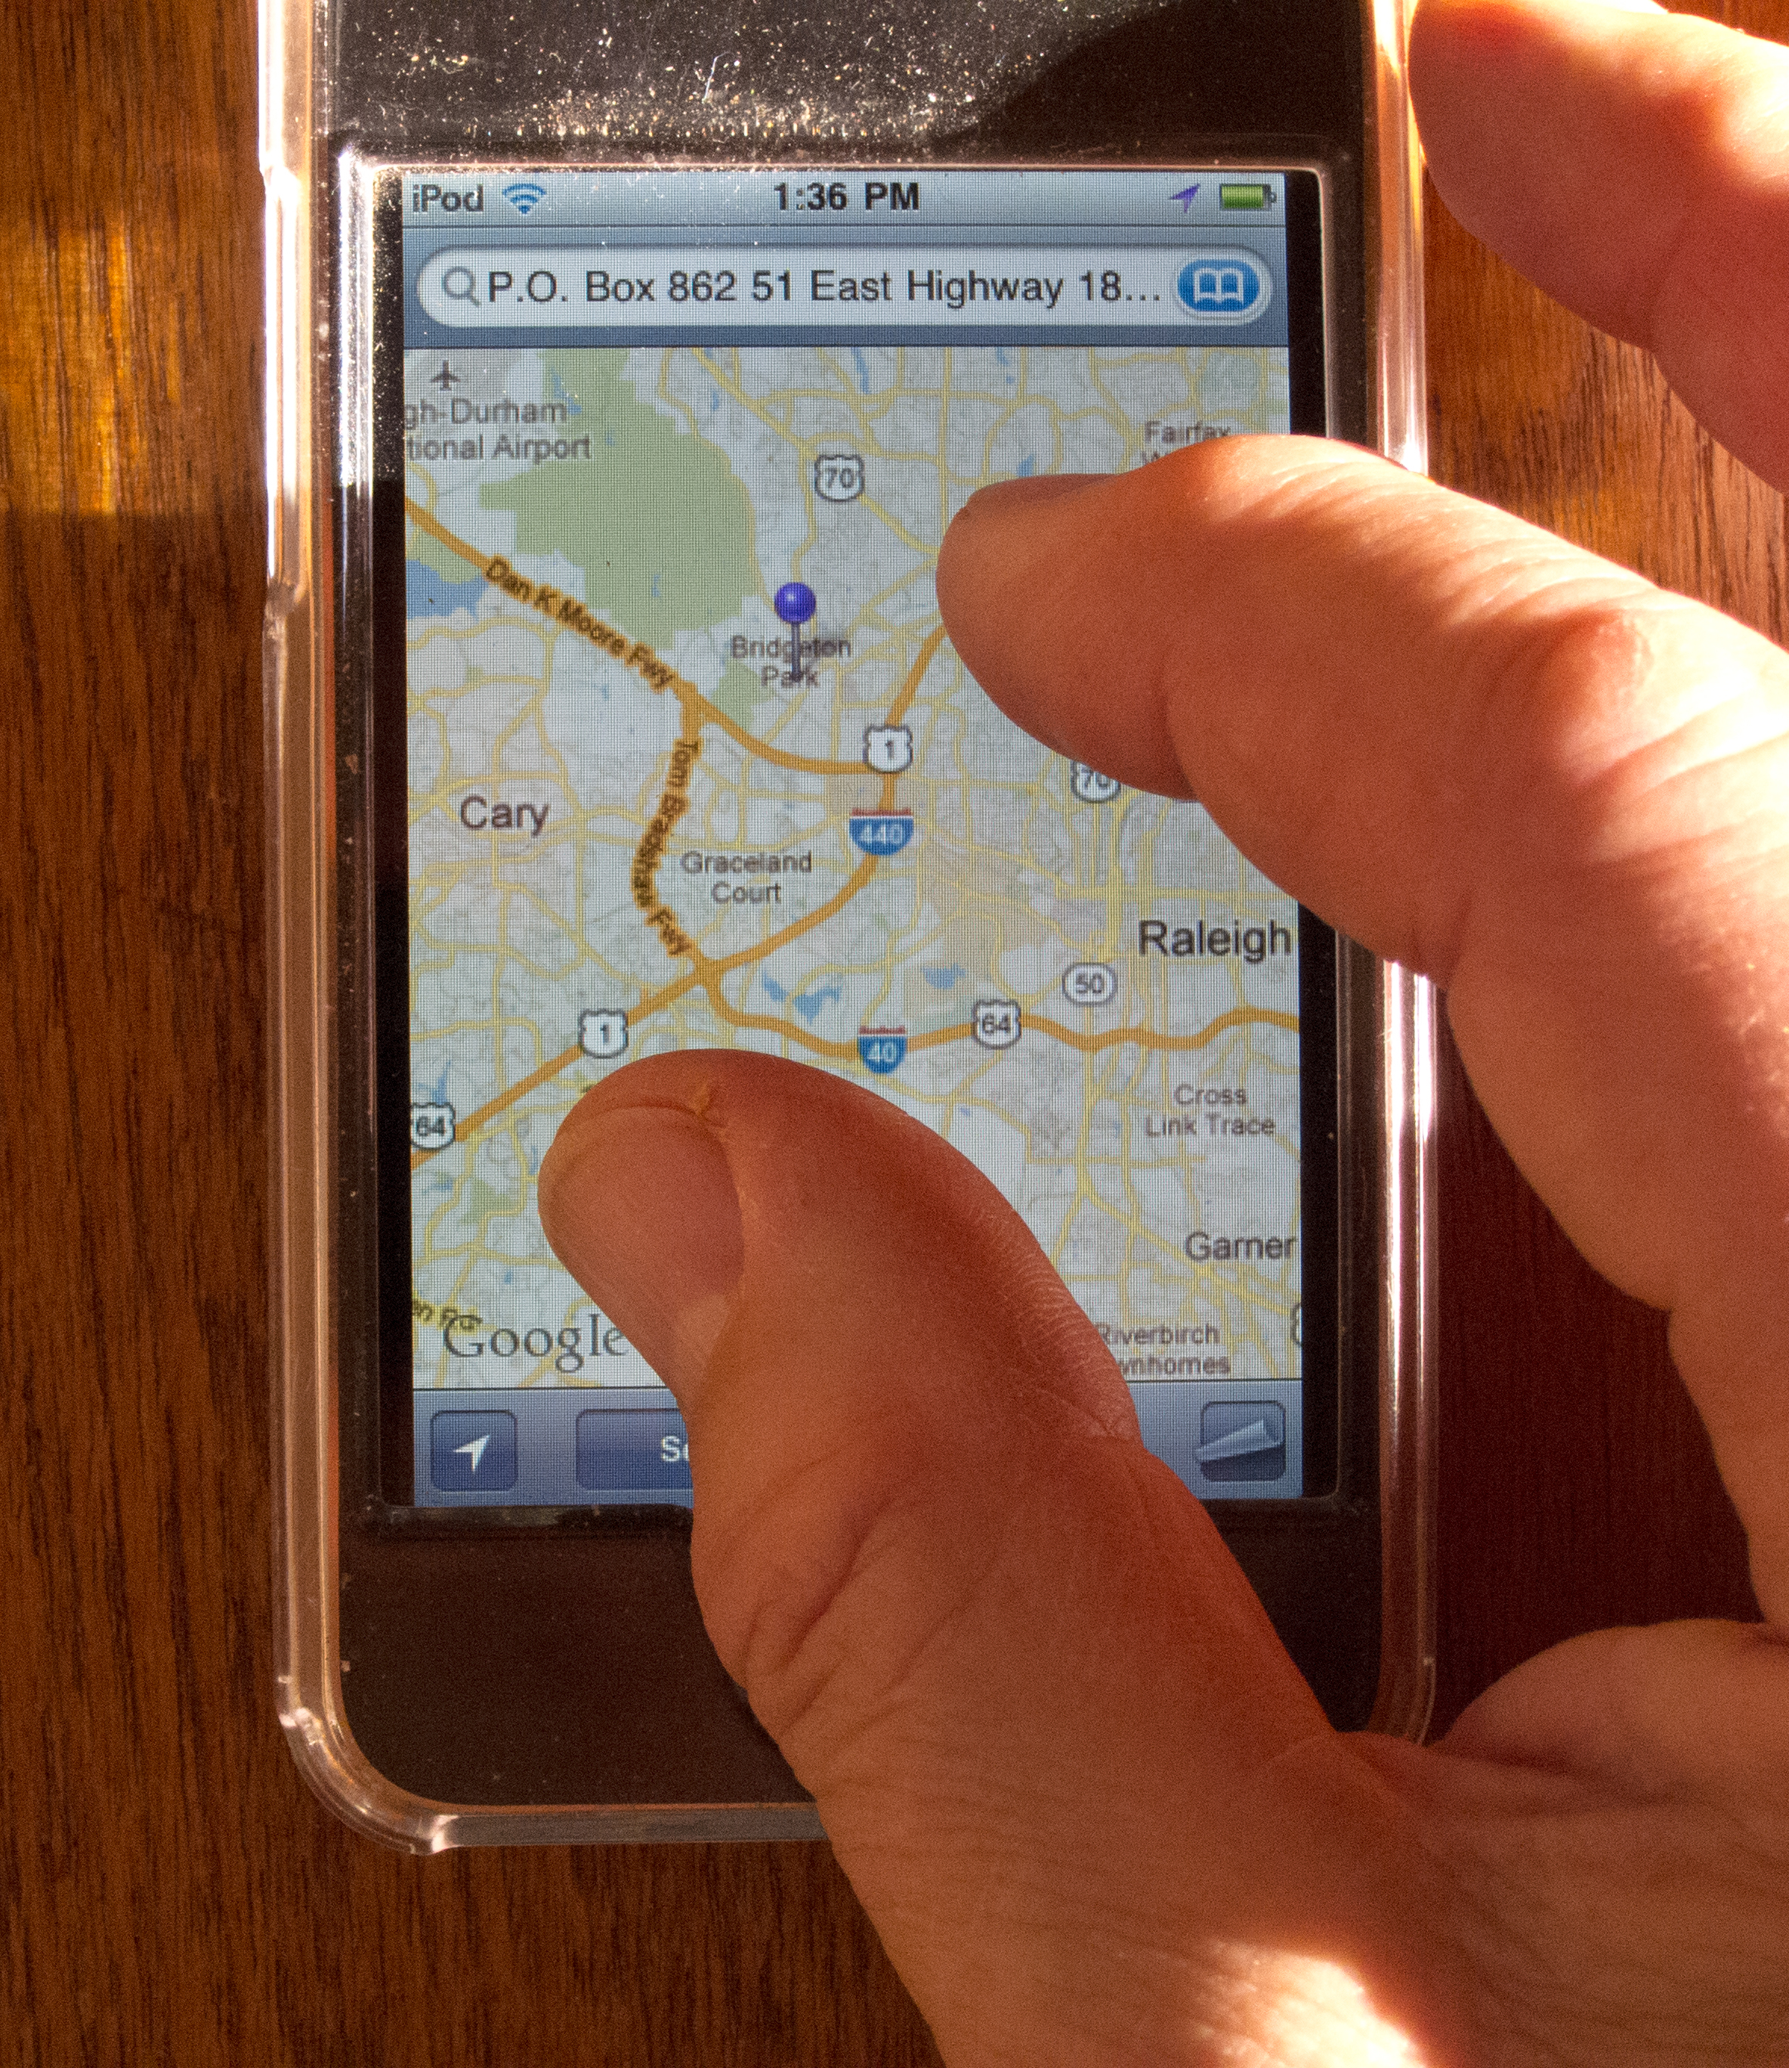
From usability to UX
Embodied, finger gesture (multi-touch)
Makes you realize that direct manipulation with a mouse is not so direct

Slide 18
From usability to user experience
Extrapolate to arms and hands in sweeping movements on a giga-pixel display
To move data and images around
To apply various kinds of analyses
A la’ TV shows like Bones, CSI
Notes:
Think of the progression and advancement. How one thought or idea leads to another

Slide 19
Rising importance of UX
From having to cost-justify usability to having UX drive the industry
Explosion of UX case studies
Increasing intolerance for bad design
Upsurge of interest in design
Awareness and demand from marketing
Industry adoption: Apple, Google, Microsoft

Slide 20


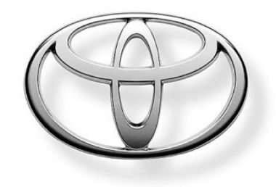
Branding is part of UX
Icons, logos, brands can mean much more than just the product they represent
Notes:
What do you think when you see these logos?

Slide 21
Branding, Marketing and Culture
Companies with good reputations are targeted
Company Reputations
Apple’s Criticism – ios7
Obama Care

Slide 22
How is user experience more than usability?
User experience – totality of effects felt by user as result of interaction with
System, device, or product
Within usage context
Notes:
Think emotion and total perception toward an entity, product or group of products. Think of anytime you’ve hear someone say “I hate Mac” or “I hate PC”

Slide 23
User experience vs. usability
User experience does not replace usability
Usability still essential
Now usability is part of user experience
Usability is pragmatic component

Slide 24
Usability includes
Learnability
Effectiveness
Efficiency
Productivity
Ease of use
Retainability
User performance aspects of user satisfaction

Slide 25
Emotional impact includes
Pleasure, fun, joy of use, aesthetics, desirability
Engagement, novelty, originality, “coolness” factor
Appeal, self-expression, self-identity, pride of ownership
Elegance, trustworthiness, a feeling of contribution to world

Slide 26
Phenomenological aspects of interaction
Deriving from phenomenology
Philosophical examination of foundations of experience and action
Cumulative effects of emotional impact considered over long term
Notes:
based on the experience of building materials and their sensory properties

Slide 27
“Presence” of a product
Presence of a product is relationship with users in which product becomes a personally meaningful part of their lives
An essential part of phenomenological aspects of interaction
Usage of technology takes on a presence in our lifestyles
Technology is used to make meaning in our lives
Notes:
I couldn’t live without xcode…that’s a presence!

Slide 28
Measuring user experience
Neither user experience nor any of its components can be measured directly
We estimate user experience and its components by measuring indicators depending on the product
Notes:
With an iphone or android phone, can you walk outside without it?

Slide 29

Misconceptions about usability
Not “dummy proofing”
Not “user-friendliness”
Users are not looking for amiability
They need efficient and effective tools
It is not (necessarily) high-tech or “cool”

Slide 30
Misconceptions about usability
“Doing usability” sometimes thought of as equivalent to usability testing
Diagnostic view
Or sometimes usability is seen to be about dressing it up
“After the software is built, I want the usability people to make it look pretty”

Slide 31
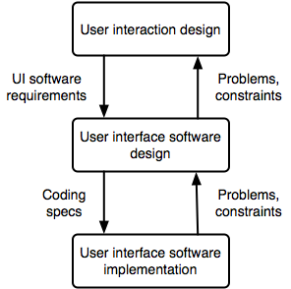
Interaction design is not about software
UI software component: Code that implements the interaction component
Interaction component: How a UI works, it’s “look and feel” and behavior

Slide 32
Two distinct roles
Interaction designer and UI software designer
Premise: Describing interaction from user’s view should result in more usable design than describing it from software or programmer view
Inherent conflict of interest: What’s best for the user is seldom easiest for the software developer!

Slide 33
UX beats added functionality
Examples: ios over blackberry
Too many options leads to design paralysis
Feature Fatigue
Hick’s law: The time it takes to make a decision increases with the number and complexity of choices. And as the decision time increases, the user experience suffers.

Slide 34
Emotional Impact
Can the emotional impact of Good UX be as positive as the negative impact of a user’s experience?
My personal believe is no, that good ux is expected.
Notes:
Remember, the best referees and umpires are the ones who are anonymous.

