Slide 1


Session #3: Requirements & Analysis

Slide 2
Introduction

Slide 3
Introduction
Contextual inquiry and analysis do not produce direct requirements
Requirements are first span of bridge between analysis and design

Slide 4
Requirements
“Requirements” means interaction design requirements
These could relate to extra elements needed to cater to the users’ requirements
If these were a digital product, it might be an added navigation or search bar.

Slide 5
Requirements specifications
Requirements “specifications” are problematic
  Even in software engineering where they have been studied for years
Detailed formal requirements
  Cannot ever be complete
  Cannot ever be 100% correct
  Cannot be prevented from changing throughout lifecycle
Notes:
May include a set of use cases that describe interactions the users will have with the product

Slide 6
Requirements
Maybe necessary for extremely domain-complex systems
We will not emphasize much in this course
Covered here for completeness

Slide 7
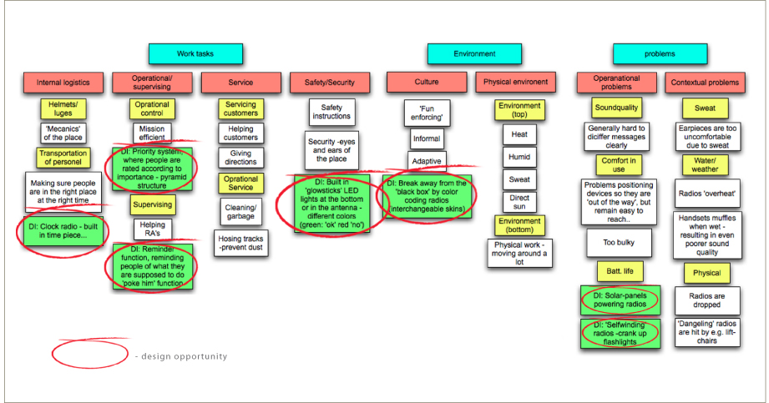
WAAD
Work Activity Affinity Diagram
Notes:
Basically, a diagram of a brainstorming session. The diagram is from http://studiobrianlaw.wordpress.com/tag/myers-briggs/

Slide 8
Formal requirements extraction
Walk WAAD for needs and requirements
Switch from inductive to deductive reasoning
  What requirement is “implied” a work activity note in a WAAD?
  Have to deduce it
Notes:
Inductive to deductive is key here. Time to put on our thinking caps!

Slide 9
Formal requirements extraction
Generic structure of requirement statement
  Name of major feature or category
  Name of second-level feature or category
  Requirement statement [WAAD source node ID]
  Rationale (if useful): Rationale statement
  Note (optional): Commentary about this requirement
Notes:
Science, but not science? Communication without clutter for our designers.

Slide 10
Example requirement statement
Work activity note: “I am concerned about privacy and security of my transactions”
Security
Privacy of ticket–buyer transactions
Shall protect security and privacy of ticket-buyer transactions [C19]
Note: In design, consider timeout feature to clear screen between customers.

Slide 11
Another example
Work activity note: “I sometimes want to find events that have to do with my own personal interests”
Transaction flow
Recommendations for buying
Ticket-buyer purchases shall be supported by recommendations for the purchase of related items. [DE2].
Implied system requirement: During a transaction session the Ticket Kiosk System shall keep track of the kinds of choices made by the ticket buyer along with the choices of other ticket buyers who bought this item. [DE2].
Note: Amazon.com is a model for this feature.

Slide 12
Importance of deduction
WAN: “I use my calendar to schedule meetings with my co-workers”
Interaction requirement: “Users shall have support for automated coordination or negotiation of schedules with the calendars of other users”
Need to find balance between extrapolating and “inventing” requirements
Notes:
Careful with adding work to your own project. Remember, you getting paid for documented deliverables only, not invented requirements.

Slide 13
Requirements HW
Remember that “requirements” are interaction design requirements. This activity must be done in a very limited time. Do a walkthrough of your work activity affinity diagram and any additional work activity notes.
Select about a half dozen different, interesting, and representative work activity notes (in the WAAD or not).
Extract some interaction design requirements from these selected work activity notes by deducing the requirement(s) implied.
Write them in the form of somewhat formal requirements statements. Use the generic structure of the requirement statement given in the book.

