Slide 1


Session #8:Wire Frames

Slide 2
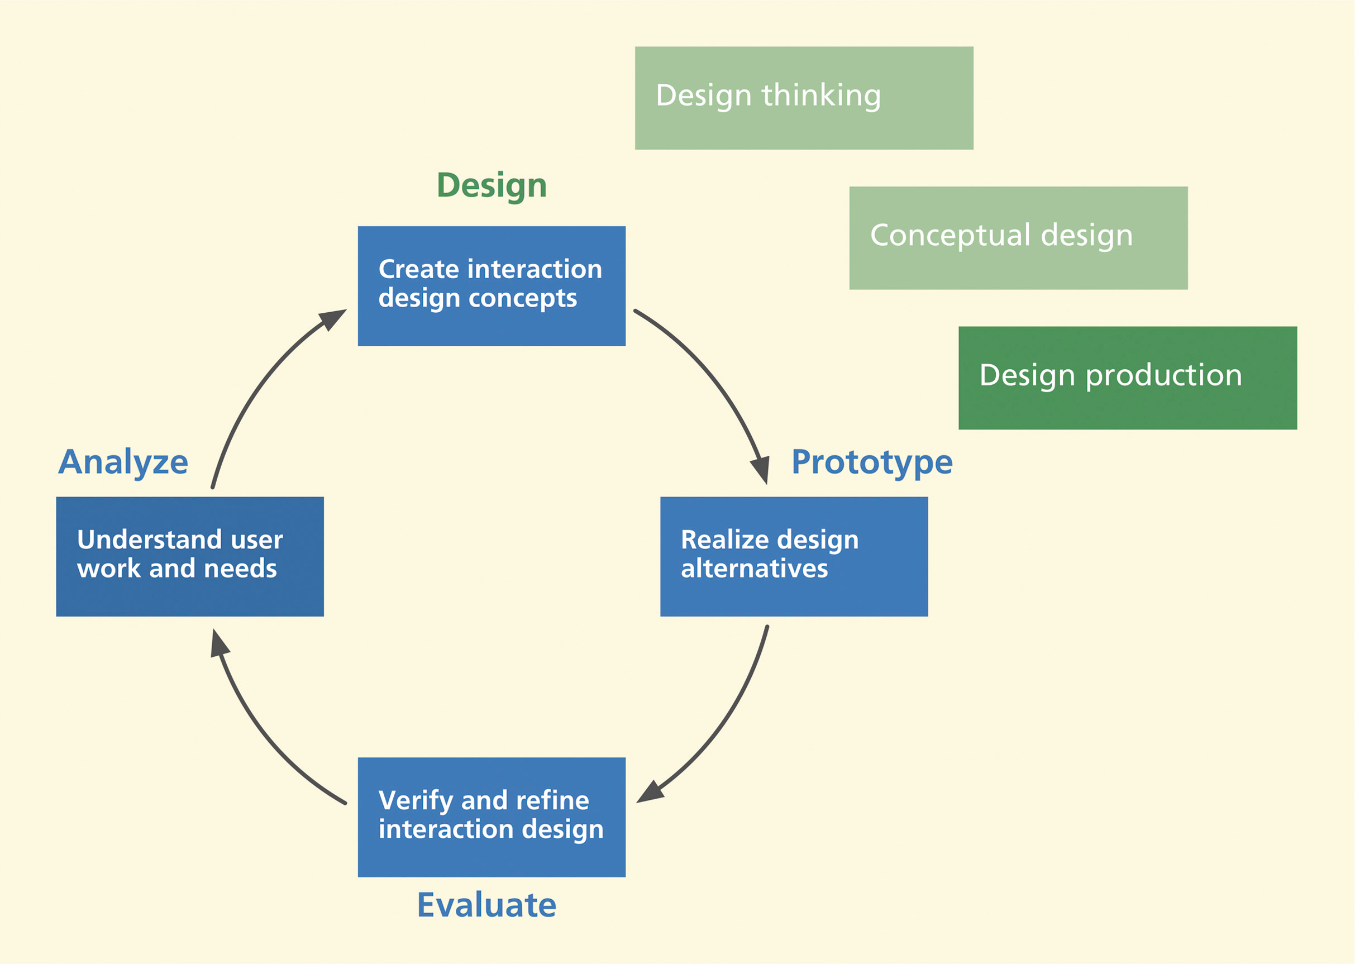
Introduction

Slide 3
Macro view of design iterations

Slide 4
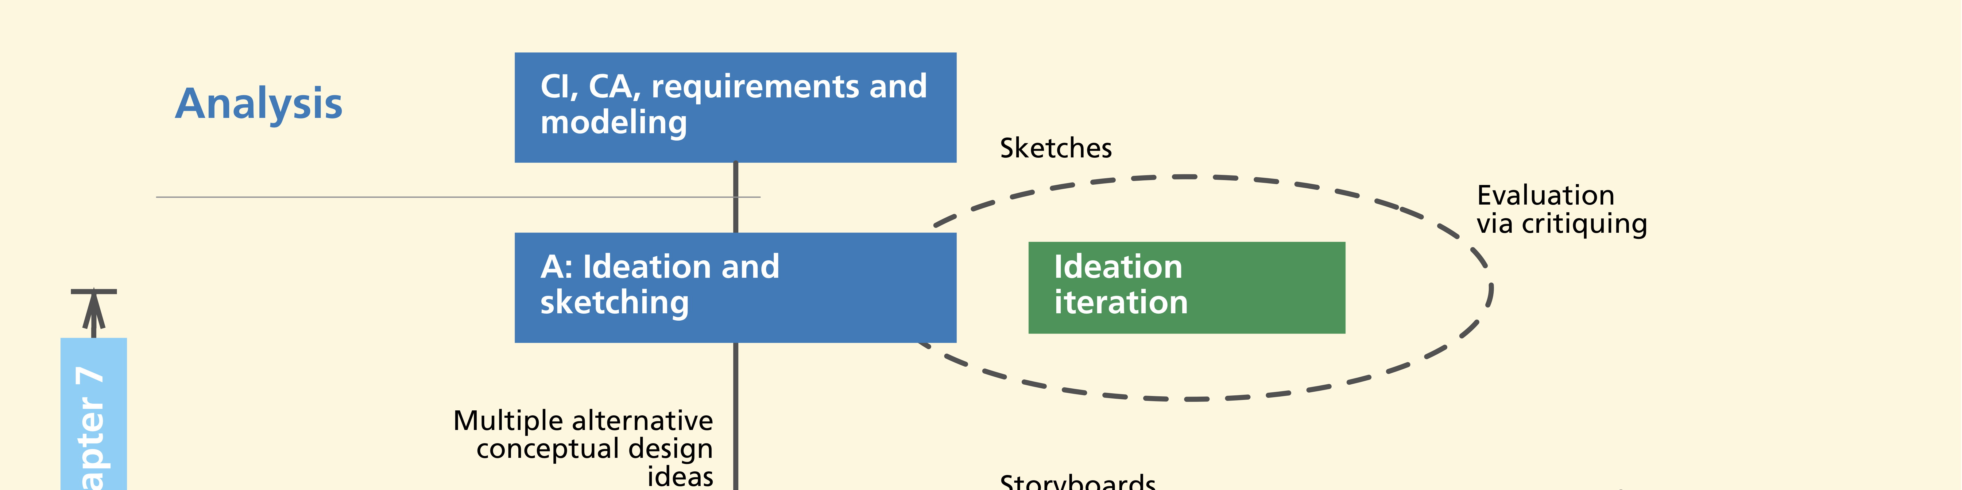
Ideation Iteration
Lightning-fast
Loosely structured iteration
For purpose of exploring design ideas
Role of prototype played by sketches

Slide 5
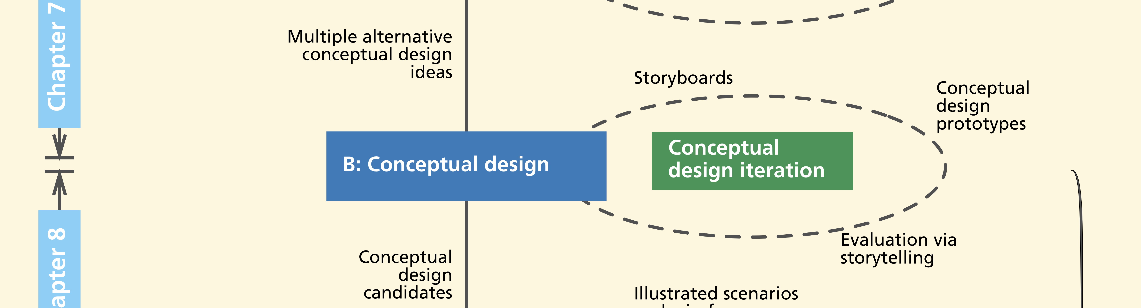
Conceptual Design Iteration
Critique and compare multiple design concepts
Sort out best one
Weigh concept feasibility
Prototypes: low-fidelity paper, storyboards

Slide 6
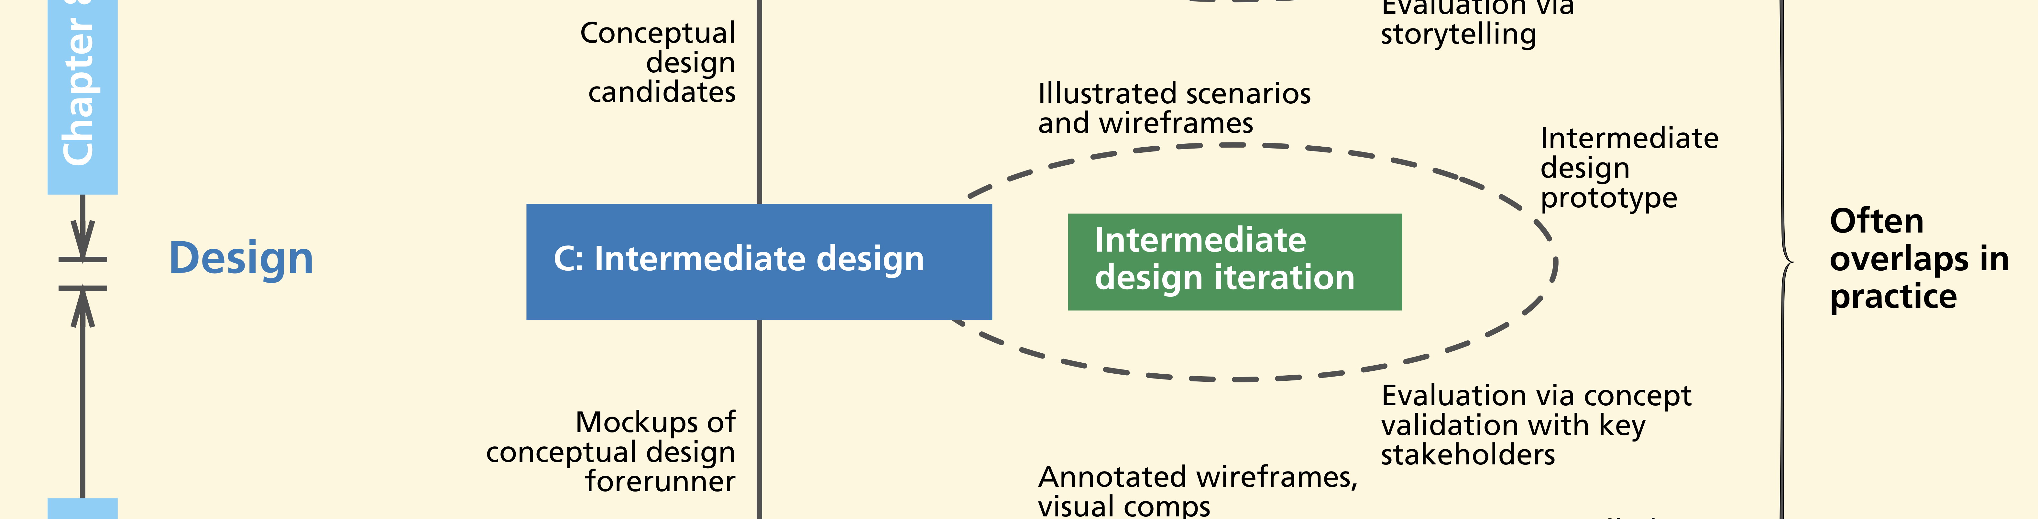
Intermediate design iteration
To arrive at one intermediate design for layout and navigation

Slide 7
Intermediate design iteration
Prototypes might evolve
  From low-fidelity to wireframes (coming soon)
Fully interactive high-fidelity mockups as vehicle for demonstrations and design reviews

Slide 8
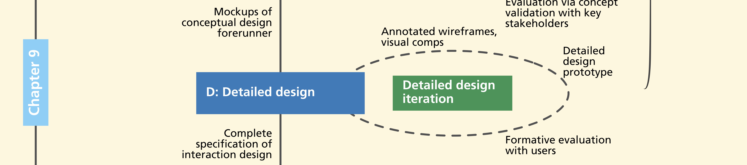
Detailed design iteration
To decide screen design and layout details
Includes “visual comps” (coming up soon) of “skin”
For look and feel appearance

Slide 9
Detailed design iteration
Design will be fully specified with complete descriptions of
  Look and feel
  Behavior
  How all workflows, exception cases, and settings will be handled

Slide 10
Doing intermediate design
Screen layout and navigational structure
Represent key work flows with sequences of wireframes, click-through prototypes

Slide 11
Doing detailed design
Annotated wireframes
Evaluate and iterate detailed designs to refine wireframes
Include all user interface objects and data elements
  Still represented abstractly but annotated with call-out text

Slide 12
Visual design and visual comps
Need visual designer who has been involved in
  Ideation, sketching, and conceptual design
Now produces what we call visual “comps”

Slide 13
Visual comps
“Comprehensive” or “composite” layout
Very specific and detailed graphical look and feel
Pixel-perfect mockup of graphical “skin”

Slide 14
Visual comps
Consistent with
  Company branding
  Style guides
  Best practices in visual design

Slide 15
Wireframes
The path to wireframes

Slide 16
Wireframes
De facto representation medium for interaction design at this stage
  Prototyping
  Documenting
  Communicating to implementers

Slide 17
Wireframes
Major bread-and-butter tool of interaction designers
Made of lines and outlines
  Hence the name “wire frame”

Slide 18
Wireframes to represent design objects
Boxes and other shapes to represent emerging design objects
Drawing is usually simple
  Often just rectangular objects
  Objects can be labeled, moved, and resized

Slide 19
Wireframes to represent navigation
Sequences of wireframes to show usage over time
Depict envisioned task flows
  In terms of user actions on user interface objects and corresponding state (screen) changes

Slide 20
Example, wireframes
Web-based photo organizing and sharing application
Illustrates high-level conceptual design

Slide 21
Example, wireframes

Slide 22
Example, design further elaborated
Shows right-hand side information pane collapsed

Slide 23
Example, show behavior
What happens when a user clicks on vertical “Related information” bar

Slide 24
Example, show behavior
What happens when user clicks “one-up” icon in upper right hand corner

Slide 25
How are wireframes used?
Conversational props to discuss design alternatives
To elicit feedback from potential users and other stakeholders
Helps you keep your eye on information architecture on screen

Slide 26
How are wireframes used?
Designer can move through deck of wireframes
  One slide at a time
  Simulating potential scenario
  Pretending to click on interaction widgets

Slide 27
Tools for wireframe mockups
Tools designed specifically for this purpose
  OmniGraffle (for Mac)
  Microsoft Visio (for PC)
  Balsamiq
  Adobe InDesign

Slide 28
How to build wireframes?
Templates available for many basic shapes and UI objects
Some parts of wireframe can be generic, others detailed
Can add color, graphics, real fonts

Slide 29
Hints and tips for wireframing
Be able to create multiple design representations quickly
Keep it modular—just as with any prototyping technique
  Not too many concepts or details “hard coded” in any one frame
  Build up using layers
  Use separate layer for each repeating set of widgets on screen

Slide 30
Hints and tips for wireframing
Example, container “window” of an application with its different controls
  Specify once as layer and reuse in subsequent screens
Use stencils, templates, and libraries of widgets
  Avoid re-inventing widgets
Find shared objects in tool libraries

