Slide 1


Session #9:Prototyping

Slide 2
Introduction
A way to evaluate design before it’s too late and too expensive

Slide 3
Depth and breadth of a prototype
To be fast and easily changed, prototype must be less than real system
  How to make it less?
  Focus on less than full fidelity of details
    Just breadth or just depth of tasks supported

Slide 4
Horizontal prototypes
From Nielsen
Slice functionality by breadth
  Broad in feature coverage, less depth of detail
  Good overview for top-down approach
  Will not support details of work flow
  Evaluation not too realistic (design still too abstract)

Slide 5
Horizontal prototypes

Slide 6
Vertical prototypes
Slice functionality vertically by depth
  As much depth as possible in current state but only for few features
  But those features included can be evaluated realistically

Slide 7
Vertical prototypes

Slide 8
“T” prototypes
Most of user interface realized at shallow level (horizontal bar of “T”)
A few parts done in depth (vertical stems of “T”)
Nice balance, advantages of both

Slide 9
Local prototypes
Small area where horizontal and vertical slices intersect
Used to evaluate design alternatives
For particular isolated interaction details

Slide 10
Local prototypes

Slide 11
Local prototypes
Examples
  Appearance of an icon
  Wording of message
  Behavior of individual function
Good for when your design team just can't decide a small part of design

Slide 12
Fidelity of prototypes
Reflects how “finished” prototype is perceived to be by customers and users
  Not how authentic or correct underlying code is

Slide 13
Low-fidelity prototypes
Low fidelity can be paper prototype or simple wireframe
Not faithful representations of details of look, feel, and behavior
Give rather high-level, more abstract impressions of intended design

Slide 14
Low-fidelity prototypes
Appropriate when design details
  Have not been decided
  Are likely to change
Proven that test users can take them seriously
Proven effective in design evaluations

Slide 15
Testimonial
A former student, after doing ux project:
After doing some of the tests I have to concede that paper prototypes are useful. Reviewing screenshots with the customer did not catch some pretty obvious usability problems and now it is hard to modify the computer prototype. Another problem is that we did not get as complete a coverage with the screenshots of the system as we thought and had to improvise some functionality pretty quickly. I think someone had told me about that . . . .

Slide 16
Medium-fidelity prototypes
Sometimes you need a prototype with a level in between low and high fidelity
Usually means wireframes because wireframes can be made at almost any level of fidelity

Slide 17
Medium-fidelity prototypes
Good for intermediate design and early detailed design
To show
  Layout
  Breadth of user interface objects
  Some work flow

Slide 18
High-fidelity prototypes
Include details of appearance and interaction behavior
Required to evaluate design details
How users can see complete (in sense of realism) design

Slide 19
High-fidelity prototypes
Still less expensive and faster than programming final product
Useful as advance sales demos
  For marketing
  As demos for raising venture capital

Slide 20
Interactivity of prototypes
Another dimension for classifying types of prototypes

Slide 21
“Click-through” prototype
Some ability to respond to user actions
Show interaction flow and some kinds of behavior
  Medium-fidelity prototype with some active links or buttons
  Allows sequencing through screens by clicking
  Usually no more functionality than that
Wireframes are good for this

Slide 22
A fully programmed prototype
Expensive, limited call for this
Good if you really need full-system operational prototype

Slide 23
“Wizard of Oz” prototypes
“Pay no attention to the man behind the curtain”
Deceptively simple
Appearance of a high degree of interactivity
Highly flexible prototype

Slide 24
“Wizard of Oz” prototypes
Simulate behavior
  In complex situations
  Where user inputs are unpredictable
Two connected computers, each in a different room
  User’s computer connected to evaluator’s computer

Slide 25
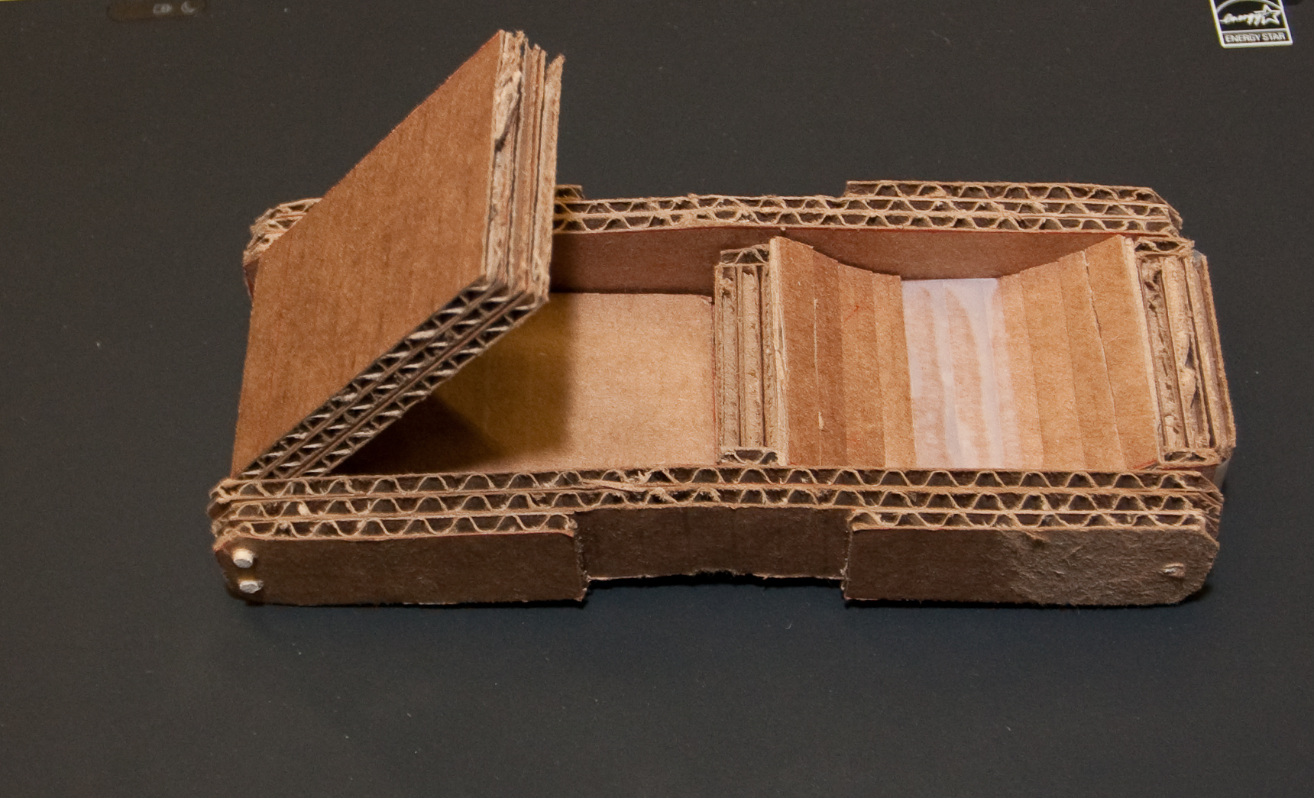
Mockups for physical actions
Support physicality as a primary characteristic of product or system
Design comes alive in a 3D, embodied, and tangible way

Slide 26
Physical mockups for physical interactivity
Example, handheld device
Mobile device that users might hold in their hands
Or a system might be “physical” like a kiosk
Good for evaluating emotional impact

Slide 27
Physical mockups
Use materials at hand: cardboard, wood, or metal
Glue on simulated buttons
Use real hardware controls such as push buttons, tilt buttons, sliders
  Example, knobs and dials, rocker switch
  Example, joystick from an old Nintendo game

Slide 28
Paper-in-device mockup prototype
Especially for mobile applications
Draw prototype screens on paper
Scan and load into device
Display as sequence of digital images in response to user navigation
  Using touches or gestures that device already can recognize
Notes:
See codiqa.com for an example of a modern tool that replaces this.

Slide 29
Animated prototypes
Video animations, usually based on series of sketches
Storyboard frames in “flip book” style sequence on video
Can be very engaging and stimulating of discussion

Slide 30
Choosing right kind of prototype
Choosing the right
  Breadth
  Depth
  Level of fidelity
  Amount of interactivity
See text for this discussion

Slide 31
Using right level of fidelity
For current stage of progress
Using right level of fidelity for design perspective being addressed
  Ecological
  Interaction
  Emotional

Slide 32
Think about more than just evaluation tasks
Include “decoy” user interface objects
Do not include only the user interface objects needed to do your evaluation tasks

Slide 33
Pilot test thoroughly
Test, test, and test

