Slide 1

Session #5: Agile Interface Design
© Kristian Secor 2018 UC San Diego Extension Online Learning Course: User Experience Design I

Slide 2
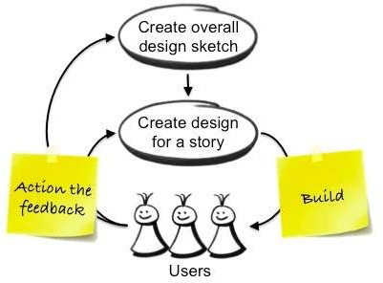
What is it?
Design that is:
User Centric
Collaborative
Iterative
2

Slide 3
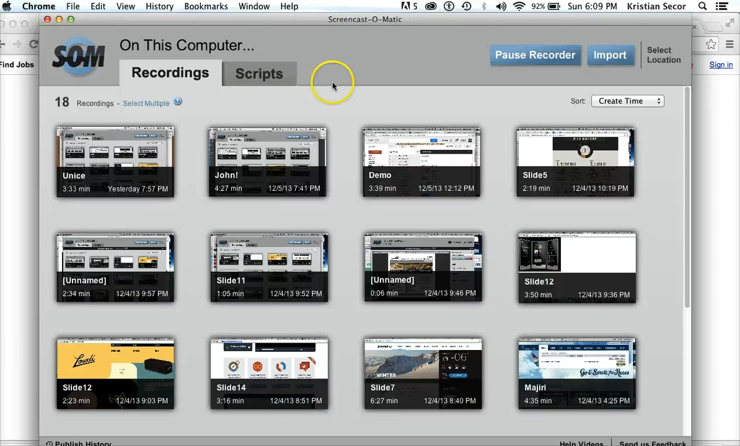
Why?
© Kristian Secor 2018 UC San Diego Extension Online Learning Course: User Experience Design I
3

Slide 4

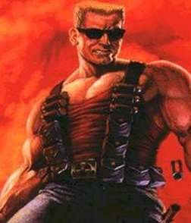
Software Engineering Disasters
Windows Vista
  Too many features
  Haphazard development
  Development “reset” in 2004-2005
FAA Advanced Automation System
  Cost overruns, delays and failures (1982-1994)
  $3-6 billion before project scrapped
Duke Nukem Forever
  Development begins in 1997
  Two project resets, staff overturns
4

Slide 5
5 Danger Areas
Increasing complexity
Project mismanagement
Staff overturn
Changing and Ill-defined requirements
Miscommunication

Slide 6
Values
Four values of software development:
  Communication
  Simplicity
  Feedback
  Courage
These values are equally applicable to user interface design

Slide 7
Agile Development Specifically
Lightweight process
User-driven
Integrated development team
Constant Testing
Continuous Integration
Short Iterations

Slide 8
Heavy Investment
Agile is a major change
It requires a change in the way people go about their daily work
It requires a different management style
It requires a change in attitude and behavior for everyone involved.

Slide 9
What’s Different about Agile Design?
Users, testers, UI designers all work alongside programmers
Focus shifts from the artifacts of design to working software
Testing is a constant process, not last- minute
Design is incremental, not all upfront
Change isn’t a bad thing

Slide 10
Benefits of Agility
More testing and user feedback means better interfaces
Improved knowledge sharing and communication across disciplines
The design process is better able to accommodate change

Slide 11
Agile Design Techniques
Include real users in the development process
Create lightweight wireframes
Don’t invest in throw-aways
Get something working, then refactor
Release early, release often
Use acceptance tests to document expectations

Slide 12
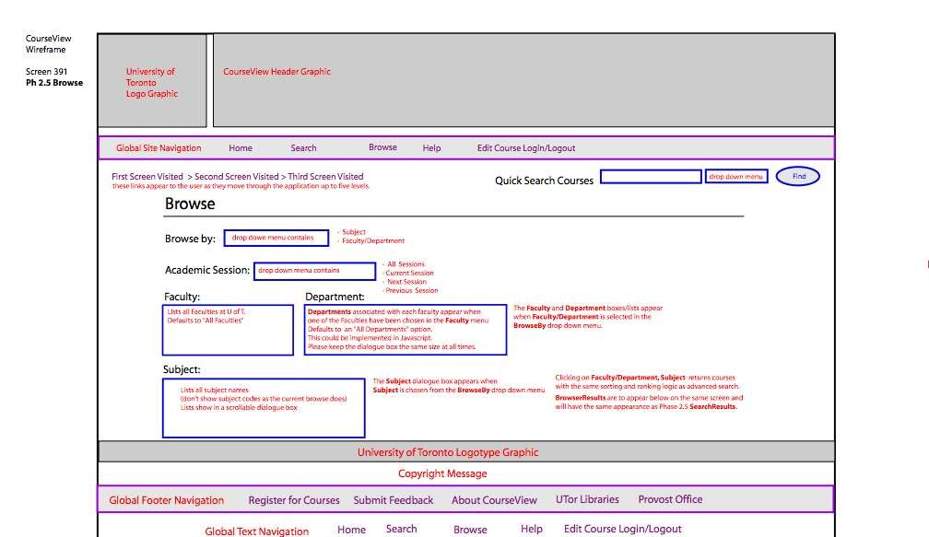
Lightweight Wireframes
© Kristian Secor 2018 UC San Diego Extension Online Learning Course: User Experience Design I
12

Slide 13
Acceptance Testing
Test with real users first
Implement their feedback as acceptance tests
Tests should encapsulate user expectations about behaviour
Tests provides a metric of success

Slide 14
Scrum
Scrum is a management framework for incremental product development using one or more cross-functional, self-organizing teams of about seven people each.
It provides a structure of roles, meetings, rules, and artifacts. Teams are responsible for creating and adapting their processes within this framework.
Scrum uses fixed-length iterations, called Sprints, which are typically two weeks or 30 days long. Scrum teams attempt to build a potentially shippable (properly tested) product increment every iteration.

Slide 15
Next…
In week’s 6 and 7 we’ll cover other ui design methodologies
Week 6- Iterative UI Design
Week 7-Waterfall Design

Slide 16
Resources
Indeed.com
Roman Pinchler
Smashing Magazine
Agile Designers

