Slide 1

Session #2: Metaphors,
organization and navigation
© Kristian Secor 2015 UC San Diego Extension Online Learning Course: User Experience Design I

Slide 2

Metaphors in the design sense..
a figure of speech in which an expression is used to refer to something that it does not literally denote in order to suggest a similarity
It goes back to the all important concept
from UID I:Recognition not recall.

Slide 3
Metaphors for user experience
Many Reasons:
The abstract becomes concrete
The unfamiliar becomes familiar
Emotions can be triggered
Metaphors can draw attention
Metaphors can trigger action

Slide 4
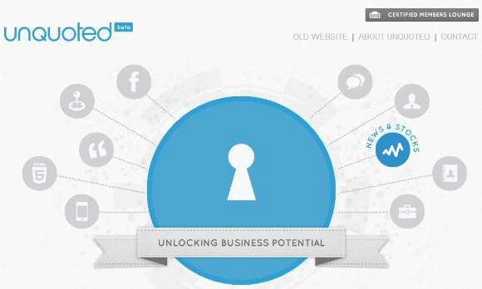
The Concrete:
How are these metaphors?

Slide 5
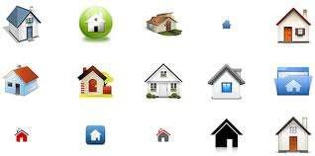
Becoming Familiar:
Graphic Designers know this all to well

Slide 6


Emotions are stirred:

Slide 7

Attention is drawn:

Slide 8

Action is invited

Slide 9
On To Organization
Organization is as important as our
message
Remember Fitts’ Law?
Left to Right….
HCI
Let’s take a look:

Slide 10
Fitts’ Law
First with Fitts:
How many sites recognize this?
How many mobile apps
Will you use it in your case studies?
How can you judge how important it is?
Let’s look at a couple of examples

Slide 11

Site1: Craigslist

Slide 12
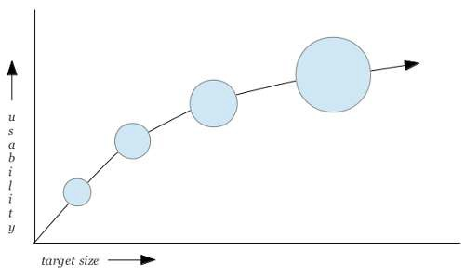
Size: Overrated?

Slide 13

Site2

Slide 14
So we’ve talked about size…
Now what about flow.
Does Fitts’ include the natural motion of moving a mouse left to right
Let’s look at a demo.

Slide 15
Fitts Demo….more than size and distance?

Slide 16
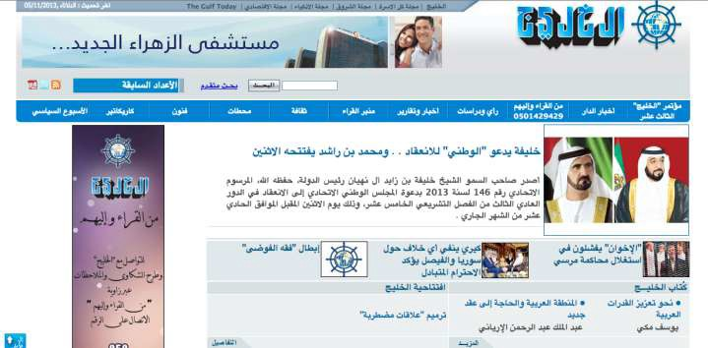
Al Khaleej Newspaper
Right to Left

Slide 17
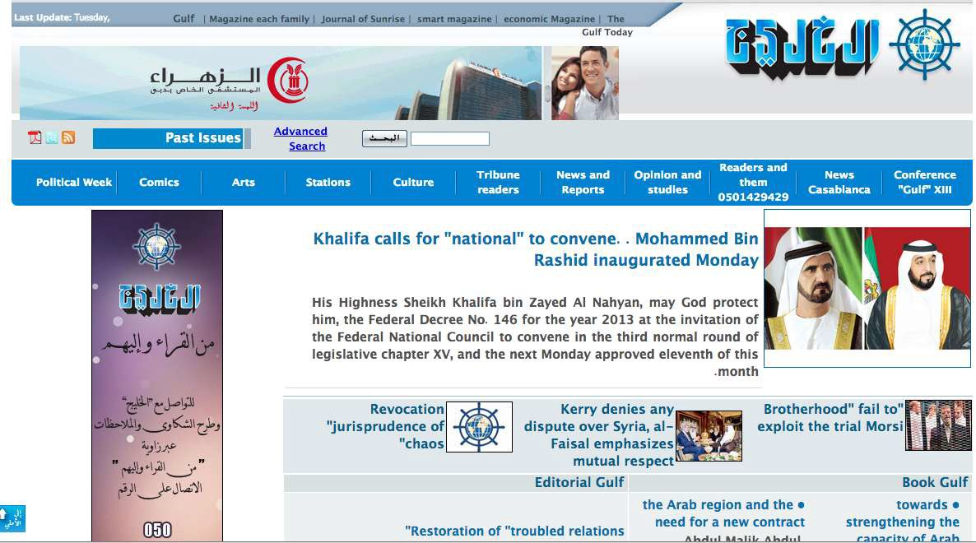
Now translated left to right:

Slide 18
Navigation
How do we judge?
Can we find things fast?
Can the layman find things fast what is the level of frustration

Slide 19

Zut Alors!

Slide 20

Frys Electronics, et al

Slide 21
Summary
So this week…
Metaphors
Organization
Navigation

