Slide 1


Session #7:Evaluation

Slide 2
The aims
Explain the key concepts used in evaluation.
Introduce different evaluation methods.
Show how different methods are used for different purposes at different stages of the design process and in different contexts.
Show how evaluators mix and modify methods.
Discuss the practical challenges
Illustrate how methods discussed in Chapters 7
and 8 are used in evaluation and describe some methods that are specific to evaluation.
Notes:
2

Slide 3
Why, what, where and when to evaluate
Iterative design & evaluation is a continuous process that examines:
Why: to check users’ requirements and that users can use the product and they like it.
What: a conceptual model, early prototypes of a new system and later, more complete prototypes.
Where: in natural and laboratory settings.
When: throughout design; finished products can be evaluated to collect information to inform new products.
Notes:
3

Slide 4
Definition of Evaluation ??
It is the process of systematically collecting data that inform us about what it is like for a particular users or group of users to use a product for a particular task in a certain type of environment

Slide 5
Two main types of Evaluation
Formative Evaluation is done at different stages of development to check that the product meets users needs
Summative Evaluation assesses the quality of a finished product
  Our focus is going to be on formative evaluation

Slide 6
What to Evaluate
It’s a continuous process which examines:
Focus on users and their tasks
Observe, measure, and analyze their performance with the system
Design iteratively
Important for designer to check and make sure that they understand user requirements

Slide 7
Why you need to Evaluate
Designers should not presume that everyone is like them or that the following of set guidelines would guarantee them good usability
Evaluation is needed to check that users can use the product and like it

Slide 8
Bruce Tognazzini tells you why you need to evaluate
“Iterative design, with its repeating cycle of design and testing, is the only validated methodology in existence that will consistently produce successful results. If you don’t have user-testing as an integral part of your design process you are going to throw buckets of money down the drain.”
See AskTog.com for topical discussions about design and evaluation.
Notes:
8

Slide 9
Why you need to Evaluate (cont’d)
Toganazzini’s 5 reasons to evaluate:
  Problems are fixed before the product is shipped, not after
  The team can concentrate on real problems, not imaginary ones
  Engineers code is sharply reduced
  Time to market is sharply reduced
  Upon 1st release, your sales department has a rock solid design it can sell without having to pepper their pitches with how well the next release will work

Slide 10
Why you need to Evaluate (cont’d)
Usability testing involves measuring the performance of typical users on typical tasks
Satisfaction, can be evaluated through questionnaires and interviews
Trends are towards evaluating more subjective user-experience goals, like emotionally satisfying, motivating fun etc.

Slide 11
Types of evaluation
Controlled settings involving users, eg usability testing & experiments in laboratories and living labs.
Natural settings involving users, eg field studies to see how the product is used in the real world.
Any settings not involving users, eg consultants critique; to predict, analyze & model aspects of the interface analytics.

Slide 12
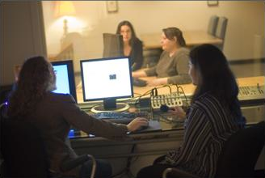
Usability lab
University of Baltimore Usability Lab
Notes:
Watch a test: https://www.youtube.com/watch?v=HmRjMmQoduk
See photos: https://foursquare.com/v/usability-lab-at-university-of-baltimore/4d46ec877e2e54816d95788f

Slide 13
Living labs
People’s use of technology in their everyday lives can be evaluated in living labs.
Such evaluations are too difficult to do in a usability lab.
Eg the Aware Home was embedded with a complex network of sensors and audio/video recording devices
Notes:
For more on the awarehome: http://www.awarehome.gatech.edu/drupal/?q=content/about-ahri

Slide 14
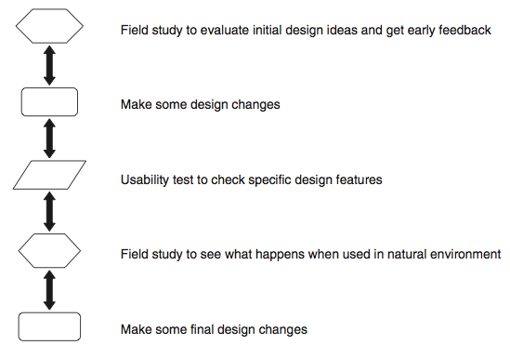
Usability testing & field studies can compliment

Slide 15
Evaluation case studies
Experiment to investigate a computer game
In the wild field study of skiers
Crowdsourcing
Notes:
15

Slide 16
Challenge & engagement in a collaborative immersive game
Physiological measures
were used.
Players were more engaged when playing against another person than when playing against a computer.
What precautionary measures did the evaluators take?
Notes:
16

Slide 17
What does this data tell you?
Notes:
17

Slide 18
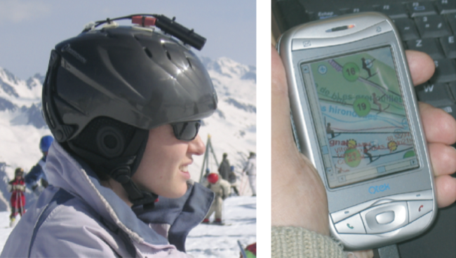
Why study skiers in the wild ?
Jambon et al. (2009) User experience in the wild. In: Proceedings of CHI ’09, ACM Press, New York,
_{p. 4070-4071.}

Slide 19
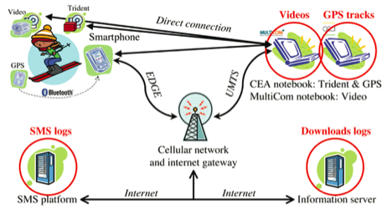
e-skiing system components
Jambon et al. (2009) User experience in the wild. In: Proceedings of CHI ’09, ACM Press, New York,
_{p. 4072.}
Notes:
The evaluation took place in a natural setting.
The evaluators imposed less control on the participants than in the previous case study. The skiers were free to go where they wished on the mountain. However, the participants did have to agree to have cameras, GPS, and other tracking devices strapped to them.
The skiers' movements when going down the slopes were collected using video and accelerometers. In addition a focus group was run in order to learn more about what the skiers thought about the system: what they liked or did not like, and what problems they experienced with the system.

Slide 20
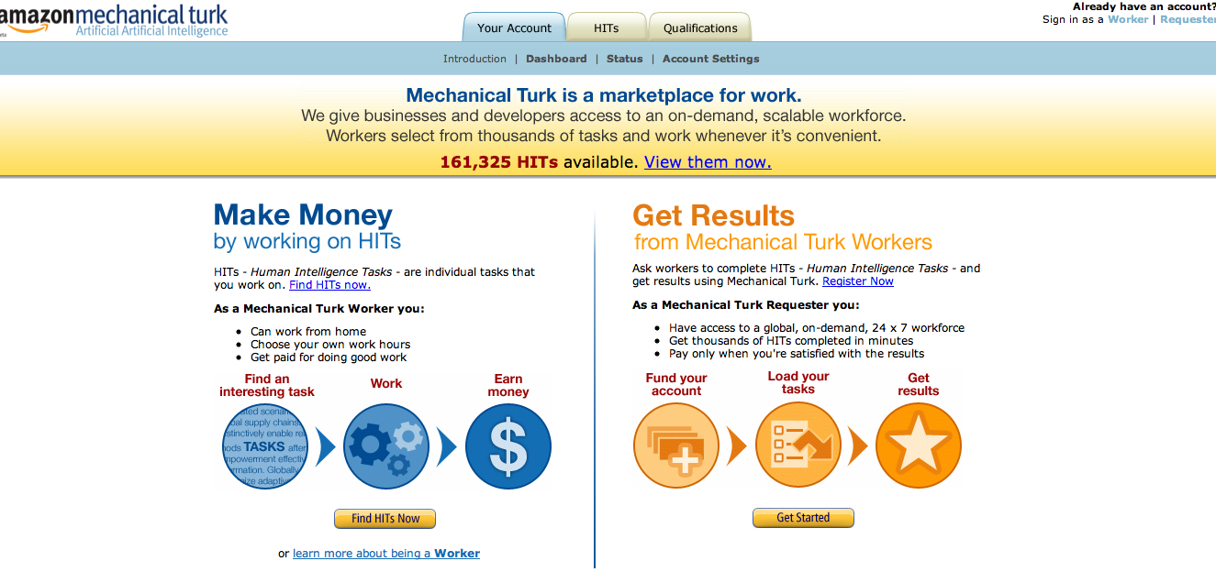
Crowdsourcing-when might you use it?

Slide 21
Evaluating an ambient system
The Hello Wall is a new kind of system that is designed to explore how people react to its presence.
What are the challenges of evaluating systems like this?
Notes:
21
Ambient displays are peripheral, aesthetically
pleasing displays of information which support awareness of some data

Slide 22
Evaluation methods
Method | Controlled settings | Natural settings | Without users
Observing | x | x
Asking users | x | x
Asking experts |  | x | x
Testing | x
Modeling |  |  | x
Notes:
22

Slide 23
Key points
    Evaluation & design are closely integrated in user-centered design.
    Some of the same techniques are used in evaluation as for establishing requirements but they are used differently
    (e.g. observation interviews & questionnaires).
    Three types of evaluation: laboratory based with users, in the field with users, studies that do not involve users
    The main methods are: observing, asking users, asking experts, user testing, inspection, and modeling users’ task performance, analytics.
    Dealing with constraints is an important skill for evaluators to develop.
Notes:
23

