Slide 1

Session #7 React Immediately
© Kristian Secor 2018 UC San Diego Extension Online Learning Course: User Interface Design

Slide 2
Lookup Patterns
Auto-Complete
Live Suggest
Live Search
Refining Search

Slide 3
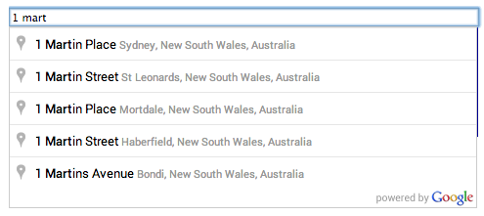
Auto-Complete
Typing
Matching
Completing

Slide 4
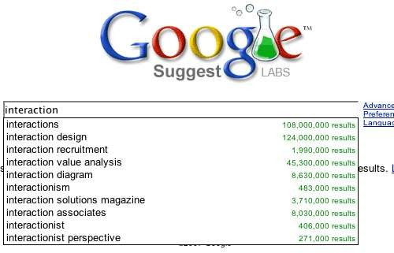
Live Suggest
© Kristian Secor 2018 UC San Diego Extension Online Learning Course: User Interface Design

Slide 5
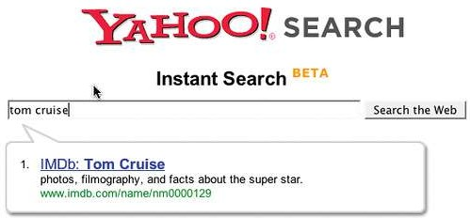
Live Search
A few caveats with this one….

Slide 6
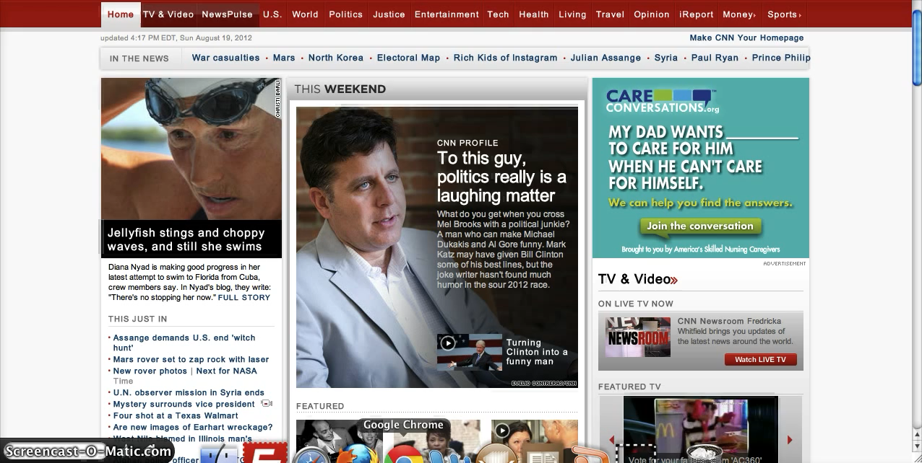
Combinations of the previous
© Kristian Secor 2018 UC San Diego Extension Online Learning Course: User Interface Design

Slide 7
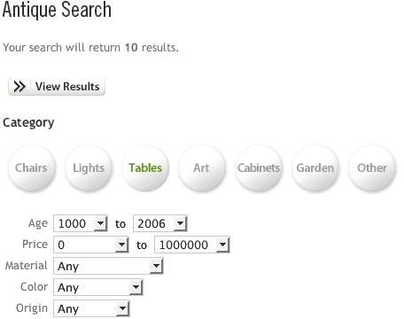
Refining Search
© Kristian Secor 2018 UC San Diego Extension Online Learning Course: User Interface Design

Slide 8
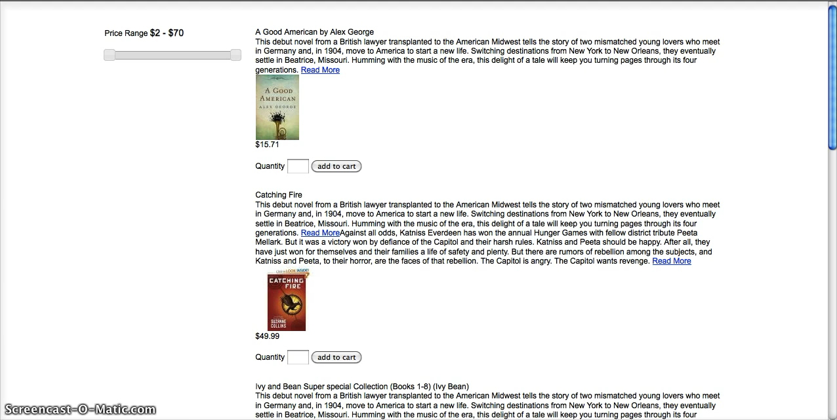
Example of refined search
© Kristian Secor 2018 UC San Diego Extension Online Learning Course: User Interface Design

Slide 9
Feedback Patterns
Live Preview
Progressive Disclosure
Progress Indicator
Periodic Refresh

Slide 10
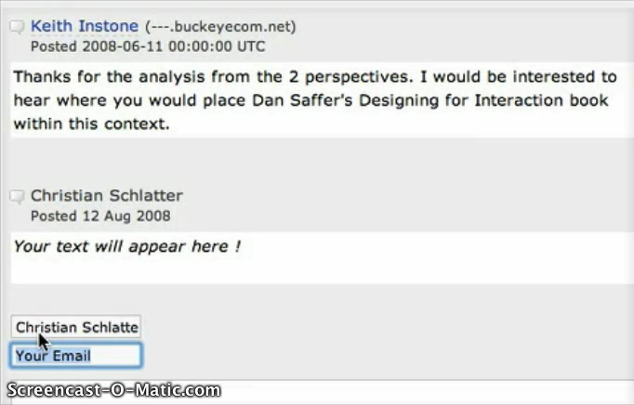
Live Preview
Live Preview
© Kristian Secor 2018 UC San Diego Extension Online Learning Course: User Interface Design

Slide 11
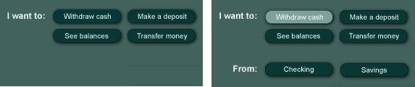
Progressive Disclosure
Step by step to assist the user

Slide 12
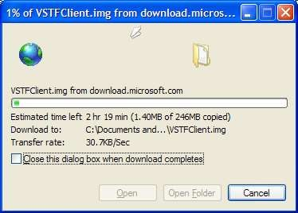
Progress Indicator
When done right it is a 4 step process…

Slide 13
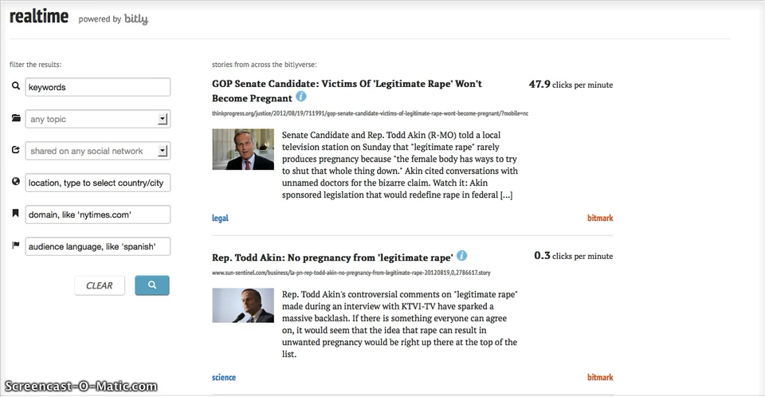
Periodic Refresh
Win-win…live updates.

Slide 14
Applying these to your projects
What’s next….
In your projects, apply patterns only when appropriate
Look at similar websites and judge them for whether their patterns are helpful or harmful
Lets’ look at a project example….

Slide 15
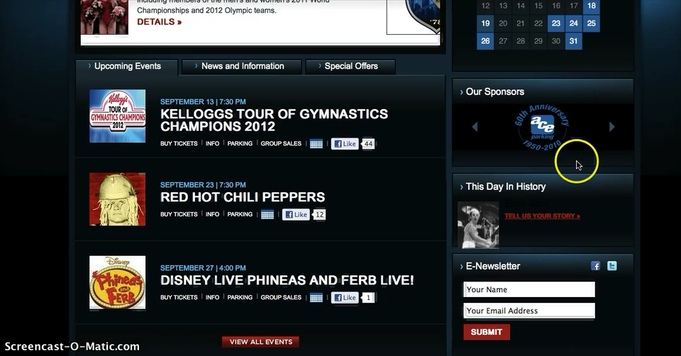
Here’s an example….
© Kristian Secor 2018 UC San Diego Extension Online Learning Course: User Interface Design

Slide 16
Mobile and Multiple Devices
User Interface Design Patterns for smaller mobile devices
© Kristian Secor 2018 UC San Diego Extension Online Learning Course: User Interface Design

Slide 17
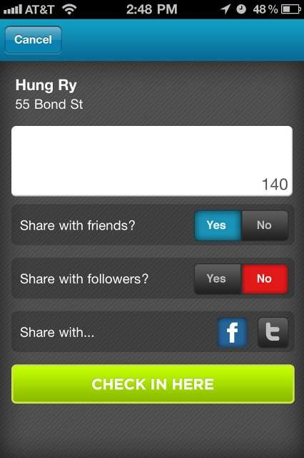
The Check-in Screen
© Kristian Secor 2018 UC San Diego Extension Online Learning Course: User Interface Design

Slide 18
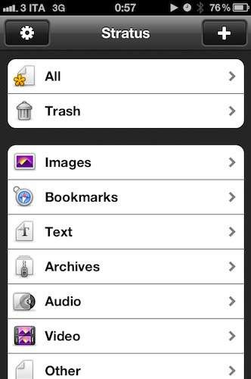
Navigation
© Kristian Secor 2018 UC San Diego Extension Online Learning Course: User Interface Design

Slide 19
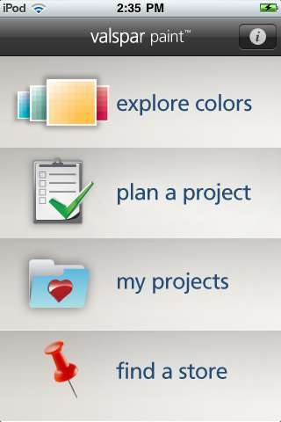
List View Perfected
© Kristian Secor 2018 UC San Diego Extension Online Learning Course: User Interface Design

Slide 20
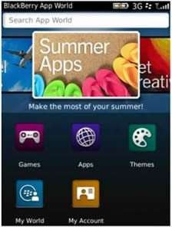
Buttons can work too
© Kristian Secor 2018 UC San Diego Extension Online Learning Course: User Interface Design

Slide 21
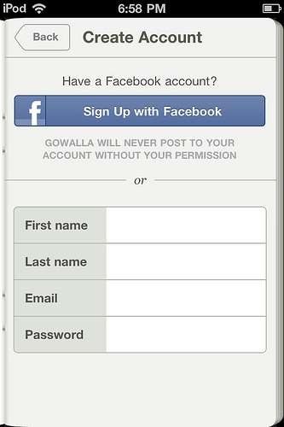
Forms
© Kristian Secor 2018 UC San Diego Extension Online Learning Course: User Interface Design

Slide 22
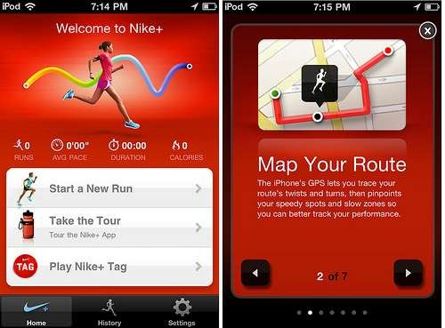
Help
© Kristian Secor 2018 UC San Diego Extension Online Learning Course: User Interface Design

Slide 23
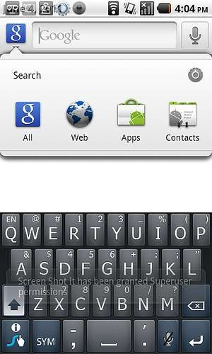
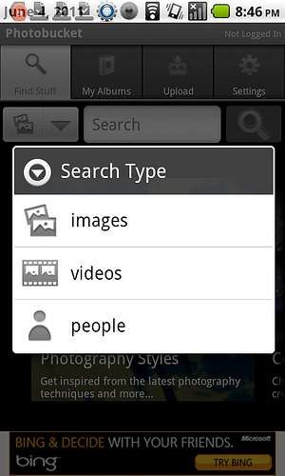
Search
© Kristian Secor 2018 UC San Diego Extension Online Learning Course: User Interface Design

Slide 24
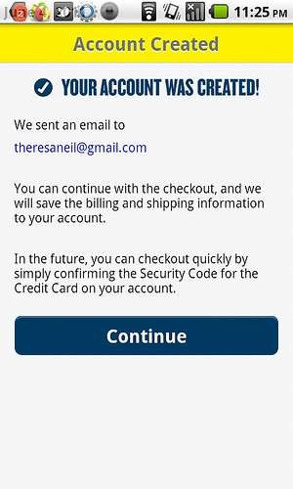
Feedback
© Kristian Secor 2018 UC San Diego Extension Online Learning Course: User Interface Design

Slide 25

Charts
© Kristian Secor 2018 UC San Diego Extension Online Learning Course: User Interface Design

Slide 26
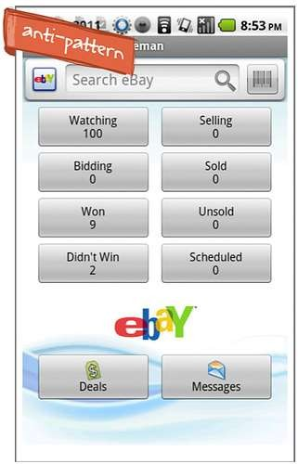
Anti-Patterns for mobile
© Kristian Secor 2018 UC San Diego Extension Online Learning Course: User Interface Design

