Slide 1

Session #6: User Personas/Mental Models/Conceptual Design
© Kristian Secor 2018 UC San Diego Extension Online Learning Course: Principles of User Experience

Slide 2
User persona
Represents a specific (but imaginary) person in a specific work role
A story and description of specific individual who has
A name
A life
A personality
© Kristian Secor 2018 UC San Diego Extension Online Learning Course: Principles of User Experience
2

Slide 3
User personas
Built up from contextual data
Offer concreteness
Offers personal engagement
Ideal for sharing visualization of design target
© Kristian Secor 2018 UC San Diego Extension Online Learning Course: Principles of User Experience
3

Slide 4
Without personas
Designing to “meet needs of users” is a vague and ill-defined
Designers make it up as they go, thinking of themselves as users
No way to control instinct to cover everything in design
Special cases end up dominating discussion
© Kristian Secor 2018 UC San Diego Extension Online Learning Course: Principles of User Experience
4

Slide 5
With personas
Can overcome struggle to design for conflicting needs and goals of
Different user classes
User classes too broad or too vaguely defined
Condition for applying personas:
People from different user classes all have to take on same work role
© Kristian Secor 2018 UC San Diego Extension Online Learning Course: Principles of User Experience
5

Slide 6
Focusing on just one person
Personas can help end feature debates
What if user wants to do X?
Sorry, but Noah will not need feature X
But someone might
Perhaps, but we are designing for Noah, not
“someone”
© Kristian Secor 2018 UC San Diego Extension Online Learning Course: Principles of User Experience
6

Slide 7
Make your personas rich
Rich, relevant, believable, specific, and precise
Give your persona a personality
Give your persona a life surrounded with detailed artifacts
© Kristian Secor 2018 UC San Diego Extension Online Learning Course: Principles of User Experience
7

Slide 8
Make your personas “sticky”
(memorable)
Give them exposure, visibility
Posters
Coffee mugs
T-shirts, screen
Full-sized cardboard standups
Action figures
© Kristian Secor 2018 UC San Diego Extension Online Learning Course: Principles of User Experience
8

Slide 9
Where personas work best
Commercial products
Systems with relatively simple work domains
For example, a certain kind of person may always carry a phone
But does not always carry a camera
This might help in design discussions about whether to combine a camera in a cellphone design
© Kristian Secor 2018 UC San Diego Extension Online Learning Course: Principles of User Experience
9

Slide 10
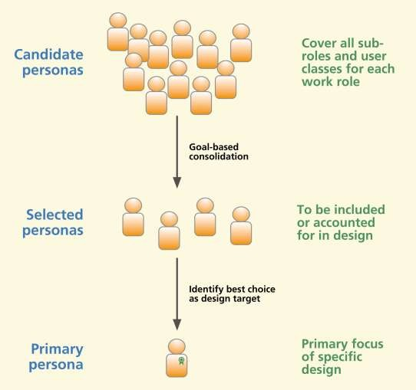
Choosing a persona
© Kristian Secor 2018 UC San Diego Extension Online Learning Course: Principles of User Experience
10

Slide 11
Designing for primary persona
Start by making your design as though Richard, your primary persona, is only user
Adjust as needed to make design suffice
for the other selected personas
Primary persona wins all conflicts and tradeoffs, other selected personas get coverage
© Kristian Secor 2018 UC San Diego Extension Online Learning Course: Principles of User Experience
11

Slide 12
Mental models
Designer’s mental model
Vision of how system works as held by designer
What the system is
How it is organized
What it does and how
© Kristian Secor 2018 UC San Diego Extension Online Learning Course: Principles of User Experience
12

Slide 13
Mental models
User’s mental model
Description of how system works as held by user
Conceptual design is what we use to connect the two
© Kristian Secor 2018 UC San Diego Extension Online Learning Course: Principles of User Experience

Slide 14
Designer's mental model in ecological perspective
Describes how system works within its environment
How system or product fits within work context
In flow of activities involving it and other parts of broader world
© Kristian Secor 2018 UC San Diego Extension Online Learning Course: Principles of User Experience

Slide 15
Designer's mental model in interaction perspective
Describes how users operate system or product
Task-oriented view, including
User intentions
Sensory, cognitive, and physical user actions
Includes device behavior
© Kristian Secor 2018 UC San Diego Extension Online Learning Course: Principles of User Experience

Slide 16
Designer's mental model in emotional perspective
Describing intended emotional impact
About expected overarching emotional response
© Kristian Secor 2018 UC San Diego Extension Online Learning Course: Principles of User Experience

Slide 17
Users mental model
Internal explanation user has built about how system works
It’s what we do naturally in unfamiliar situations
Starts with imperfect theories
Draws on expertise and previous experience
© Kristian Secor 2018 UC San Diego Extension Online Learning Course: Principles of User Experience

Slide 18
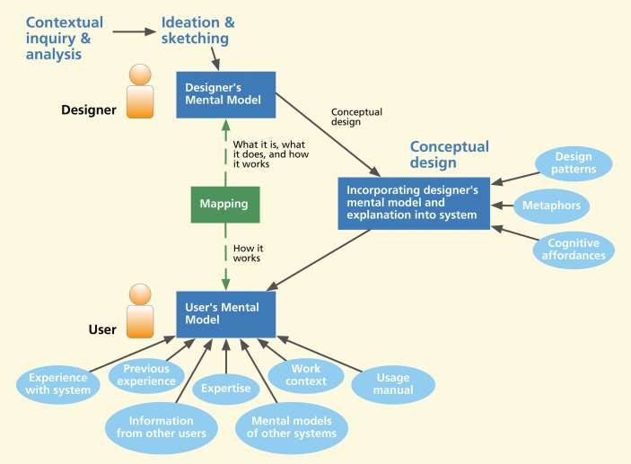
Conceptual design as mapping
© Kristian Secor 2018 UC San Diego Extension Online Learning Course: Principles of User Experience
18

Slide 19
Mapping designer to users
Goal: Get user’s mental model to match reality of designer’s mental model
Implementation of this mapping
Conceptual design as manifest in system
The part of an interaction design containing a theme
For communicating design vision
Where you innovate to plant seed of UX
© Kristian Secor 2018 UC San Diego Extension Online Learning Course: Principles of User Experience

Slide 20
Metaphors
Analogies for communication and explanations
Explain unfamiliar using familiar conventional knowledge
Use what users already know about existing system or phenomena
Adapt to help user learn how to use new system
© Kristian Secor 2018 UC San Diego Extension Online Learning Course: Principles of User Experience

Slide 21
Metaphors
Example, typewriter metaphor in a word processing system
One of simplest and oldest examples
So old, in fact, that it has become a ‘dead metaphor” and works in reverse
© Kristian Secor 2018 UC San Diego Extension Online Learning Course: Principles of User Experience

Slide 22
Examples of metaphors
Ecological perspective example
iTunes as a mother ship for iPods, iPhones, and iPads
© Kristian Secor 2018 UC San Diego Extension Online Learning Course: Principles of User Experience

Slide 23
Examples of metaphors
Interaction perspective example
Actions for reading a book on an iPad, Kindle, or Nook
© Kristian Secor 2018 UC San Diego Extension Online Learning Course: Principles of User Experience

Slide 24
Conceptual design in three perspectives
Ecological perspective
To communicate design vision of system as
black box within its environment
Interaction perspective
To communicate design vision of how user operates system
© Kristian Secor 2018 UC San Diego Extension Online Learning Course: Principles of User Experience
24

Slide 25
Conceptual design in three perspectives
Emotional perspective
To communicate a vision of how design elements will evoke emotional impact
Example, for a sports car:
About jaw-dropping performance
About how your heart skips a beat when you see its aerodynamic form
About fun and being independent from crowd
© Kristian Secor 2018 UC San Diego Extension Online Learning Course: Principles of User Experience
25

Slide 26
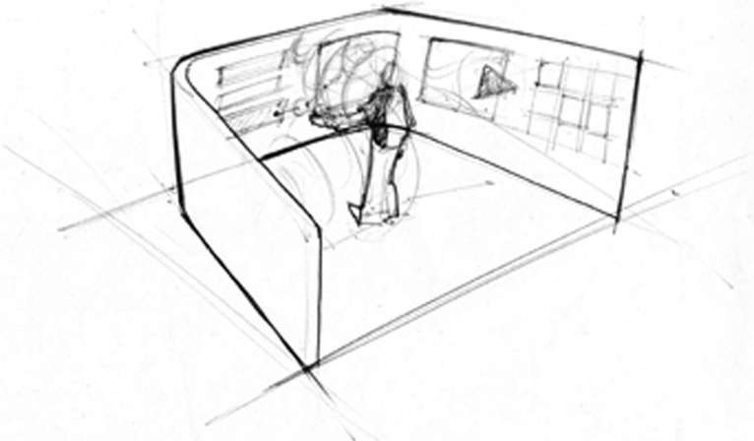
Example, early conceptual design
Immersion in ecological perspective
© Kristian Secor 2018 UC San Diego Extension Online Learning Course: Principles of User Experience
26

Slide 27
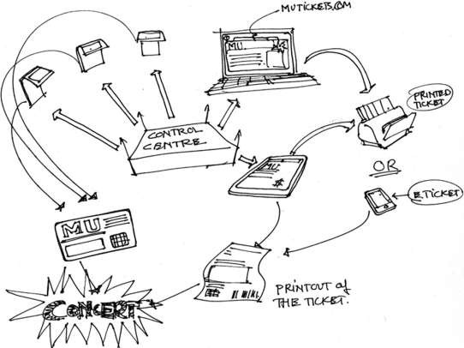
Example, conceptual design
Broad environmental view in ecological perspective
© Kristian Secor 2018 UC San Diego Extension Online Learning Course: Principles of User Experience

Slide 28
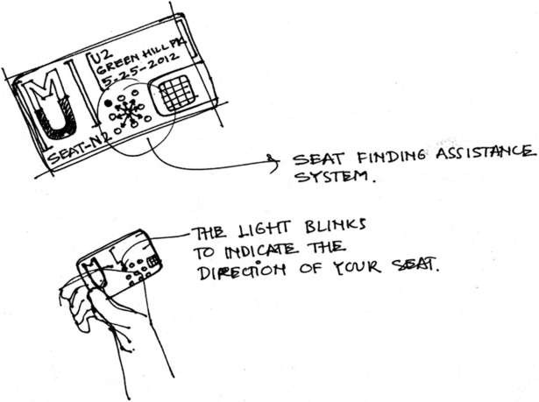
Example, ecological conceptual design
Focusing on feature for smart ticket to guide users to seating
© Kristian Secor 2018 UC San Diego Extension Online Learning Course: Principles of User Experience

Slide 29
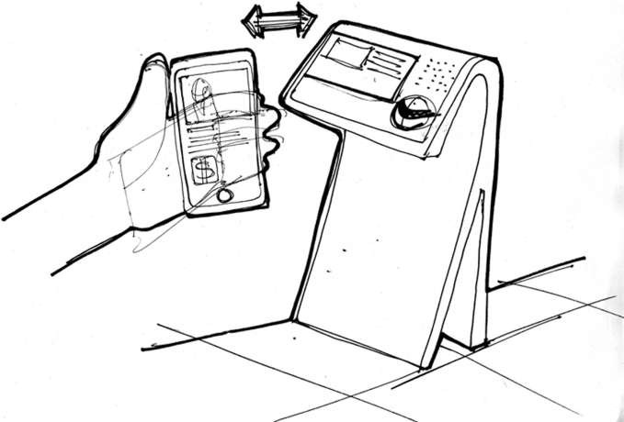
Example, ecological conceptual design
Focusing on communication with a smartphone
© Kristian Secor 2018 UC San Diego Extension Online Learning Course: Principles of User Experience
29

Slide 30
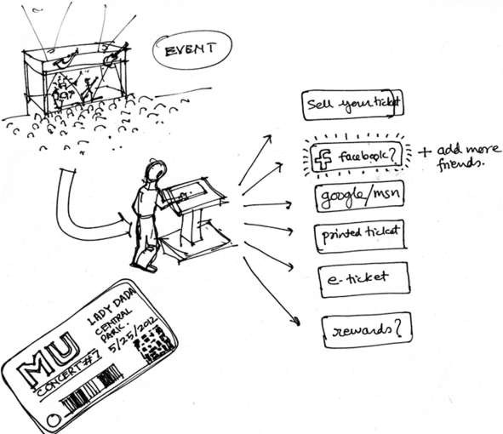
Example, ecological conceptual design
Focusing on social networking
© Kristian Secor 2018 UC San Diego Extension Online Learning Course: Principles of User Experience
30

Slide 31
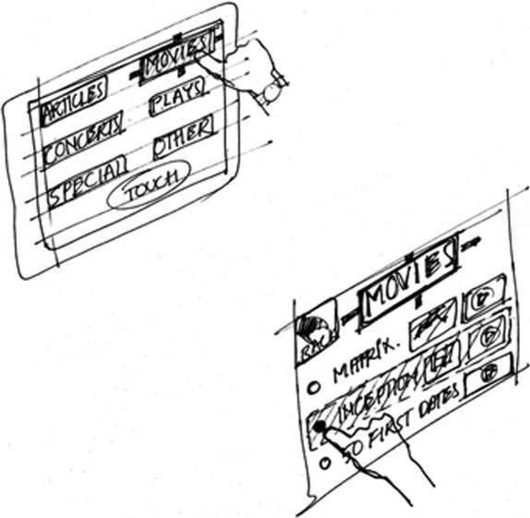
Example, conceptual design in interaction perspective
© Kristian Secor 2018 UC San Diego Extension Online Learning Course: Principles of User Experience
31

