Slide 1

Session #6: Use Transitions
© Kristian Secor 2018 UC San Diego Extension Online Learning Course: User Interface Design

Slide 2
Transitional Patterns
Sudden movement or light can grab your attention, thanks to a second region for visual *.
Brighten and Dim
Expand and Collapse
Self-Healing Fade,
Animation
Spotlight.
*from Mind Hacks
© Kristian Secor 2018 UC San Diego Extension Online Learning Course: User Interface Design

Slide 3
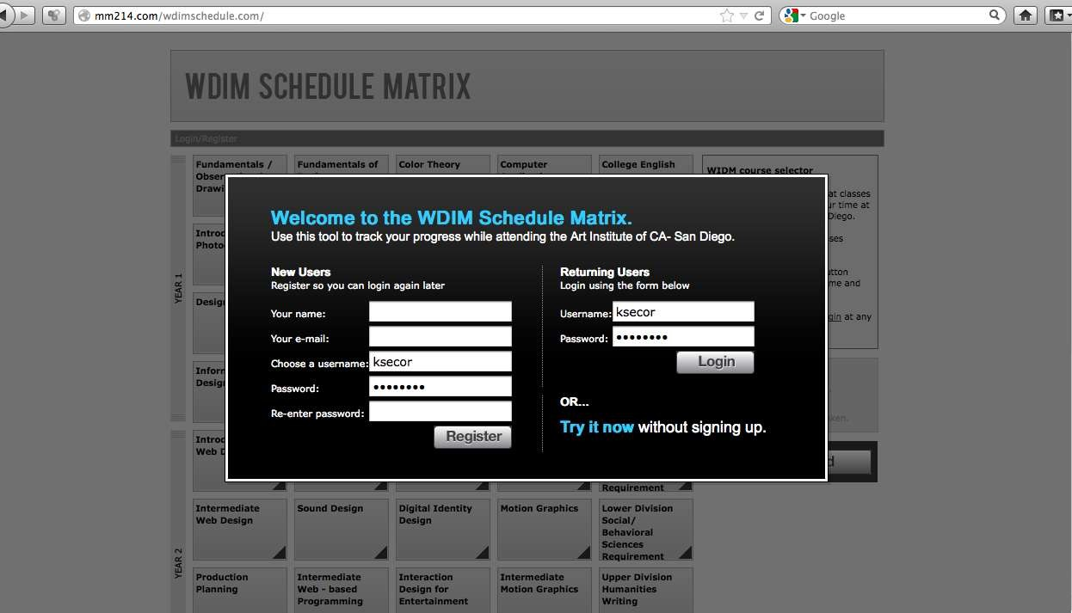
Brighten/Dim

Slide 4
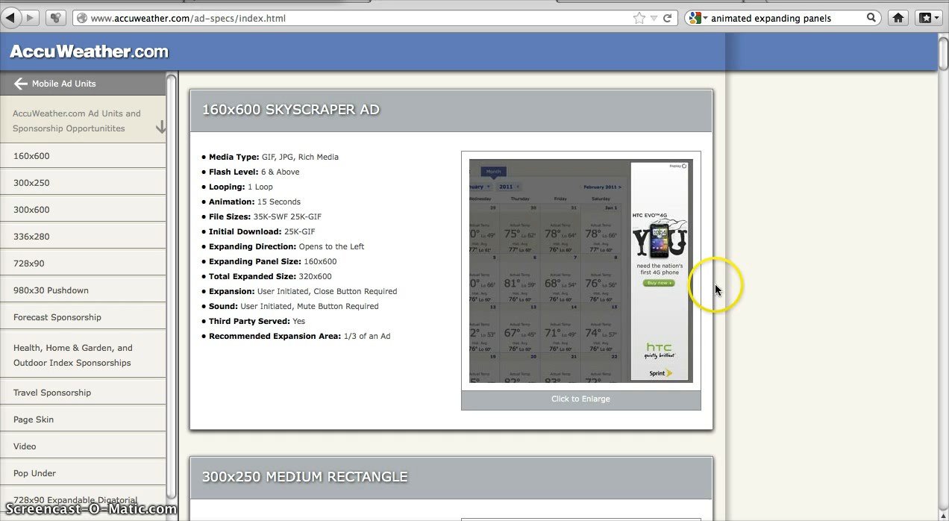
Expand/Collapse
© Kristian Secor 2018 UC San Diego Extension Online Learning Course: User Interface Design

Slide 5
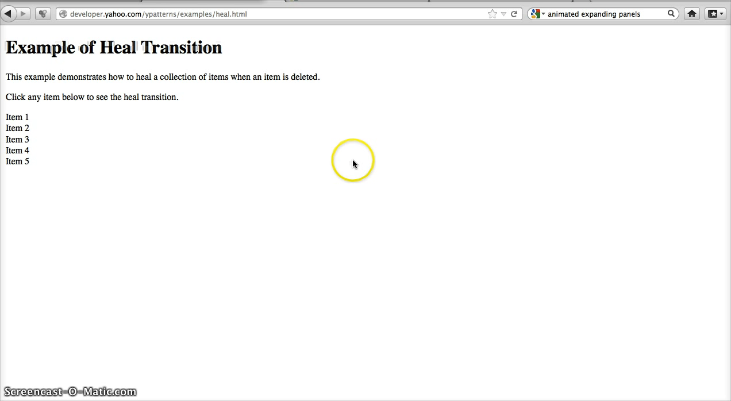
Self-Healing Fade
© Kristian Secor 2018 UC San Diego Extension Online Learning Course: User Interface Design

Slide 6
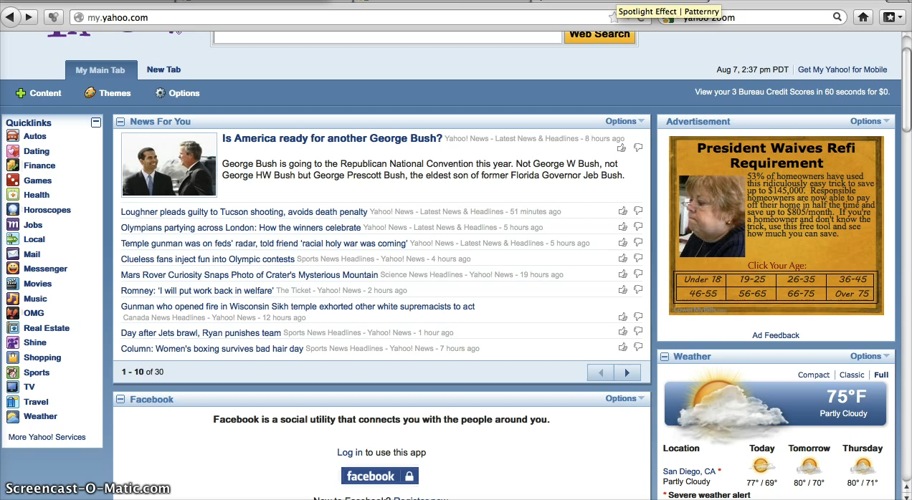
Animation
© Kristian Secor 2018 UC San Diego Extension Online Learning Course: User Interface Design

Slide 7
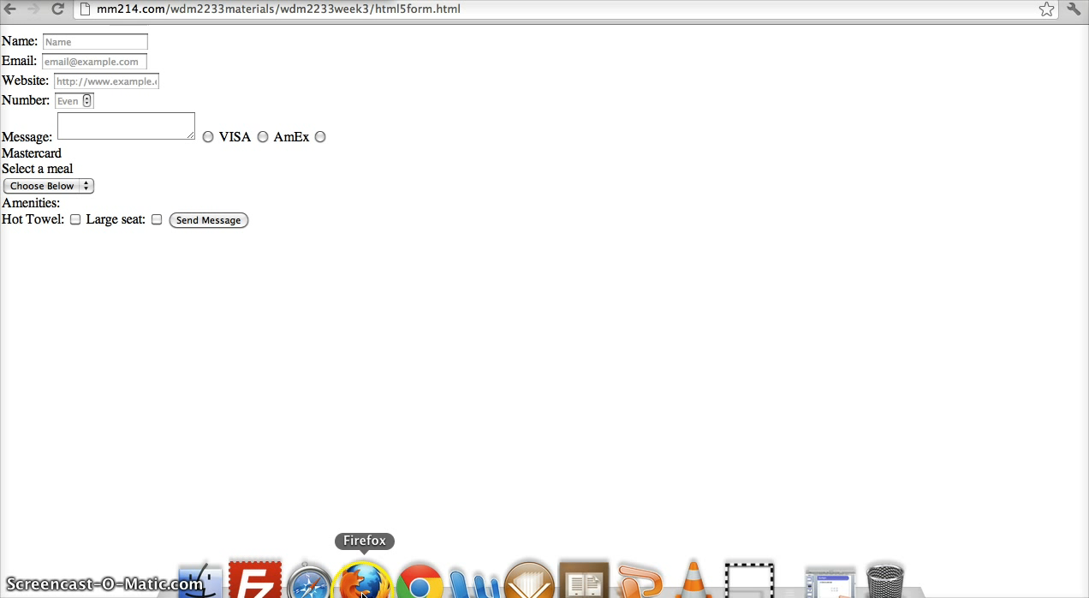
Spotlight
© Kristian Secor 2018 UC San Diego Extension Online Learning Course: User Interface Design

Slide 8
Purpose of Transitions
Engagement-transitions that react to our user make an application seem alive and responsive…it give the app a personality and encourages the user to interact.
Communication-Transitions communicate the value of an asset…they focus attention to valued objects away from non-valued objects
© Kristian Secor 2018 UC San Diego Extension Online Learning Course: User Interface Design

Slide 9
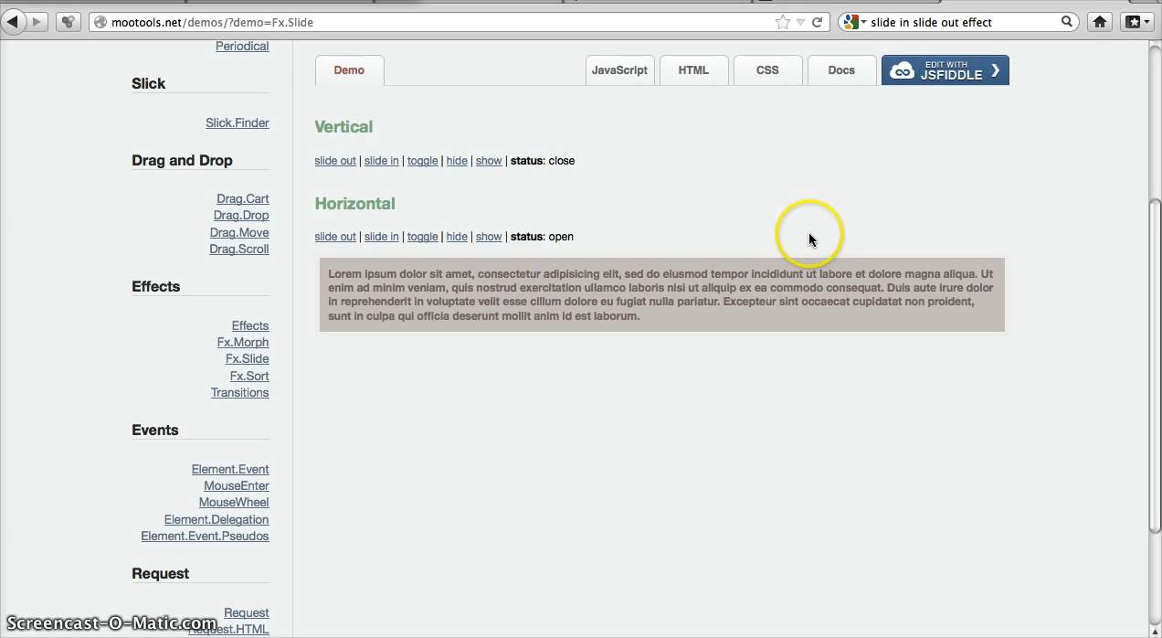
Slide In/Slide Out
© Kristian Secor 2018 UC San Diego Extension Online Learning Course: User Interface Design

Slide 10

Faceplate
© Kristian Secor 2018 UC San Diego Extension Online Learning Course: User Interface Design

Slide 11
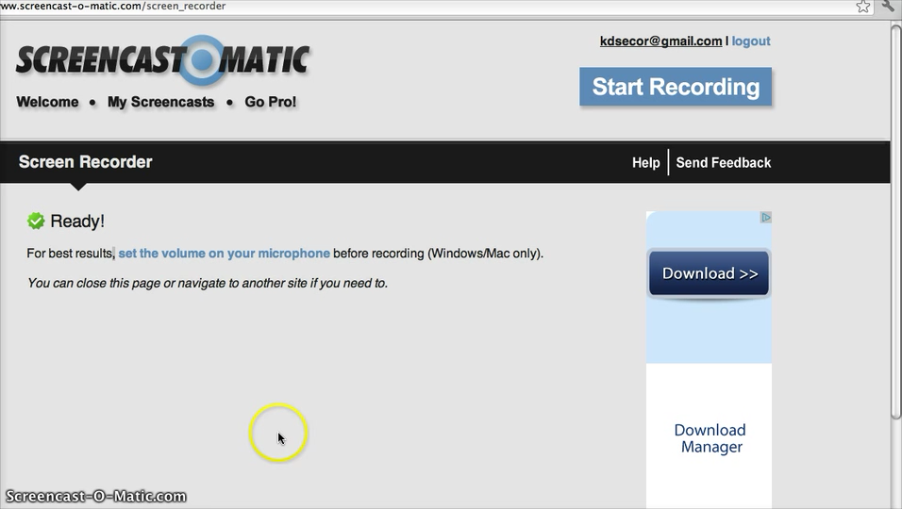
Flip
© Kristian Secor 2018 UC San Diego Extension Online Learning Course: User Interface Design

Slide 12
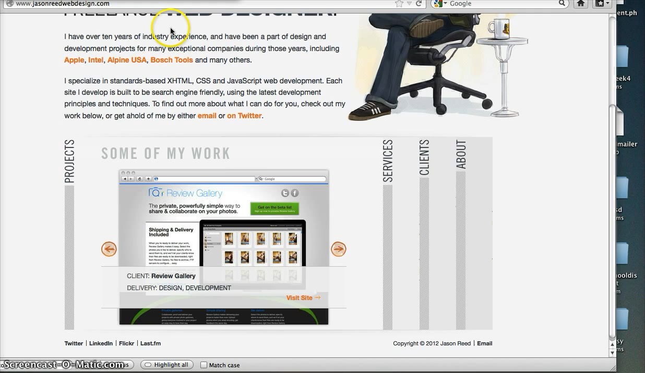
Accordion
© Kristian Secor 2018 UC San Diego Extension Online Learning Course: User Interface Design

Slide 13
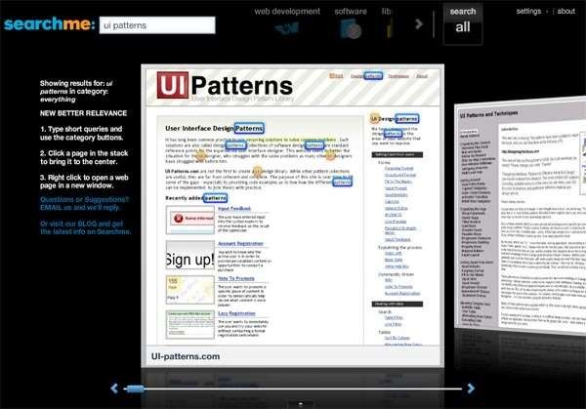
Carousel
When Carousels attack….
© Kristian Secor 2018 UC San Diego Extension Online Learning Course: User Interface Design

Slide 14
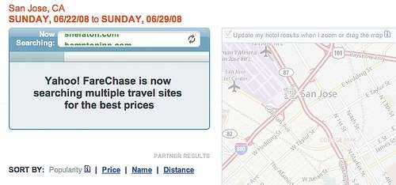
Fade
The fade is often used to disrupt while an application is working:
© Kristian Secor 2018 UC San Diego Extension Online Learning Course: User Interface Design

Slide 15
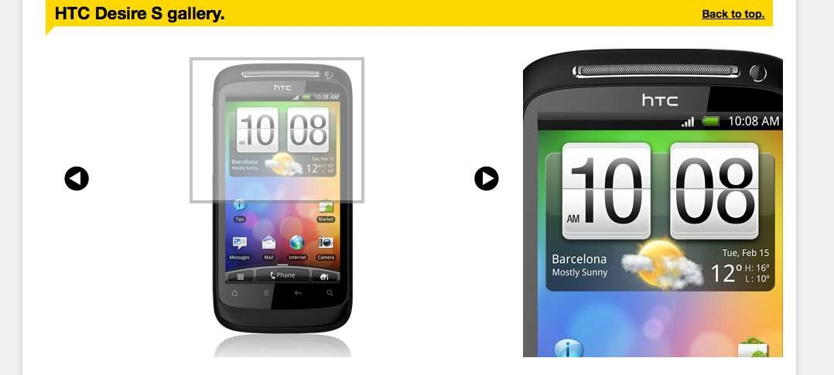
Zoom
Zoom is an ecommerce pattern…
© Kristian Secor 2018 UC San Diego Extension Online Learning Course: User Interface Design

Slide 16
Perceived Performance
Any indication that an action is underway or is close to being finished…think of your average progress or load bar…
But did you know…an illusion can lead the user to believe that loading is happening faster than it is? Click here
© Kristian Secor 2018 UC San Diego Extension Online Learning Course: User Interface Design

Slide 17
Transitions….
Best Practices
-The more rapid the change, the more important the even.
-Movement toward the user is seen as more important than movement away from the user.
-Keep the transitions near the users’ area of focus . This will make the transitions more discoverable and feel less like advertising.
© Kristian Secor 2018 UC San Diego Extension Online Learning Course: User Interface Design

