Slide 1

Session #8: Case Studies
© Kristian Secor 2018 UC San Diego Extension Online Learning Course: User Interface Design 2

Slide 2
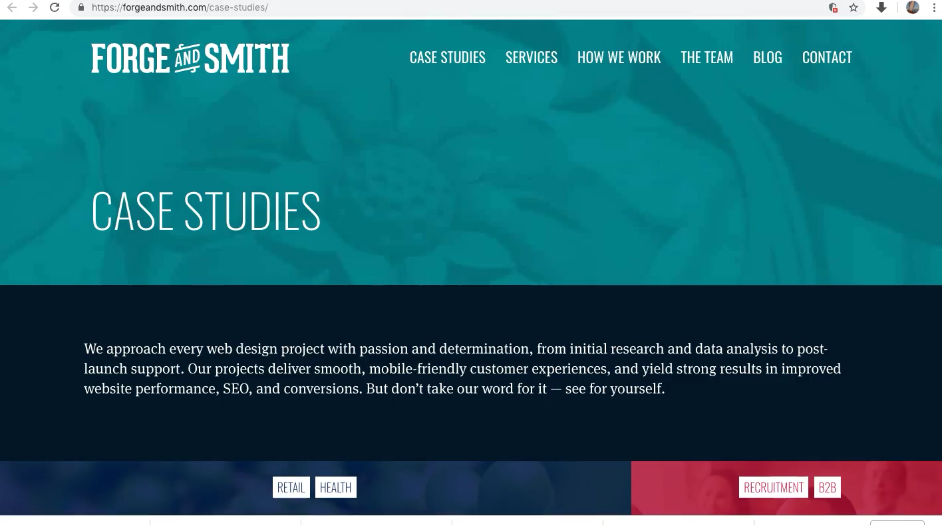
Web Firms
© Kristian Secor 2018 UC San Diego Extension Online Learning Course: User Interface Design 2

Slide 3
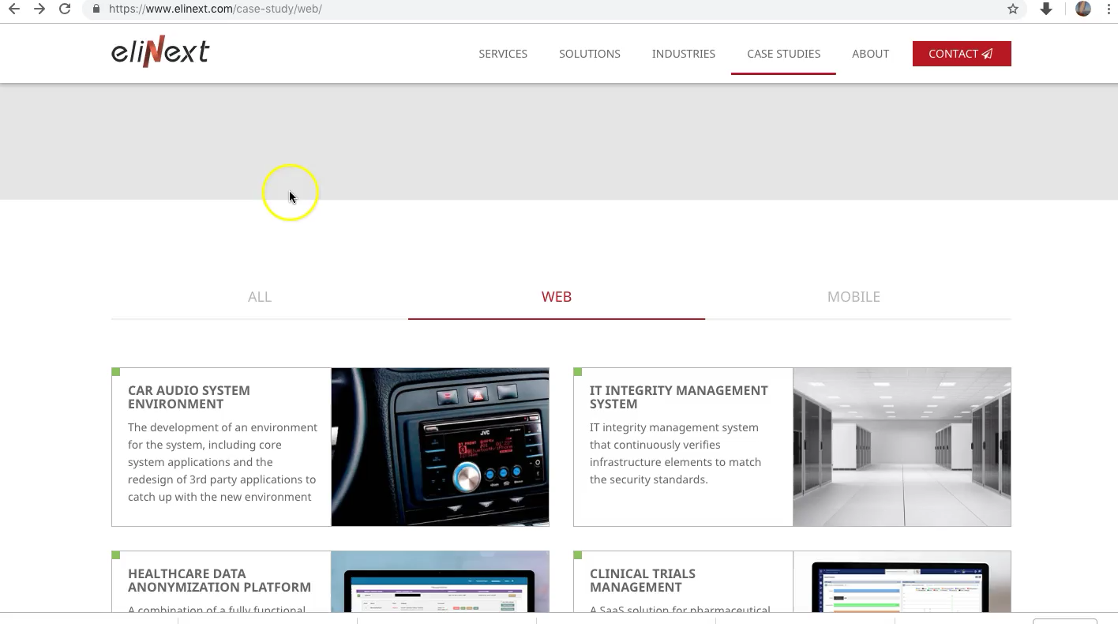
Software and App Developers
© Kristian Secor 2018 UC San Diego Extension Online Learning Course: User Interface Design 2

Slide 4
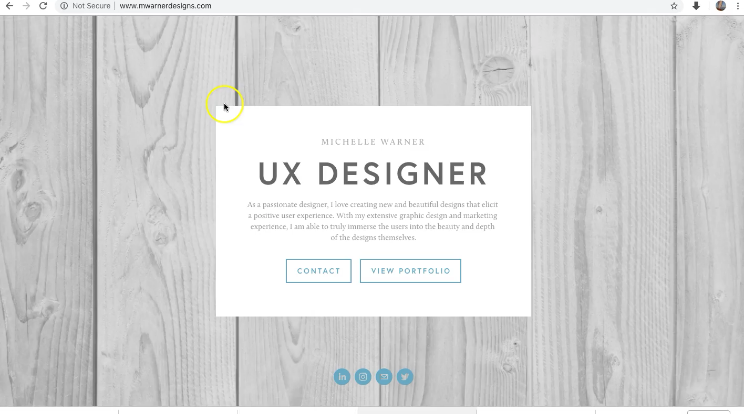
User Experience
© Kristian Secor 2012 UC San Diego Extension Online Learning Course: User Interface Design 4

Slide 5
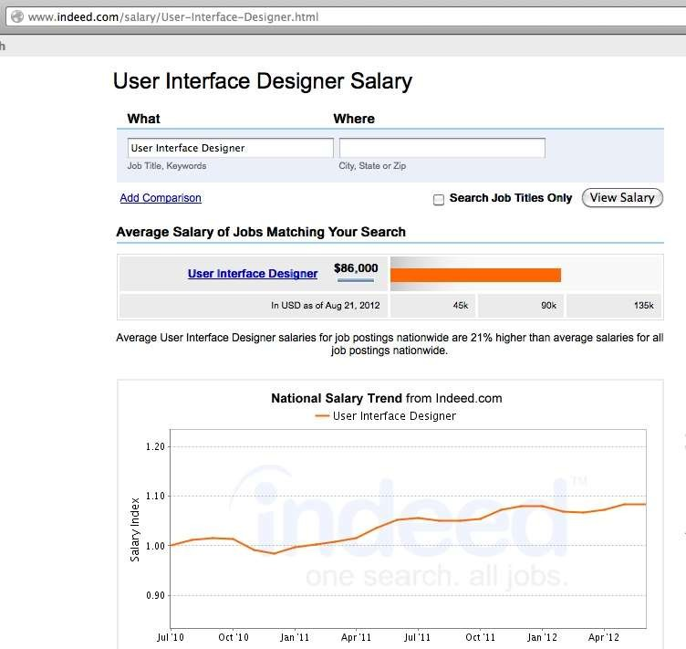
Salaries for UX Designers
© Kristian Secor 2018 UC San Diego Extension Online Learning Course: User Interface Design 2

Slide 6
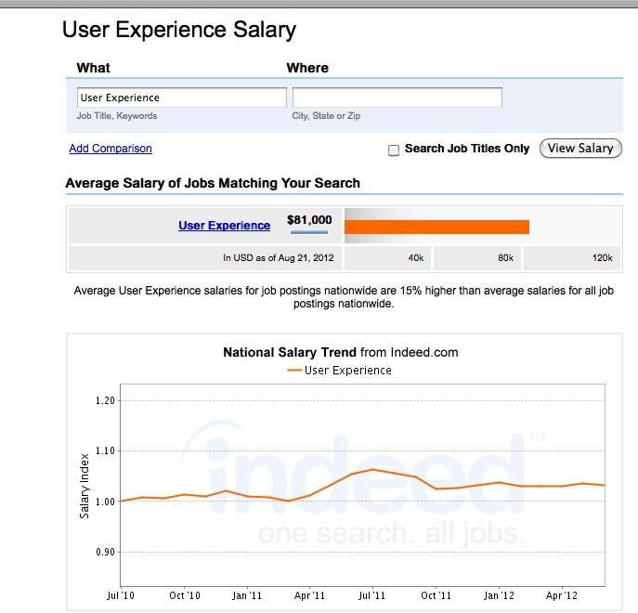
UX Salary
© Kristian Secor 2018 UC San Diego Extension Online Learning Course: User Interface Design 2

Slide 7

How to perform a UX test…
© Kristian Secor 2018 UC San Diego Extension Online Learning Course: User Interface Design 2

Slide 8
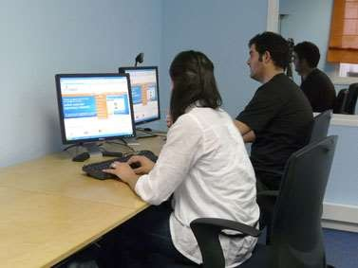
Many firms have labs…
© Kristian Secor 2018 UC San Diego Extension Online Learning Course: User Interface Design 2

Slide 9
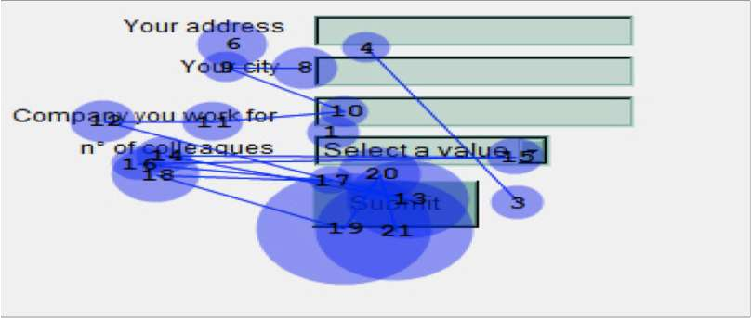
Or….for more depth
Eye Tracking: Are labels placed correctly?
© Kristian Secor 2018 UC San Diego Extension Online Learning Course: User Interface Design 2

Slide 10

In Closing…
Airlines
Hubspot
Fitbit
Houzz
© Kristian Secor 2018 UC San Diego Extension Online Learning Course: User Interface Design 2

