Slide 1

Session #1:Overview
© Kristian Secor 2015 UC San Diego Extension Online Learning Course: User Experience Design I

Slide 2
The next step….
Different from User Interface I
Goals
Deliverables
Professional Organizations
Portfolio
Case Study

Slide 3
UX, UID, HCI…
UX – User Experience
UID – User Interface Design
HCI – Human Computer Interaction
User Experience Design: The creation and synchronization of the elements with a particular company, with the intent of influencing their perceptions and behavior.

Slide 4
4 Types of UX Targets…
Brand Presence
Marketing
Content Source
Task Based Applications
Two case studies will be required, one for Brand Presence or Marketing and one for a Content Source or an Application

Slide 5

Brand Type Site Analysis
Let’s take a look:

Slide 6

Marketing Site Analysis
Who is the target market?

Slide 7

Content Source
Aol? Really?

Slide 8
Task-Based Applications
This can be Software
It can be eCommerce
It can be eLearning
It can be Mobile
It can be Social Media Apps

Slide 9

Software
The Apple Developer Site:

Slide 10

More on software….
Who does what well…how to choose!

Slide 11

eCommerce
Always Hireable…

Slide 12

eLearning
Huge Market-Very Competitive!

Slide 13
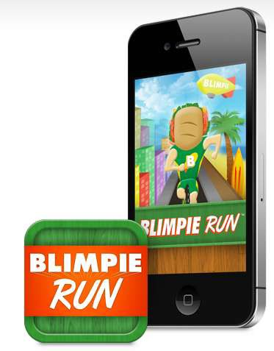
Mobile Apps
Click & Remember our new definition of UX!
Click here to see a case study of that app

Slide 14
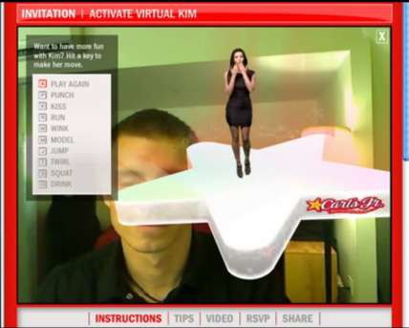
Social Media/Mobile Apps
Click here to see a social media app from 2010. What was its goal? Was it successful.

Slide 15
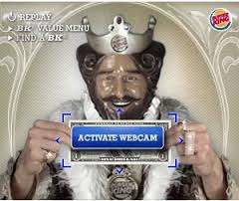
Now let’s take a look at BK
Click here to see Burger King’s effort
with the same technology
Which is better?
Which hits the Target market?

Slide 16
Taking a look at Case Studies
The previous categories will be the
subject of your two case studies.
Again, you will do your final redesign based off of one of your case studies

Slide 17

A look at 3 case studies
Please see notes for links to studies!

Slide 18
Last:
Do yourself a favor and investigate the
following sites:
Interaction Design Association
The Information Architecture Institute
American Society for Information
Science and Technology
ACM Special Interest Group on
Computer-Human Interaction

