Slide 1



Session #2: The Wheel

Slide 2
The Wheel
Characterizes course of evolution of an interaction design
Template a skeleton of development activities that must be instantiated within each project
o Based on project resources, goals
© Kristian Secor 2020 UC San Diego Extension Online Learning Course: User Interface Design

Slide 3

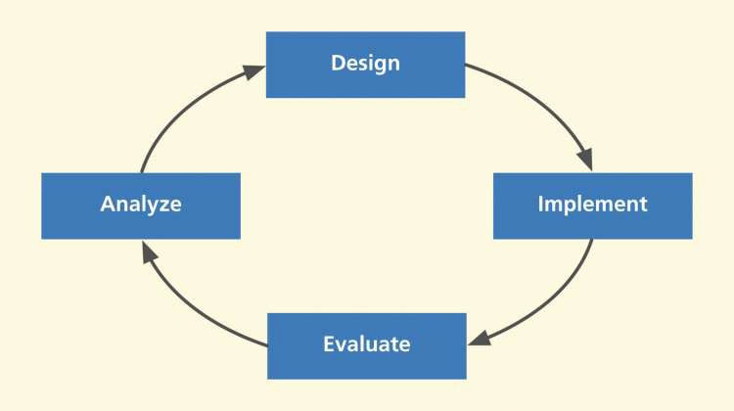
Four basic abstract activities
© Kristian Secor 2020 UC San Diego Extension Online Learning Course: User Interface Design

Slide 4

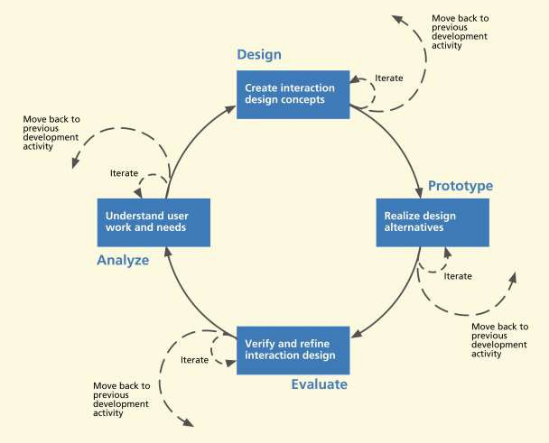
How these fit into the Wheel
© Kristian Secor 2020 UC San Diego Extension Online Learning Course: User Interface Design

Slide 5

Flow among activities for UX
Activities can iterate, overlap
Process managed with activity transition criteria
Main goal: Move forward to production
© Kristian Secor 2020 UC San Diego Extension Online Learning Course: User Interface Design

Slide 6

Managing progress within lifecycle
Team must be able to decide:
When to leave an activity
Where to go after any given activity
When to revisit a previous process activity
© Kristian Secor 2020 UC San Diego Extension Online Learning Course: User Interface Design

Slide 7

Managing progress within lifecycle
Team must be able to decide:
When to stop making transitions and proceed to production
Answers depend on transition criterion at end of each process activity
Based on whether designers have met goals and objectives for current iteration
© Kristian Secor 2020 UC San Diego Extension Online Learning Course: User Interface Design

Slide 8
Managing progress within lifecycle
Resources limits
Especially time and budget
Can trump other criteria for stopping process
© Kristian Secor 2020 UC San Diego Extension Online Learning Course: User Interface Design

Slide 9

Project parameters influence choice of process
Tolerance for risk
Of things going wrong
Of features or requirements being missing
Of not meeting needs of users
The less tolerance for risks—the more need for rigor and completeness in process
© Kristian Secor 2020 UC San Diego Extension Online Learning Course: User Interface Design

Slide 10
Project parameters influence choice of process
Project goals: goal-oriented process choices
Project resources: budget, schedule, person power, skills (people with extensive experience and maturity need less rigorous process)
© Kristian Secor 2020 UC San Diego Extension Online Learning Course: User Interface Design

Slide 11
Project parameters influence choice of process
Type of system being designed (for example, mp3 player vs. air traffic control system)
Development organizational culture (organizational history, traditions, market position, urgency to market)
Stage of progress within project
© Kristian Secor 2020 UC San Diego Extension Online Learning Course: User Interface Design

Slide 12

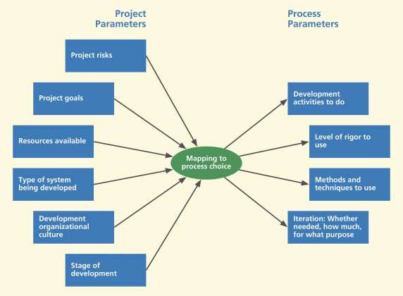
Mapping project parameters to process choices
© Kristian Secor 2020 UC San Diego Extension Online Learning Course: User Interface Design

Slide 13

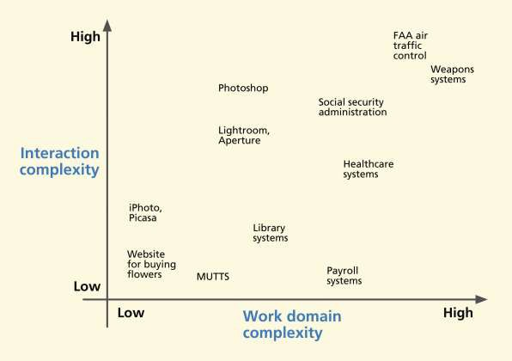
The system complexity space
© Kristian Secor 2020 UC San Diego Extension Online Learning Course: User Interface Design

Slide 14
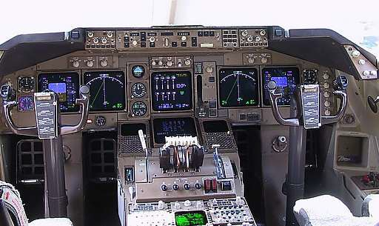
Interaction complexity
About intricacy or elaborateness of user actions
Includes cognitive density
© Kristian Secor 2020 UC San Diego Extension Online Learning Course: User Interface Design

Slide 15
Work domain complexity
High work domain complexity
Convoluted and elaborate work flow mechanisms
Collaborative work flow
Dependencies and constraints
Example, geological fault analysis for earthquake prediction
© Kristian Secor 2020 UC San Diego Extension Online Learning Course: User Interface Design

Slide 16

Influence of system type on process choice
Complex interaction, complex work domain ➔ strong requirement for rigorous process
o Example, air traffic control system, air traffic controller deciding landing orders for incoming airliners
© Kristian Secor 2020 UC San Diego Extension Online Learning Course: User Interface Design

Slide 17
Influence of system type on process choice
Simple interaction, complex work domain
User tasks relatively simple and easy to understand
But domain complexity calls for more attention to contextual inquiry and analysis, modeling, and requirements
© Kristian Secor 2020 UC San Diego Extension Online Learning Course: User Interface Design

Slide 18
Influence of system type on process choice
Simple interaction, complex work domain
Need insight into internal system complexity and complex rules and compliance requirements
Example, tax preparation software
© Kristian Secor 2020 UC San Diego Extension Online Learning Course: User Interface Design

Slide 19
Influence of system type on process choice
Complex interaction, simple work domain
Emphasis on design, ideation, and sketching, plus evaluation within real usage
Example, designing a digital watch
Attention needed for interaction design: task interaction structure, screen layouts, user actions, metaphors
© Kristian Secor 2020 UC San Diego Extension Online Learning Course: User Interface Design

Slide 20
Influence of system type on process choice
Simple interaction, simple work domain
Smaller Websites, certain interactive applications, some commercial products
Can be need for focus on emotional impact factors such as aesthetics, fun, joy of use
Example, designing a new mp3 music player
© Kristian Secor 2020 UC San Diego Extension Online Learning Course: User Interface Design

Slide 21
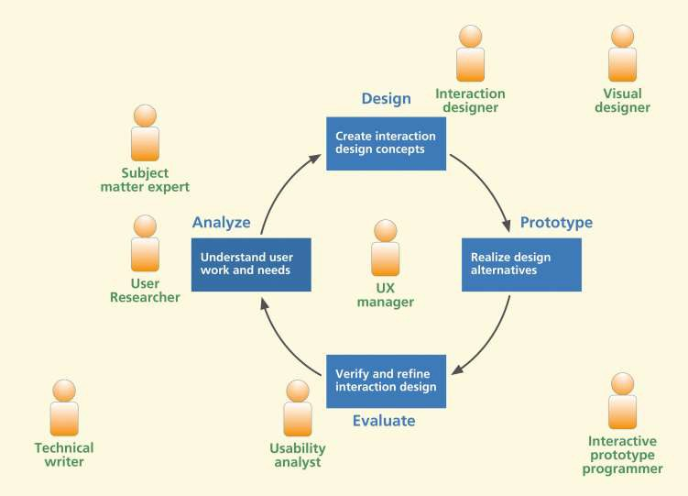
Meet the user interface team
© Kristian Secor 2020 UC San Diego Extension Online Learning Course: User Interface Design

Slide 22

Meet the user interface team
Project manager
Lead UX designer
User researcher
o For contextual inquiry and other work domain analysis activities
Users, user representatives, customers, and subject matter experts
© Kristian Secor 2020 UC San Diego Extension Online Learning Course: User Interface Design

Slide 23
Meet the user interface team
Interaction designer
For ideation and sketching, conceptual and detailed design, and low-fidelity prototyping activities
UX analyst or evaluator
For planning and performing UX evaluations, analyzing UX problems, and suggesting redesign solutions
Slides adapted from the UXBook Supplmentary Materials at http://www.theuxbook.net/

Slide 24
Meet the user interface team
Visual/graphic designer
For designing look and feel and branding and helping interaction designers with visual aspects of designs
Technical writer
For documentation, help system design, and language aspects of interaction designs
© Kristian Secor 2020 UC San Diego Extension Online Learning Course: User Interface Design

Slide 25
Meet the user interface team
UI programmer
For programming interactive high-fidelity UX design prototypes
To implement interaction designs in system software
UX manager
Overall responsibility for UX process
© Kristian Secor 2020 UC San Diego Extension Online Learning Course: User Interface Design

Slide 26
Iteration
Iteration is good, but not enough
Iteration can help you converge locally
Cannot just start with any old design and iterate yourself to quality user experience
© Kristian Secor 2020 UC San Diego Extension Online Learning Course: User Interface Design

Slide 27
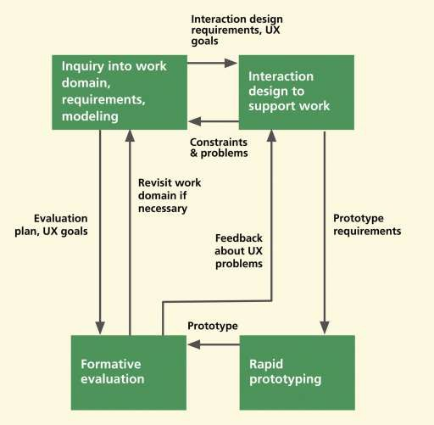
UX iteration scope limited
UX iteration not same as multiple passes through whole development
Limited to small, early, lightweight, inexpensive part of overall lifecycle process
© Kristian Secor 2020 UC San Diego Extension Online Learning Course: User Interface Design

