Slide 1

Session #14:Overview

Slide 2
Developing Plugins
Part of jQuery’s beauty is its simplicity.
DRY – Don’t Repeat Yourself
By extending jQuery, you create reusable components that can be used on any web page.
Your code is encapsulated and there is less risk that you will use the same function names elsewhere.
Similar to JavaScript’s prototype functionality

Slide 3
Javascript Prototype Example
Date.prototype.myMet=function(){
if (this.getMonth()==0){this.myProp="January"}; if (this.getMonth()==1){this.myProp="February"}; if (this.getMonth()==2){this.myProp="March"};
if (this.getMonth()==3){this.myProp="April"}; if (this.getMonth()==4){this.myProp="May"}; if (this.getMonth()==5){this.myProp="June"}; if (this.getMonth()==6){this.myProp="July"};
if (this.getMonth()==7){this.myProp="August"};
if (this.getMonth()==8){this.myProp="September"}; if (this.getMonth()==9){this.myProp="October"};
if (this.getMonth()==10){this.myProp="November"}; if (this.getMonth()==11){this.myProp="December"};}
function myFunction(){ var d = new Date(); d.myMet();
var x=document.getElementById("demo");
x.innerHTML=d.myProp;
}
myFunction();

Slide 4
Using Plugins
The idea of a plugin is to do something with a collection of elements.
You could consider each method that comes with
the jQuery core a plugin, like .fadeOut() or
.addClass() .
You can make your own plugins and use them privately in your code or you upload them to the jQuery plugin registry

Slide 5
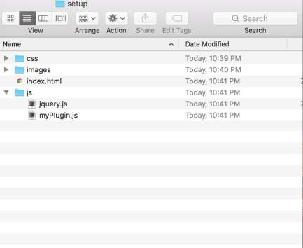
The SetUp
<script src="js/jquery.js"></script>
<script src="js/myPlugin.js"></script>

Slide 6
Creating a Plugin: The Basics
$( "a" ).css( "color", "red" );
So…..
jQuery.prototype is $.fn!!!!
$.fn.greenify = function() {
this.css( "color", "green" );
};
$( "a" ).greenify(); // Makes all the links green.

Slide 7
We can Chain with jQuery
Method chaining, also known as named parameter idiom, is a common syntax for invoking multiple method calls in object- oriented programming languages. Each method returns an object, allowing the calls to be chained together in a single statement without requiring variables to store the intermediate results.
https://en.wikipedia.org/wiki/Method_chaining

Slide 8
jQuery Chain Example
We can link multiple actions in a selector:
$.fn.greenify = function() { this.css( "color", "green" ); return this;
}
$( "a" ).greenify().addClass( "greenified" );

Slide 9
jQuery.noConflict()
<script src="other_lib.js"></script>
<script src="jquery.js"></script>
<script>
$.noConflict();
jQuery( document ).ready(function( $ ) {
// Code that uses jQuery's $ can follow here.
});
// Code that uses other library's $ can follow here.
</script>

Slide 10
Protecting the $ Alias and Adding Scope
(function ( $ ) {
$.fn.greenify = function() { this.css( "color", "green" ); return this;
};
}( jQuery ));

Slide 11
Using each in a plugin
$.fn.myNewPlugin = function() {
return this.each(function() {
// Do something to each element here.
});
};

Slide 12
A Best Practice
(function( $ ) {
$.fn.openPopup =
function() {
// Open popup code.
};
$.fn.closePopup =
function() {
// Close popup code.
};
}( jQuery ));
(function( $ ) {
$.fn.popup = function( action ) {
if ( action === "open") {
// Open popup code.
}
if ( action === "close" ) {
// Close popup code.
}
};
}( jQuery ));
VS.

Slide 13
Accepting Options
(function ( $ ) {
$.fn.greenify = function( options ) { var settings = $.extend({
color: "#556b2f", backgroundColor: "white"
}, options );
return this.css({ color: settings.color,
backgroundColor: settings.backgroundColor
});
eg:
$( "div" ).greenify({ color: "orange"
});
};
}( jQuery ));

Slide 14
So what is helpful?
(function( $ ) {
$.fn.showLinkLocation = function() { this.filter( "a" ).each(function() { var link = $( this );
link.append( " (" + link.attr( "href" ) + ")" );
});
return this;
};
}( jQuery ));
// Usage example:
$( "a" ).showLinkLocation();
<!-- Before plugin is called: -->
<a href="page.html">Foo</a>
<!-- After plugin is called: -->
<a href="page.html">Foo (page.html)</a>

Slide 15
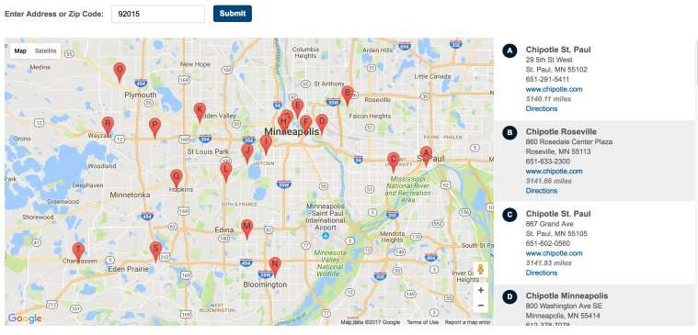
jQuery Store Locator
$(function() {
$('#somediv).storeLocator();
});

Slide 16
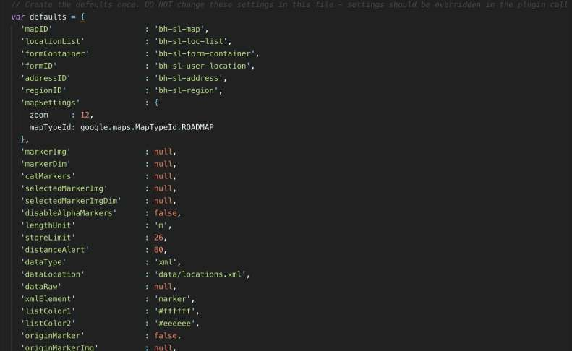
Locator Settings

