Slide 1
Chapter 7. Usage Research Data Elicitation (Contextual Inquiry)
Notes:
Discussion item #1

Slide 2
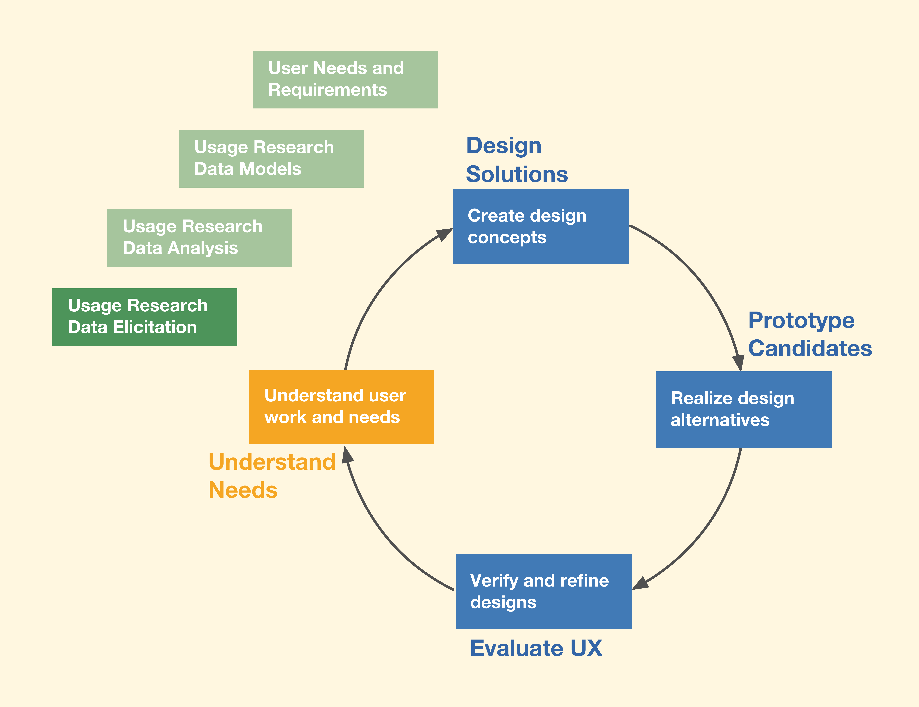

Slide 3
Usage research (1)
To understand customer’s work practice
To inform design/redesign
To improve work practice and construct and/or improve system designs to support it
Usage research is major UX method for the Understand Needs lifecycle activity
Gather detailed descriptions of customer or user work practice

Slide 4
Usage research (2)
Not about “requirements” in traditional sense
Not asking users what they want or need
Rather, it’s the difficult task of understanding user’s work in context
How works gets done, what the breakdowns are, etc.

Slide 5
Data elicitation sub-activity
First step within the Understand Needs lifecycle activity
All about gathering raw usage research data
Learning about existing work and work practice

Slide 6
Work
We start with mostly system perspective and rigorous approach
Work: Set of activities people undertake to accomplish goals in work domain
Some activities entail system or product usage
Example: Using a CAD/CAM application to design an automobile
“Work” includes play, if it is a goal of user

Slide 7
Work domain
Work domain: Entire context of work and work practice in target enterprise or other target usage environment
Complete context of work practice
Context essential to understand the work

Slide 8
Work practice
Work practice: How people do their work
Instantiation of the work domain by a particular team/company
Is carried out in customary performance of a particular job to carry out operations of enterprise
Involves learned skills, decision making, physical actions, and social interaction
Can be based on tradition, ritualized, and habituated

Slide 9
Work practice
Work practice is pattern of
Procedures
Established actions
Approaches
Routines
Conventions
Customs
Protocols
Physical actions
Manual activities

Slide 10
Usage research: Preparation (1)
For system with complex work domain
Get feel for customer’s organizational policies and ethos
Look at their online presence
Website
Participation in social networks
Understand vocabulary and technical terms of work domain

Slide 11
Usage research: Preparation (2)
Learn about competition
Learn about culture of work domain in general
Example: Conservative financial domain vs. laid-back art domain
Recognize differences in perspectives between managers and users

Slide 12
Decide on data sources
Users of current product or system
Subject-matter experts (SMEs)
Focus groups: Group work practice discussions
User surveys
Competitive analysis
We will continue with users and you can adapt process to other data sources

Slide 13
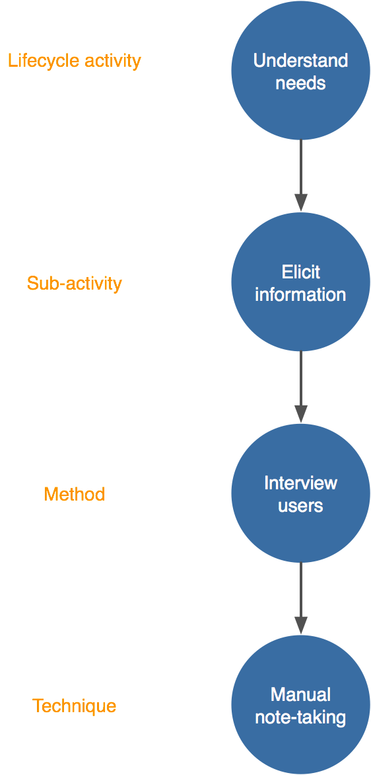
Example: Data Elicitation sub-activity instance

Slide 14
Need for both observation and interviewing
Interviewing: What they say
Get them to think aloud while working
Narration can add “hidden” information
Observing: What they do
See actual behavior, which often differs from what they say

Slide 15
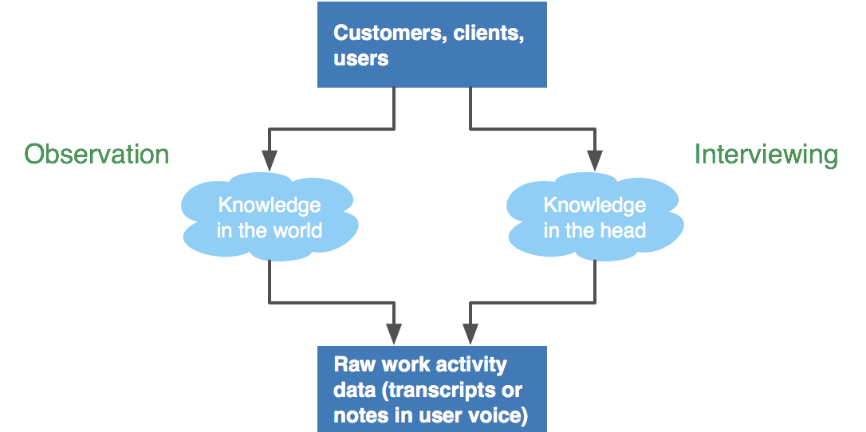
Usage research data elicitation

Slide 16
Issues about your team
Decide how many people to send on visits
UX people and other team members
Set own limits on number of visits and number of team members
Depending on your budget and schedule
Plan interview and observation strategy (who in team does what)

Slide 17
Lining up right client and user people

Slide 18
(1)
Select and contact appropriate client management or users
Explain need for a visit: Can’t do this without them
Explain purpose of visit: To learn about their work activities
Explain approach: For them actually to do the work while you are there to observe
Obtain permission to observe and/or interview users at work

Slide 19
(2)
Build rapport and trust
Guarantee personal and corporate confidentiality
Ensures freedom to speak out about problems
Explain that you want to see broadest representation of users and work
Establish or negotiate various parameters
How often to visit?
How long you will/can be there per visit?

Slide 20
(3)
How long for average individual interview?
Maximum number of interviews per visit?
Select and contact appropriate support people
Determined by management people
Arrange logistics for visits

Slide 21
(4)
Identify appropriate people to meet, observe, and interview: customers, users
Especially frequent users, managers
Cover as many usage roles as possible
Usage role defined by the job, not the person
Examples: Ticket buyer, ticket seller
What if you cannot find real users?

Slide 22
Lining up the right environment
Plan visits to multiple sites if they exist
Set up right conditions (real work context)
Prepare a list of initial questions

Slide 23
Focus of data elicitation (1)
Are we gathering data on an existing system or a new system?
You are thinking ahead about new system
But usage research inquiry is about the way things are done now
If you are gathering data on the new system, you are not doing data elicitation
You are doing requirements (this happens a lot; just be aware)

Slide 24
Focus of data elicitation (2)
However, if the proposed new product/system is different enough from the old
At end of each data elicitation session can ask:
“In what ways might you want to use the features of the proposed new product/system?”

Slide 25
During visit: Collecting user work activity data

Slide 26
(1)
When you first arrive
Meet client, manager, administrator, or supervisor
Keep building trust and rapport
Remember goal
Don’t ask users what they want or need
“If I had asked people what they wanted, they would have said, faster horses” — Henry Ford

Slide 27
(2)
Observe users in own work context
Ask users about how they do their work
“Think aloud” data elicitation technique
Form partnerships with users
User is “expert” (in the work domain)
You are the person from outside

Slide 28
(3)
Stream-of-consciousness notes
Capture what is happening
Hand-written are often best (think “police detective”)
Laptop can be a hindrance, distraction
No video recording, for many reasons
Possible audio notes to yourself
Digital photos of physical layout, users doing their work

Slide 29
(4)
Sketch diagrams of physical layout
Collect artifacts of the work practice (e.g., forms that flow through the system)
How to be a good usage research data gatherer
Be a listener
Usually do not offer your opinions about what users might need
Do not lead user or introduce your own perspectives

Slide 30
(5)
Do not expect every user to have same view of work domain and work
Ask questions about differences and find ways to combine to get “truth”
Capture details as they occur
Do not wait and try to remember it later
Follow leads
Collect “clues”
Be ready to adapt, modify, explore, and branch out

Slide 31
(6)
Be an effective data ferret or detective
Discover, extract, “tease out”
Pay attention to information needs of users
What about design ideas that crop up with users?
What about analyst and designer ideas that crop up?

Slide 32
Look For
Surprises
Problem areas and barriers to performance
Emotional and social aspects
Meaningfulness (long-term emotional impact) in work or play practice
Opportunities for “shadowing”
Document the customer journey
Example: Being processed within a large health organization

Slide 33
Anticipating modeling needs in data elicitation
Many of the data models will already be started
Instead of writing data notes for these, just add to the model (or start the model)
Example: Add an arc to a flow diagram

Slide 34
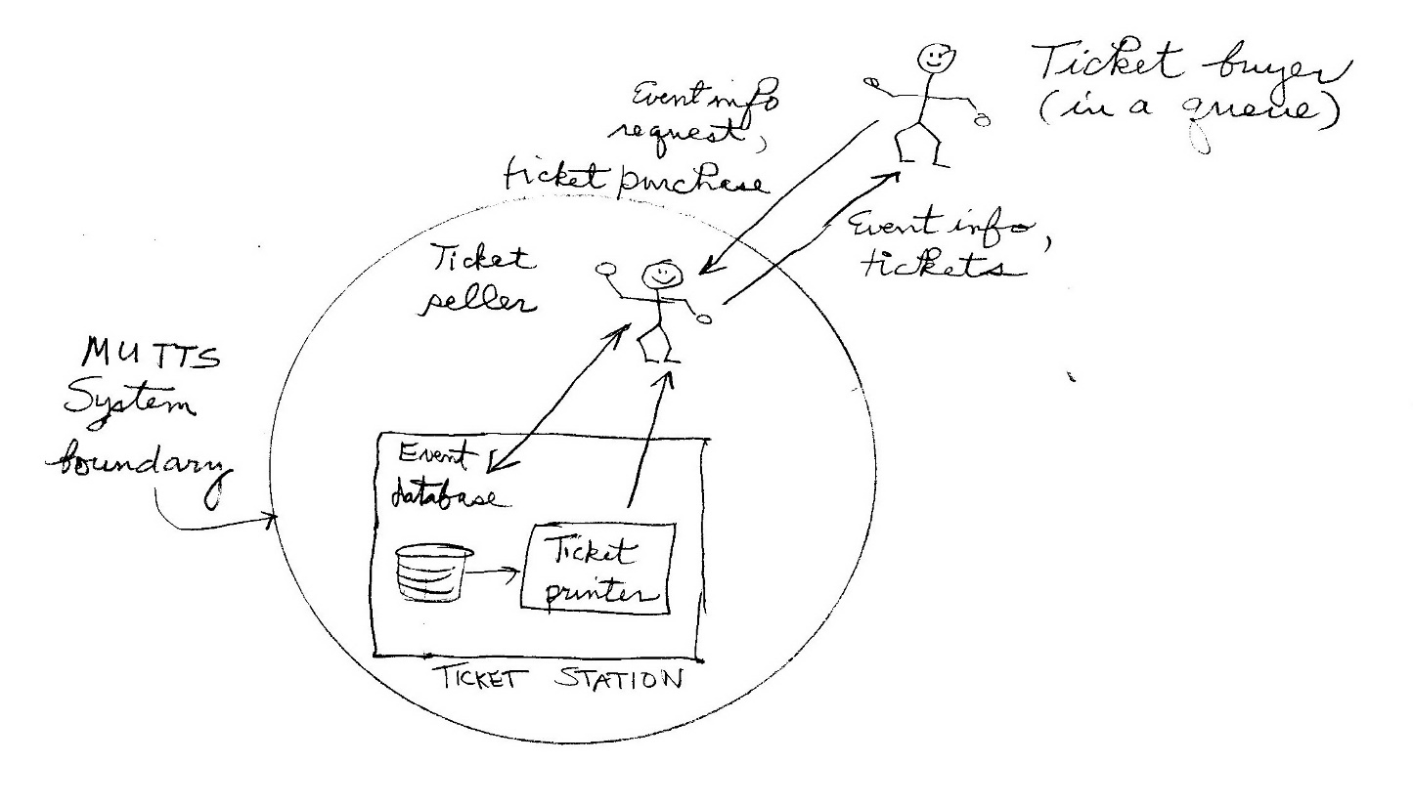
Anticipating modeling needs in data elicitation
Examples continued
Flow model
Sketch as diagram
34

Slide 35
Information categories for data models (1)
User work roles: Jobs users perform
User personas: Specific user characteristics
Inputs to user stories: Narratives describing features, capabilities
Work practice artifacts: Information and other things users employ, manipulate, share
Examples: Menus, order forms, work orders

Slide 36
Information categories for data models (2)
Flow of information and artifacts: Note how information and artifacts flow among user roles and parts of system (e.g., a central database)
User tasks: Task structure and task sequencing descriptions (task steps)
Physical work environment: Descriptions, photos of work environment
Information architecture: Information objects users access, manipulate, share

Slide 37
Anticipating modeling needs in data elicitation (1)
Example: Identify user work roles
User work role is a job, not a person
For user work role model, identify:
User work (or play) roles as early as possible (Example: ticket seller)
Any sub-roles (Example: student ticket buyer)
User class characteristics (descriptions of people who can fill the corresponding role)

Slide 38
Anticipating modeling needs in data elicitation (2)
Identify key tasks
Hierarchical task structure
Task interaction sequences

Slide 39
Rapid methods for data elicitation
Not every project needs high rigor
Less needed in product perspective
Over time, diminished need for rigor in UX field
Our craft is maturing
Principle of UX design work: Always work as fast as conditions permit
Do just what contributes to project goals
Working faster avoids waste and reduces costs

Slide 40
Abbreviations of rigorous data elicitation methods (1)
Interview and observe fewer users
Fewer but more experienced users
Get the most out of each session
Make fewer client visits
Take fewer and more efficient data notes
Only the really important ones
Increased efficiency, usually without downside

Slide 41
Alternative to rigorous data elicitation methods (2)
Use other data sources
Be your own domain expert
If you have the experience and knowledge
Subject-matter expert (SME) interviews
Especially if access to real users is limited

Slide 42
Wrap it up
Do not overstay your welcome
Be efficient, get what you need, and get out of their way
Limit interviews to no more than two hours

Slide 43
Example for in-class exercises: The SmartFridge
This is the team project for you in several upcoming in-class exercises
Think of the lowly refrigerator in your kitchen
Think of the potential for UX design if the fridge could be connected to the Internet

Slide 44
In-class exercise: Usage research data elicitation

Slide 45
(1)
Break team into two sub-teams: The interviewers (say, 3 people) and the representative users (say, 2 or 3 people)
The interviewers should ask the interviewees to recollect their usage of refrigerators
Focus on context, breakdowns, key tasks, ecology, and so on
Ask them to think about how that usage fits into the context of the rest of their lives, at home and outside the home

Slide 46
(2)
This is a case where you should ask about how they might want to use the proposed new product/system, too
Look especially for any emotional impact data and look at long-term usage, not just short snapshots of usage.

Slide 47
(3)
During the interviews, take raw data notes on paper or a laptop
Take as many “finished” work activity notes as possible (skip the raw data)
In anticipation of the later conversion of your raw contextual data into separate work activity notes, keep your raw data notes modular
Use short sentences, each with a single thought or fact or point

Slide 48
(4)
After class, continue to interview more people outside your team and outside the class, to get more data points
Your team should have up to 100 different raw data points
Don’t over-do it; it’s just an exercise
Write the essence of each note on a single Post-it “sticky” note (supplied)

