Slide 1
Chapter 31. The Interaction Cycle

Slide 2
The User Interaction Cycle
Characterizes sequences of sensory, cognitive, and physical actions by user during interaction with a machine
Our adaptation of Norman’s “stages of action” model
Provides framework for analyzing UX design issues and UX problems in terms of user action categories

Slide 3
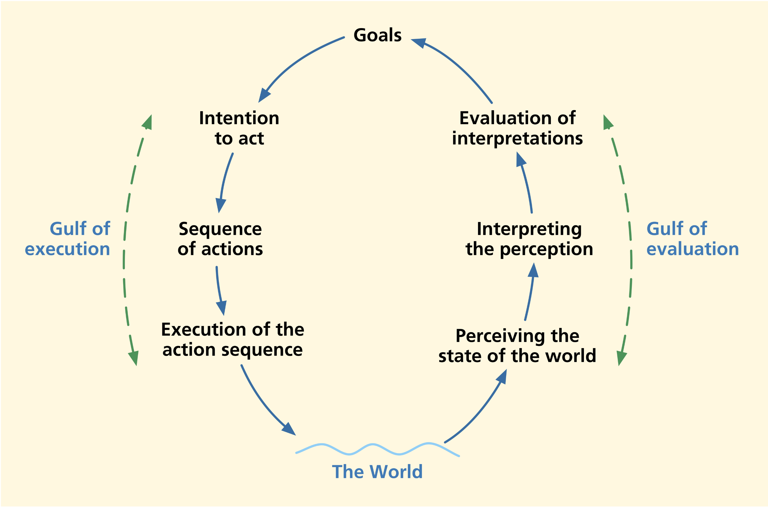
Norman’s "Stages of Action“ model
Generic view of user actions in interaction with almost any kind of machine

Slide 4
Execution side of model
Left-hand side of figure
  Establish goal (e.g., edit a document)
  Decompose into intentions (need to open document)
  Map intentions to action sequence specifications (click on Open button)

Slide 5
Gulf of execution
Users need help in knowing what actions to make on what objects
A language gap: From the language of the work domain (e.g., wanting to feel warmer) to the language of the system (e.g., turning up the thermostat)
The gulf of execution lies in between knowing desired effect and knowing what action to take
The UX designer’s job: Design interaction to help user form correct model of how it works

Slide 6
Gulf of evaluation
User needs help in knowing whether action had the expected outcome
Depends on system feedback to reflect state change within system
Also a language gap: System state in terms of internal system variables to the language of the users’ work domain
User perceives, interprets, and evaluates outcome with respect to goals and intentions via system feedback

Slide 7
Adapting Norman’s model to our Interaction Cycle
Partitioning the stagers
Adding “Outcomes” and “System response”

Slide 8
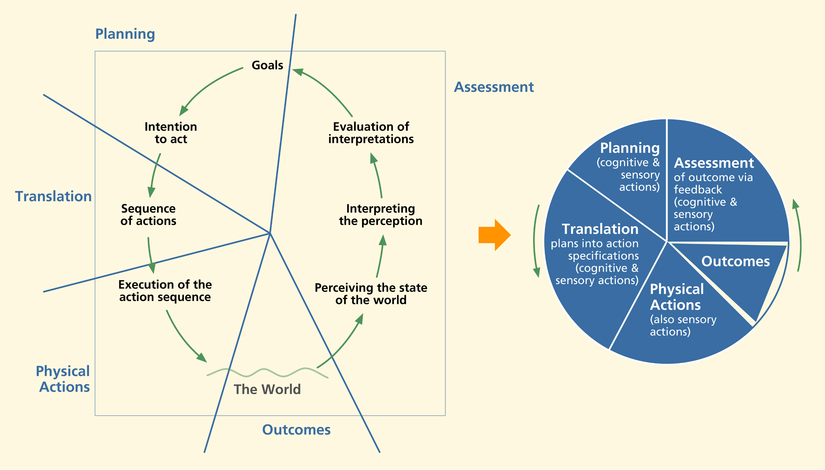
Transition To Interaction Cycle

Slide 9
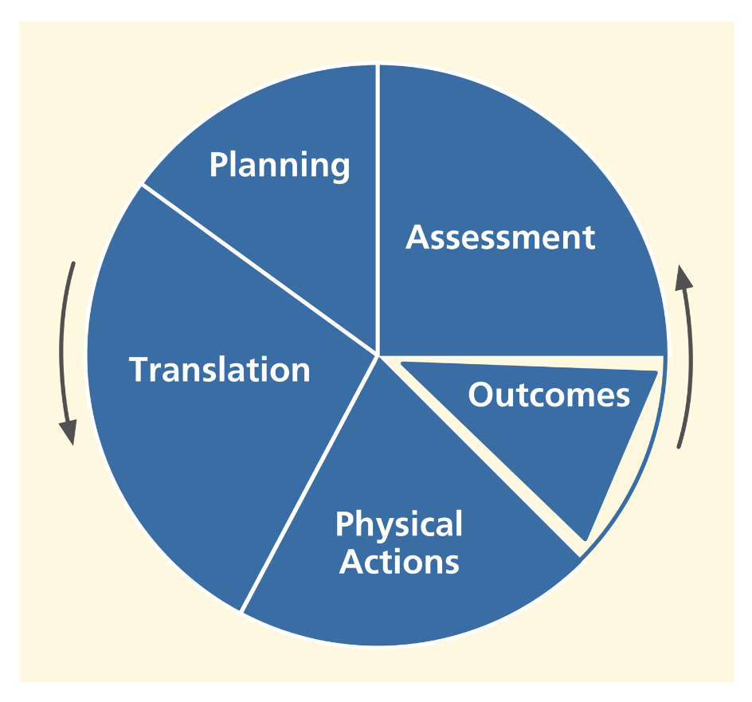
The Interaction Cycle
Planning
Translation to determine actions
Physical actions
Outcome
Assessment of outcome

Slide 10
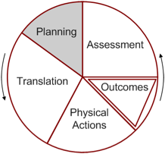
Planning
Design helping user know what to do
Provide clear model of how users view system in terms of tasks
  Help users with system model, metaphors, work context
  Help users plan goals, tasks
  Help users decompose tasks logically
Occurs in work domain (travel), not in system domain (operating a car)

Slide 11
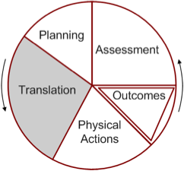
Translation
Design helping user know what actions to make on what objects
Provide effective cognitive affordances – cues (e.g., in labels, data field formats, icons) that help users get access to system functionality
Maps to system domain (operating the steering wheel, brakes of a car)

Slide 12
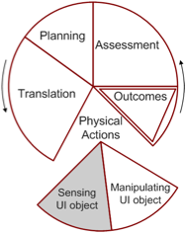
Physical Actions
Design helping user do the actions
  Example: Clicking, dragging, touching
Includes haptics, direct manipulation, embodied interaction, physical fatigue, manual dexterity, physical disabilities
No cognitive component

Slide 13
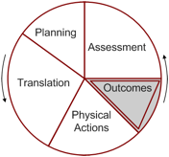
Outcomes
Internal, invisible effect or result within system
State change triggered by user’s physical actions
  Often involves computation, functionality
  UX designer must make visible via feedback in system response

Slide 14
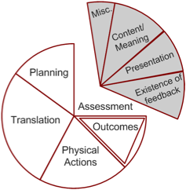
Assessment
Design helping user know if interaction was successful
Evaluation component of the cycle
User perceives feedback representing outcomes
  Interprets in terms of success or failure of interaction

