Slide 1

Session #7: Overview
© Kristian Secor 2017 UC San Diego Extension Online Learning Course: HTML5 and JavaScript

Slide 2
Week 7
Storage
Debugging Javascript
Error Handling
Code Quality
© Kristian Secor 2017 UC San Diego Extension Online Learning Course: HTML5 and JavaScript
2

Slide 3
Using HTML5 Storage
Limitations in current browsers:
5 MB of storage from each origin.
Can not ask user for more
localStorage is permanent (Unless they know how to clear it)
sessionStorage is temporary (Based on the user session)
© Kristian Secor 2017 UC San Diego Extension Online Learning Course: HTML5 and JavaScript
2

Slide 4
Examples
How to set a localStorage token: localStorage.setItem(‘language’,’English’);
How to retrieve that a token:
var language = localStorage.getItem(‘language’);
© Kristian Secor 2017 UC San Diego Extension Online Learning Course: HTML5 and JavaScript
2

Slide 5
The same works for sessionStorage
sessionStorage.setItem(‘loggedin’,true); var status = sessionStorage.getItem(‘loggedin’);
if (status === true) {
//show password protected content
}
© Kristian Secor 2017 UC San Diego Extension Online Learning Course: HTML5 and JavaScript
2

Slide 6
We can clear these tokens
sessionStorage.removeItem(‘loggedin’);
…or clear all tokens
sessionStorage.clear();
..and of course localStorage has the same methods.
© Kristian Secor 2017 UC San Diego Extension Online Learning Course: HTML5 and JavaScript
2

Slide 7
Debugging Javascript
Recognize error types
Trace errors with dialog boxes and the console
Use comments to locate bugs
Trace errors with debugging tools
Write code to respond to exceptions and errors
© Kristian Secor 2017 UC San Diego Extension Online Learning Course: HTML5 and JavaScript
7

Slide 8
Understanding Syntax Errors
Syntax errors
Occur when interpreter fails to recognize code ir: var kris = “teacher;
Causes
Incorrect use of JavaScript code
References to non-existent objects, methods, variables

Slide 9
Handling Run-Time Errors
Run-time errors
Occur when interpreter encounters a problem while program executing
Not necessarily JavaScript language errors
Occur when interpreter encounters code it cannot execute
Run-time error can be caused by a syntax error

Slide 10
Logic Errors
Logic errors
Program’s design is flawed
Prevents program from running as anticipated
“Logic” reference
Execution of program statements and procedures in the correct order to produce the desired results

Slide 11
Logic Errors Example
Example: infinite loop
for (var count = 10; count >= 0; count) { console.log("We have liftoff in " + count);
}
Example: infinite loop corrected
for (var count = 10; count >= 0; count--) {
console.log("We have liftoff in " + count);
}

Slide 12
Interpreting Error Messages
First line of defense in locating bugs
Browser console displays
Line number where error occurred
Error description
Run-time errors
Error messages generated by a web browser
Can be caused by syntax errors but not by logic errors
Example:test.html:4 Uncaught SyntaxError: Unexpected end of input
function missingClosingBrace() {
var message = "This function is missing a closing brace.";
window.alert(message);
© Kristian Secor 2017 UC San Diego Extension Online Learning Course: HTML5
and JavaScript
12

Slide 13
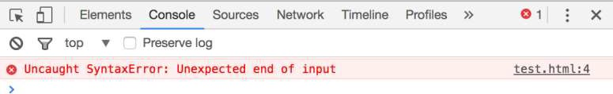
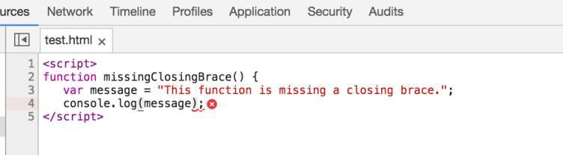
Interpreting Error Messages

Slide 14
Interpreting Error Messages
Error message
Displays error’s general location in a program
Not always accurate
Browsers do not strictly enforce JavaScript syntax
How to reduce bugs in JavaScript programs:
Always use good syntax
Thoroughly test with every browser type, version
Test browser if used by more than one percent of the market

Slide 15
Tracing Errors with the console.log() Method
Trace a bug by analyzing a list of values
Logging
writing values directly to the console using the console.log() method
syntax: console.log(value);
can log string literal, variable value, or combination
Example
calculateInterest() function
© Kristian Secor 2017 UC San Diego Extension Online Learning Course: HTML5 and JavaScript
15

Slide 16
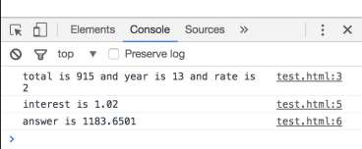
Tracing Errors (cont’d.)
var calculateInterest = function (total,year,rate) {
console.log("total is " + total + " and year is " + year + " and rate is " + rate);
var interest = rate/100+1; console.log("interest is " + interest);
var answer = parseFloat((total*Math.pow(interest,year)).toFixed(4))) ; console.log("answer is " + answer);
return answer;
}
var interestaccrued = calculateInterest(915,13,2);

Slide 17
Using Comments to Locate Bugs
Another method of locating bugs
“Comment out” problematic lines
Helps isolate statement causing the error
When error message first received
Start by commenting out only the statement specified by the line number in the error message
Continue commenting lines until error eliminated

Slide 18
Tracing Errors with Debugging Tools
Examining code manually
Usually first step taken with a logic error
Works fine with smaller programs
Debugging tools
Help trace each line of code
More efficient method of finding and resolving logic errors

Slide 19
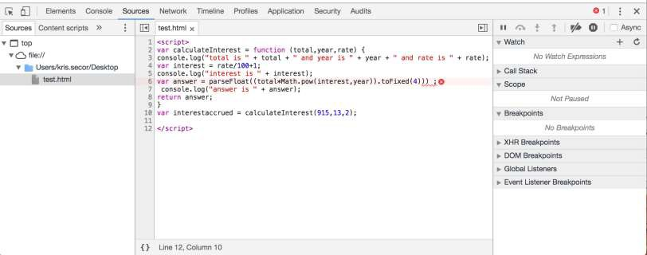
Understanding the Chrome Debugger

Slide 20
Setting Breakpoints
Break mode
Temporary suspension of program execution
Used to monitor values and trace program execution
Breakpoint
Statement where execution enters break mode
When program paused at a breakpoint
Use debug tools to trace program execution

Slide 21
Throwing Exceptions
Execute code containing an exception in a try statement
throw statement
Specifies an error message in case an error that occurs within a try block
try {
var lastName = document.getElementById("lName").value; if (lastName === "") {
throw "Please enter your last name.";
}
}

Slide 22
Catching Exceptions
Use a catch statement
Handles, or “catches” the error
Syntax:
catch(error) {
statements;
}
Example:
catch(lNameError) {
window.alert(lNameError); return false;
}

Slide 23
Executing Final Exception Handling Tasks
finally statement
Executes regardless of whether its associated try block throws an exception
Used to perform some type of cleanup
Or any necessary tasks after code evaluated with a try statement

Slide 24
Checking HTML Elements
If a bug cannot be located using methods described
here
Perform a line-by-line analysis of the HTML code
Ensure all necessary opening and closing tags included
Use code editor specialized for web development
Highlights syntax errors as you type
Use the W3C Markup Validation Service to validate a Web page: https://validator.w3.org/

Slide 25
Using Strict Mode
Strict mode
Removes some features from JavaScript
Requires more stringent syntax for other features
Example: must always use var to declare variables
Include statement "use strict";
Including at start of script section requests strict mode for all code in that section
Including at start of code block in function requests
strict mode just for that function

Slide 26
Reloading a Web Page/Clear Cache
Usually click the browser Reload or Refresh button
Web browser cannot always completely clear its memory
Remnants of an old bug may remain
Force web page reload
Hold Shift key and click the browser’s Reload or Refresh button
May need to close browser window completely
May need to delete frequently visited web pages

Slide 27
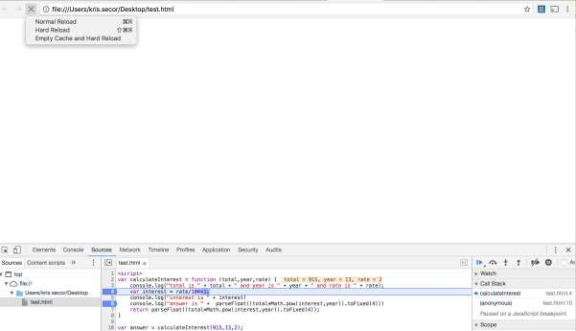
Clearing Cache
In Chrome, if you have your dev tools open, you can:
© Kristian Secor 2017 UC San Diego Extension Online Learning Course: HTML5 and JavaScript

Slide 28
Linting
Running code through a program that flags some common issues that may affect code quality
jslint is a commonly used linting program
Similar result to using strict mode, but generates a report containing line numbers
jslint.com
© Kristian Secor 2017 UC San Diego Extension Online Learning Course: HTML5 and JavaScript
28

