Slide 1
Session #2: Metaphors, Organization and Navigation
1
© Kristian Secor 2018 UC San Diego Extension Online Learning Course: User Experience Design I

Slide 2

Metaphors in the design sense..
a figure of speech in which an
expression is used to refer to something that it does not literally denote in order to suggest a similarity
It goes back to the all important concept "Recognition not recall".
2
© Kristian Secor 2018 UC San Diego Extension Online Learning Course: User Experience Design I

Slide 3

Metaphors for user experience
Many Reasons:
The abstract becomes concrete
The unfamiliar becomes familiar
Emotions can be triggered
Metaphors can draw attention
Metaphors can trigger action
2
© Kristian Secor 2018 UC San Diego Extension Online Learning Course: User Experience Design I

Slide 4


The Concrete:
How are these metaphors?
4

Slide 5


Becoming Familiar:
Graphic Designers know this all to well
4

Slide 6



Emotions are stirred:
4

Slide 7



Attention is drawn:
4

Slide 8



Action is invited:
4

Slide 9

On To
Organization
Organization is as important as our message
Remember Fitts’ Law?
Left to Right….
HCI
Let’s take a look:
4

Slide 10



Fitts’ Law
l First with Fitts:
l How many sites recognize this?
l How many mobile apps
l Will you use it in your case studies?
l How can you judge how important it is?
l Let’s look at a couple of examples
10
© Kristian Secor 2018 UC San Diego Extension Online Learning Course: User Experience Design I

Slide 11

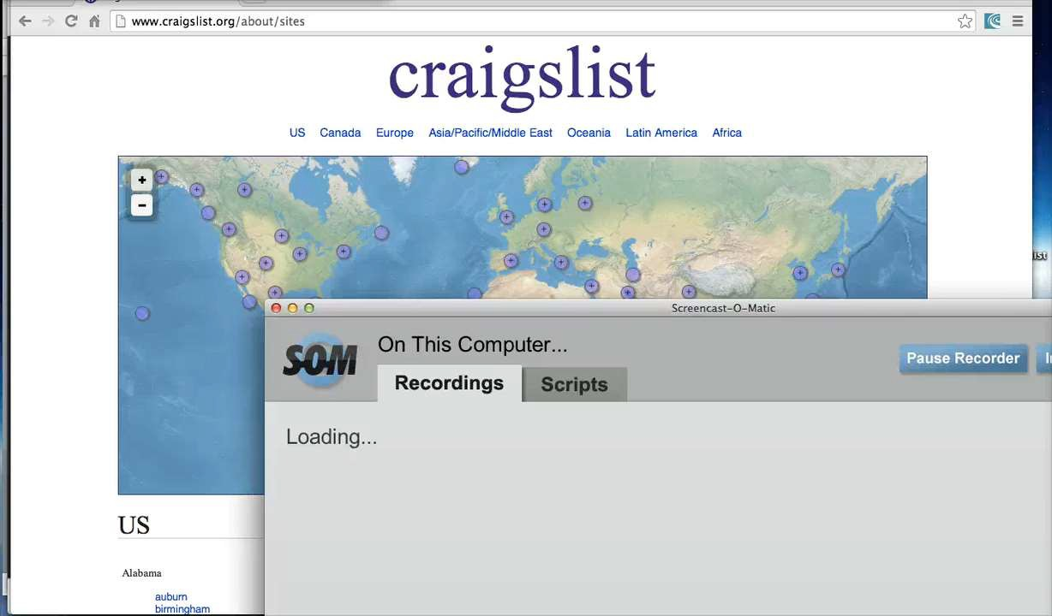
Site1: Craigslist

Slide 12

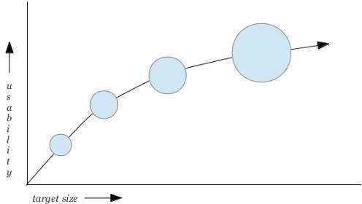
Size: Overrated?

Slide 13

Site2

Slide 14




So we’ve talked about size…
Now what about flow.
Does Fitts’ include the natural motion of moving a mouse left to right
Let’s look at a demo.

Slide 15




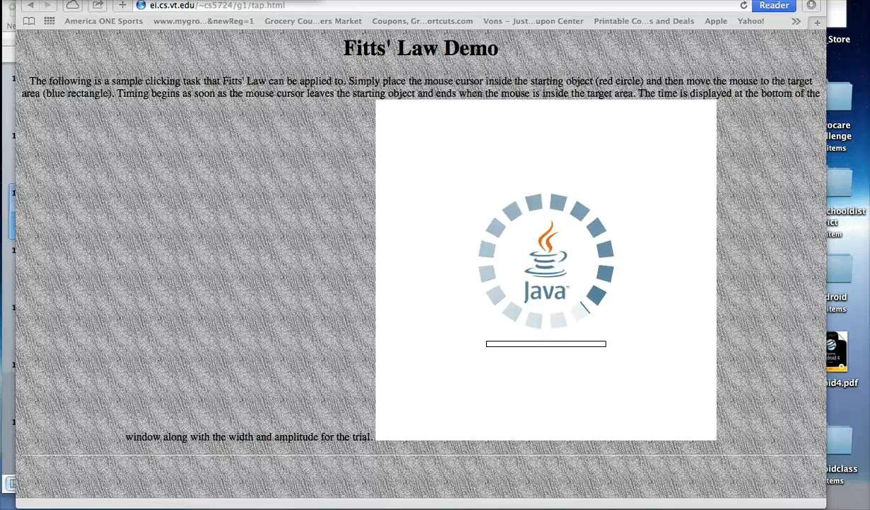
Fitts Demo….more than size and distance?

Slide 16

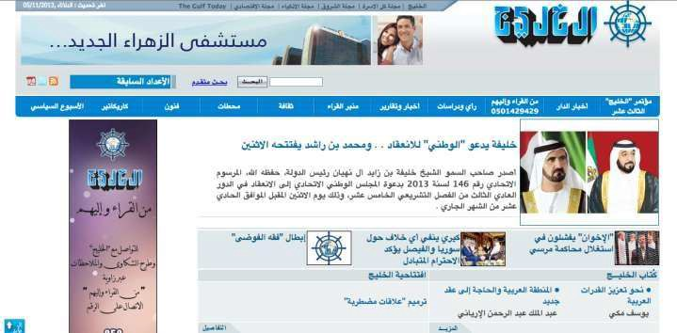
Al Khaleej Newspaper
Right to Left

Slide 17



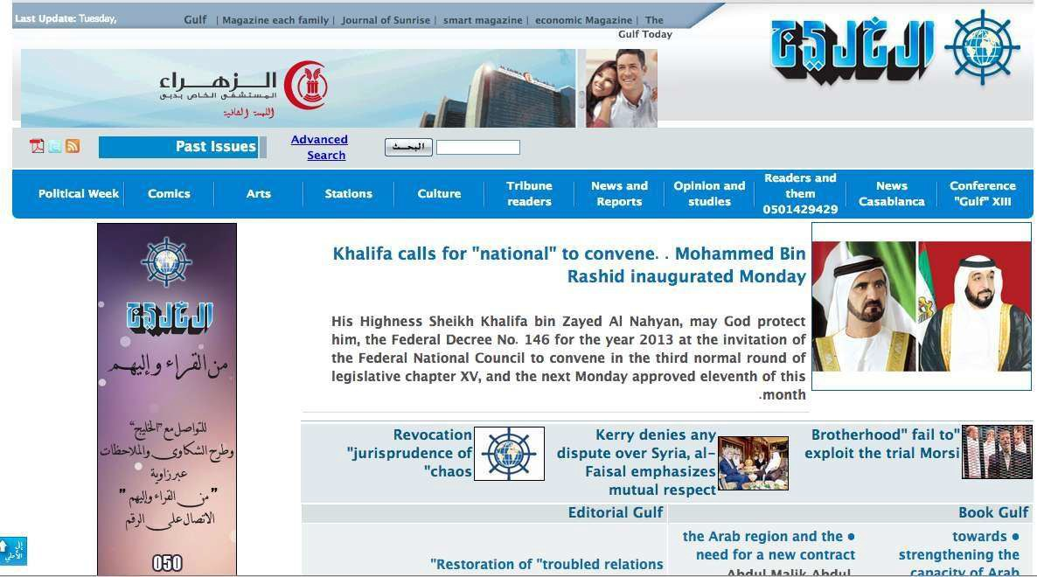
Now translated left to right:

Slide 18


Navigation
How do we judge?
Can we find things fast?
Can the layman find things fast what is the level of frustration

Slide 19


What to look for….
Navigation with way too many options.
Unimportant links in the primary navigation menu
Website Navigation designed for large screens only
Too many flyout submenus
Links don’t differentiate from the rest of the text
Different primary Navigation Bar for each webpage
Text labels that are way too long

Slide 20




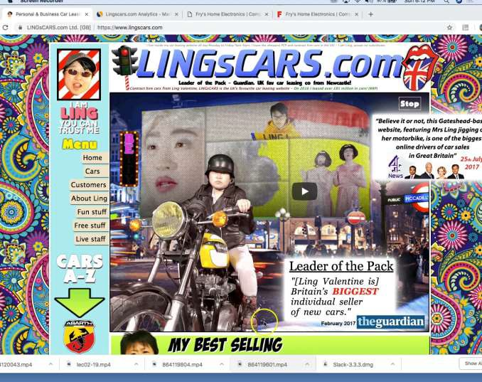
Lingscars, Frys Electronics, et al

Slide 21
Summary
So this week…
Metaphors
Organization
Navigation

