Slide 1

Session #1: Overview
© Kristian Secor 2017 UC San Diego Extension Online Learning Course: HTML5 and JavaScript

Slide 2
Week 1
What is JavaScript
How to run JavaScript
Where to put JavaScript
Semicolons
Brackets
Braces
Parentheses
Comments
Data Types
Variables

Slide 3
HTML5 with JavaScript
Javascript is ubiquitous
This course will focus on Javascript and its manipulation of web pages and html5
You will need to know some html5 and css3
You will need to produce a project

Slide 4
What is JavaScript?
Javascript is NOT supported identically by all browsers
NOT related to Java other than by name and some syntactic similarities
Built as a front end language, however there are frameworks such as node that have some embedded server sided functionality

Slide 5

JavaScript vs Java
interpreted, not compiled
more relaxed syntax and rules
fewer and "looser" data types
variables don't need to be declared
errors often silent (few exceptions)
key construct is the function rather than the class
"first-class" functions are used in many situations
contained within a web page and integrates with its HTML/CSS content

Slide 6
So what does JavaScript do?
Controls appearance
Forms
Stores data locally
Asynchronously connects to server (via ajax)
Can present data from an API
Has several built-in objects that can utilize helpful things like the date or math

Slide 7
Why use client-side programming?
client-side scripting (JavaScript) benefits:
usability: can modify a page without having to post back to the server (faster UI)
efficiency: can make small, quick changes to page without waiting for server
event-driven: can respond to user actions like clicks and key presses

Slide 8
Where to put Javascript
Script tag should be placed in HTML page's head:
<script src= ”js/filename.js” type= "text/javascript” >
</script>
Codeis stored in a separate .js file
JS code can be placed directly in the HTML file's body or head (like CSS)
but this is bad practice (should separate content, presentation, and behavior

Slide 9
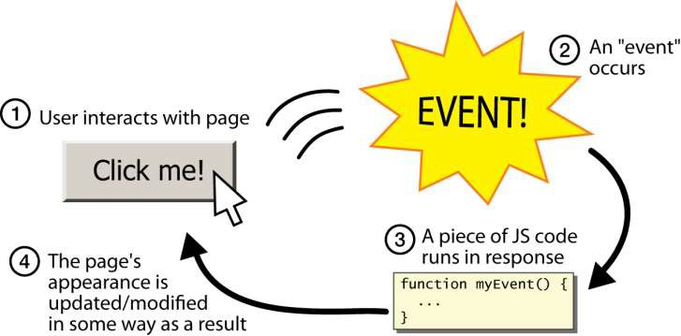
Event-driven programming

Slide 10
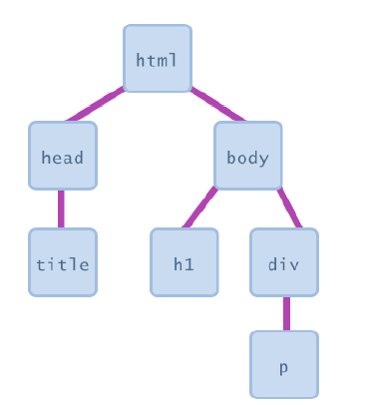
Document Object Model (DOM)
Most JS code manipulates elements on an HTML page
We can examine elements' state
e.g. see whether a box is checked
We can change state
e.g. insert some new text into a div
We can change styles
e.g. make a paragraph red

Slide 11
JavaScript Syntax
JavaScript programs are created with basic text editors just like your HTML web pages.
The JavaScript interpreter that will be running your code will look line-by-line through the code to see what to do.
In order for the interpreter to understand what you've written, there are some rules you must follow, i.e., syntax.

Slide 12
Semi-Colons
Semi-Colons end a statement
Use semi-colons as good practice
When you have statements on one line, the first semicolon is required
You may minify your code later and semicolons will help more clearly separate statements
Don’t put a semicolon after a closing curly brace unless you are assigning a variable to a something that has braces:
var something = {}; //NO!!!

Slide 13
Brackets
[] are used to group elements or create objects
var someGroup = [‘student1’,’student2’,’student3’];
This will all be repeated during the array and object section of this course

Slide 14
Braces
Creates Object:
var someObject = { }
Creates a group of statements:
var someFunction = function (){ statement1;statement2;
}

Slide 15
Parantheses
Supply parameters:
function callSomeCode (‘arg1’,’arg2’){
}
Group Expressions: var answer = (3*5) + 2;
Execute Functions: callSomeCode(‘arg1’,’arg2’);

Slide 16
Comments
Unlike html: <!-- →
Single Line Comment //
Multi-line comment /* */
Comment your code based on two assumptions:
Assume you will get amnesia!
Assume someone else will use your code!

Slide 17
Data-types
types are not specified, but JS does have types ("loosely typed")
Number, Boolean, String, Array, Object, Function, Null, Undefined
can find out a variable's type by calling
var someNumber = “5”; typeof(someNumber) //would equal String

Slide 18
Variables
var name = expression;
var clientName = ”Some Student";
var age = 32;
var weight = 127.4;
variables are declared with the var keyword (case sensitive)

Slide 19
Good Habits
Come up with your own style and stick to it. (Camel casing, Pascal casing, All Lower casing)
Comment out code before you code to keep your self on track
Declare Variables on top
Move your code to an external page based on function before you go live

Slide 20
Bad Habits
Not ending each statement with a semicolon
Not declaring variables where necessary
Not grouping your code for reuse
Not putting your code in an external file
More tips in a couple of weeks

Slide 21
The most important things!
Use Chrome or Firefox and get to know the console.
console.log
typeof
Now please see my screencast demo of all the aforementioned functionalities in the Lesson 1 folder

