Slide 1




Session #3: Requirements & Analysis

Slide 2
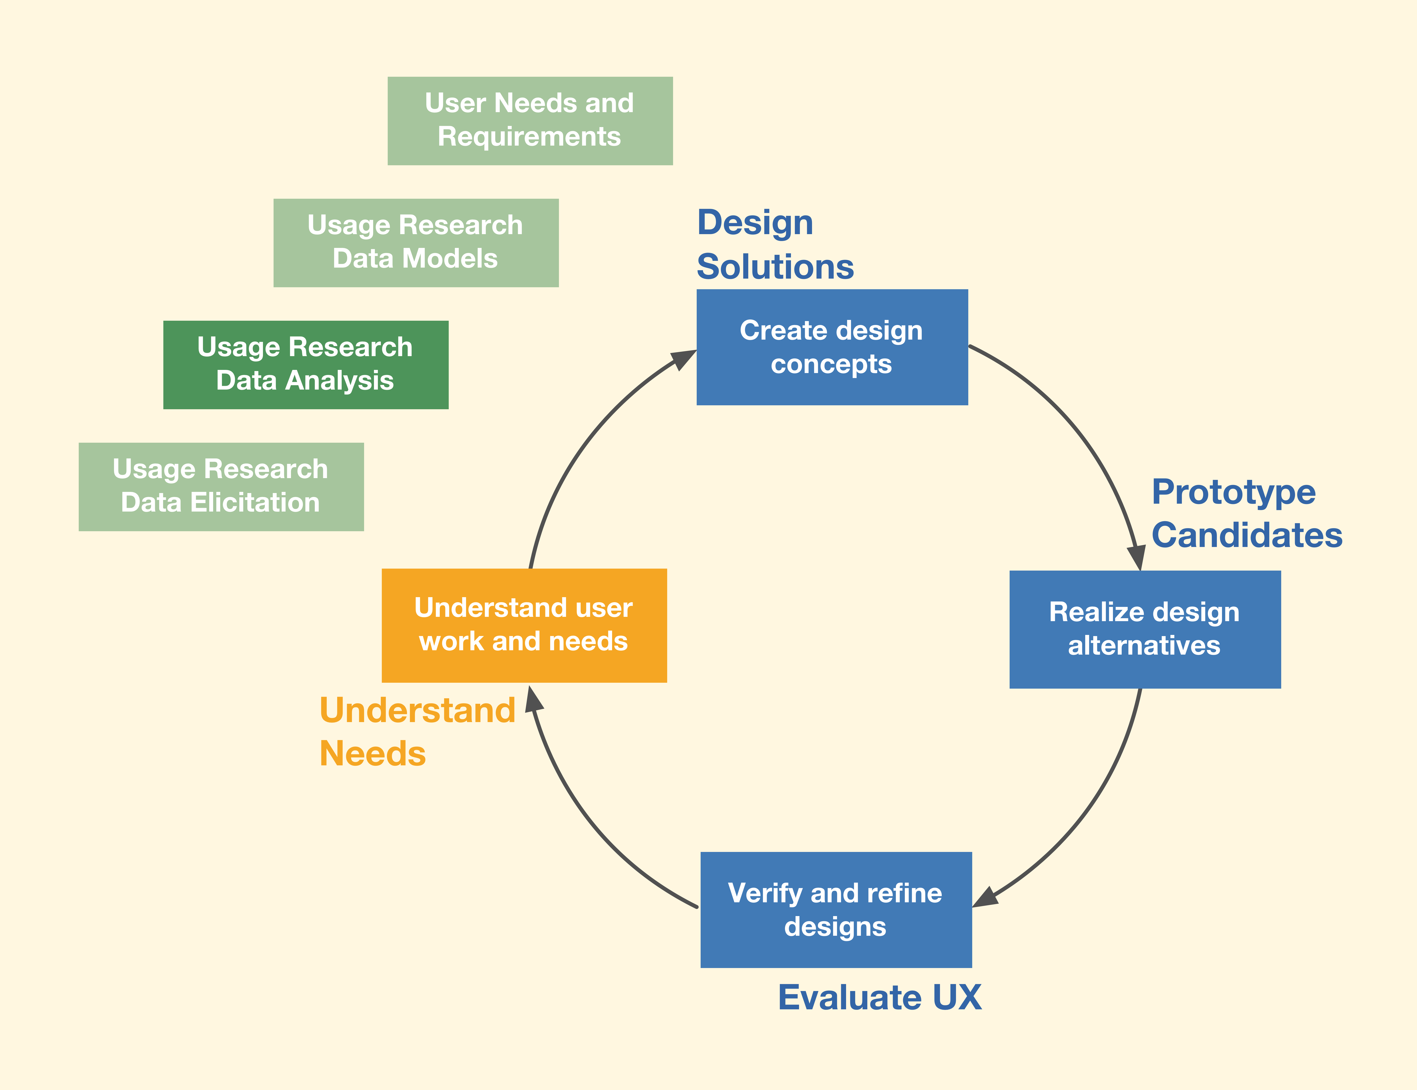

Slide 3
Usage research analysis
Systematic analysis of usage research user work activity data
Bring models along in parallel
Immerse yourself in artifacts, sketches, posters, props, and diagrams in your design studio

Slide 4
Usage research analysis components
To illuminate the work practice in a coherent way:
Continue to develop early modeling
Write initial user stories
Distill remaining raw data – synthesize work activity notes
Organize the data – build work activity notes into a work activity affinity diagram (WAAD)

Slide 5
1. Continue to develop early models (part 1)
Use all model-related data notes to continue early usage research data modeling started in data elicitation
  User work roles, personas
  Flow model
  Artifacts
  Physical
  Tasks: Hierarchy, task sequences

Slide 6
Continue to develop early models (part 2)
If a given data note relating to data models fits into an existing model, integrate it into that model
If not, start up a new model with that data

Slide 7
Set aside other inputs to data modeling
Set aside the rest of the data notes related to usage research data modeling
  For which you don’t yet have enough information
  For the major data-modeling activity in Chapter 9

Slide 8
Add to existing data models on the fly
Example: Data note says the user feels it is difficult to get enough information about events from a ticket seller at the ticket window
Represent this as a barrier to workflow icon in the flow model

Slide 9
2. Write initial user stories (part 1)
Use all data notes related to user stories
Write any initial user stories for which you have enough information now
  Anything about a single feature or capability a user wants or needs
  Small scope

Slide 10
Write initial user stories (part 2)
User story is brief narrative in voice of a user work role stating a single need for a capability
As a <user work role>
I want to <accomplish something>
So that <some benefit happens>

Slide 11
Example user story
User comment:
I think you should be able to use either cash or a credit card to pay for the tickets.
User story:
As a ticket buyer
I want to be able to pay with a credit card
So that it will be more convenient

Slide 12
3. Distill remaining raw usage research data
All remaining raw usage research data should be about things other than user stories and data models
Synthesize these into work activity notes
IMPORTANT: Doing this well is key to rest of usage research analysis

Slide 13
How to Proceed
For each raw data note:
  Synthesize each work activity note in turn
Hand-written on a Post It note
  Or typed into a laptop
These work activity notes will all be inputs to a WAAD (work activity affinity diagram)

Slide 14
Ensure each work activity note is
  Elemental
  Brief
  Concise
  Easy to understand
  Retain context
  Read guidelines in book for what makes a good work activity note

Slide 15
Make each work activity note elemental
Break apart raw data into notes
  Each about exactly one point or idea
  Just one simple declarative point (concept, idea, or fact)
  Possibly with one rationale statement

Slide 16
Example: Work activity notes for MUTTS
Raw user (ticket buyer) comment:
  It is too difficult to get enough information about events from a ticket seller at the ticket window. For example, sometimes I want to see information about popular events that are showing downtown this week.

Slide 17
Synthesized work activity notes:
    Too difficult to get enough event information at window.
    Provide information about current popular downtown events.

Slide 18
Make each work activity note brief
Paraphrase and synthesize, instead of quoting raw data verbatim
One to three succinct sentences

Slide 19
Raw user (ticket buyer) comment:
  I always get the feeling that there are other good events that I can choose from but I just do not know which ones are available and the ticket seller usually is not willing to help much or doesn’t understand what I need, especially when the ticket window is busy. I’d rather be able to do my own searching.
Synthesized work activity notes:
  Ticket seller not showing every option.
  Ticket seller too busy, doesn’t understand needs.
  Users want to find their own events.

Slide 20
Make each work activity note concise
Make a specific point
Filter out noise, fluff, verbiage

Slide 21
Raw user (ticket buyer) comment:
  It is hard to judge just from information available at ticket window whether an event has been well received by others.
Synthesized work activity notes (with some designer license):
  Users want reviews and feedback on events.
  [Design idea] Include capability for people to add reviews? Question: Locate at event venues rather than kiosk?

Slide 22
Make each work activity note easy to understand
  Each work activity note should be
    Easily read
    Understood at a glance

Slide 23
In each work activity note retain topical context
Make each note complete and self-standing
Disambiguate pronouns, references to context
Don’t lose context when splitting up a raw data note
  Example: If, after splitting a note, you have one that mentions “it”, “he”, “she”, etc., resolve the ambiguity by being more specific

Slide 24
Other guidance to work activity notes
Refer to work roles rather than individual people
Avoid repetition of same information in multiple places
  For example, do not include information from flow model in work activity notes

Slide 25
4. Organize work activity notes
For a small project, sort out the work activity notes into category piles on a table top
Otherwise, work activity notes will go into a WAAD (work activity affinity diagram)

Slide 26
Organize work activity notes in a WAAD
WAAD is hierarchical affinity diagram
  “Affinity” means being related as by being in common categories
  So, a WAAD is a way to sort work activity notes by categories
    Where categories are common topics or themes within the work domain

Slide 27
Prepare to construct WAAD (part 1)
Might need to print work activity notes (e.g., on Post-it™ stock) for WAAD (work activity affinity diagram)
Need plenty of wall space in design studio
  Dedicated for duration of project
Tape up large “belt” of butcher paper or similar around walls of room
  As working space for posting work activity notes

Slide 28
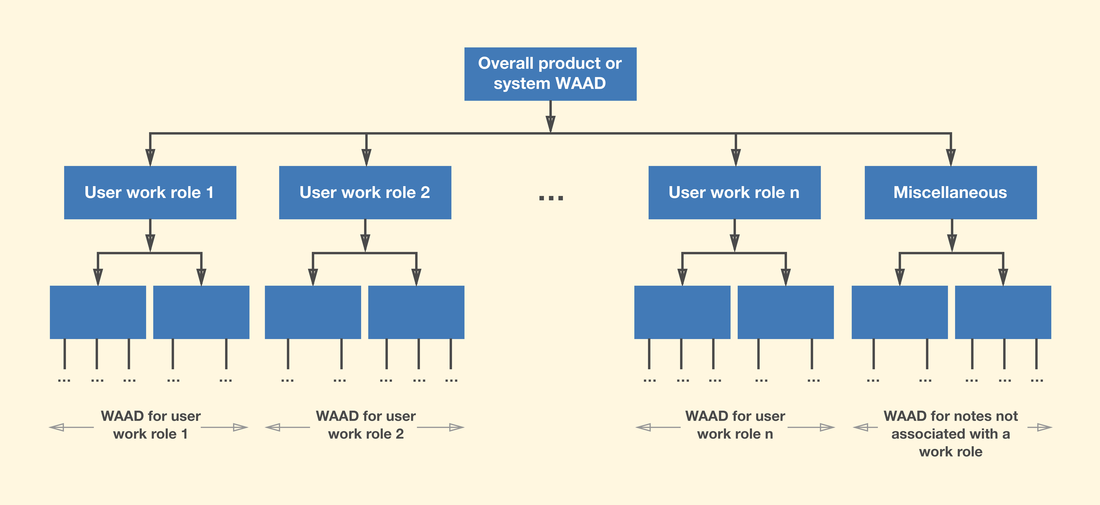
Prepare to construct WAAD (2)
Sort the work activity notes by user work role
You will make a separate WAAD for each user work role
Also include a “Miscellaneous” category

Slide 29
Construct WAAD
Consider each work role pile and corresponding sub-WAAD in turn
For each work role pile, consider each work activity note in turn

Slide 30
If work activity note does not fit into any group topic already posted
Start a new group
Add label to identify the topic of new group

Slide 31
Importance of precise labels
    Needed to later identify topic at a glance
    So don’t have to re-read notes to know what cluster is about
    High descriptive power to capture meaning (gestalt)
    Avoid vague or general terms
    Example: “How we validate information”
      Should have been “How we validate inputs to data forms”

Slide 32
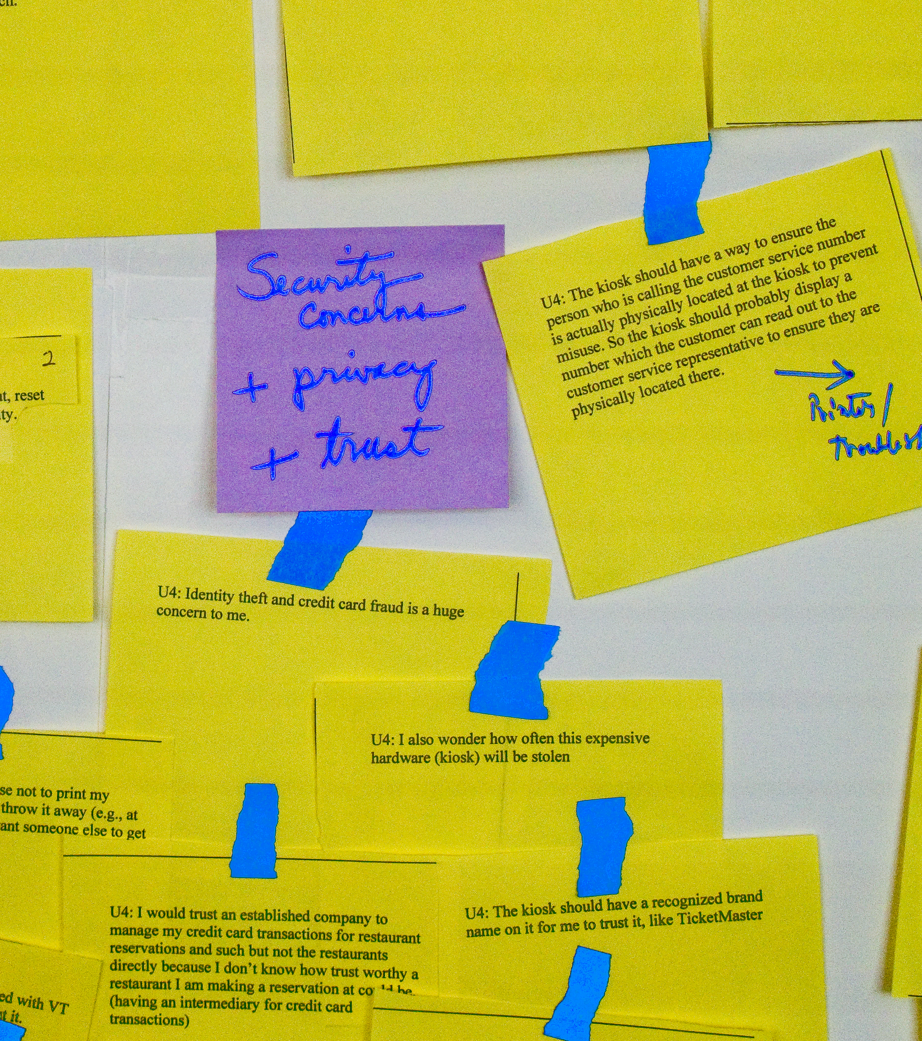
If work activity note fits into a group topic already posted
Add it to that group
Adjust group topic label, if necessary, to accommodate any added breadth

Slide 33
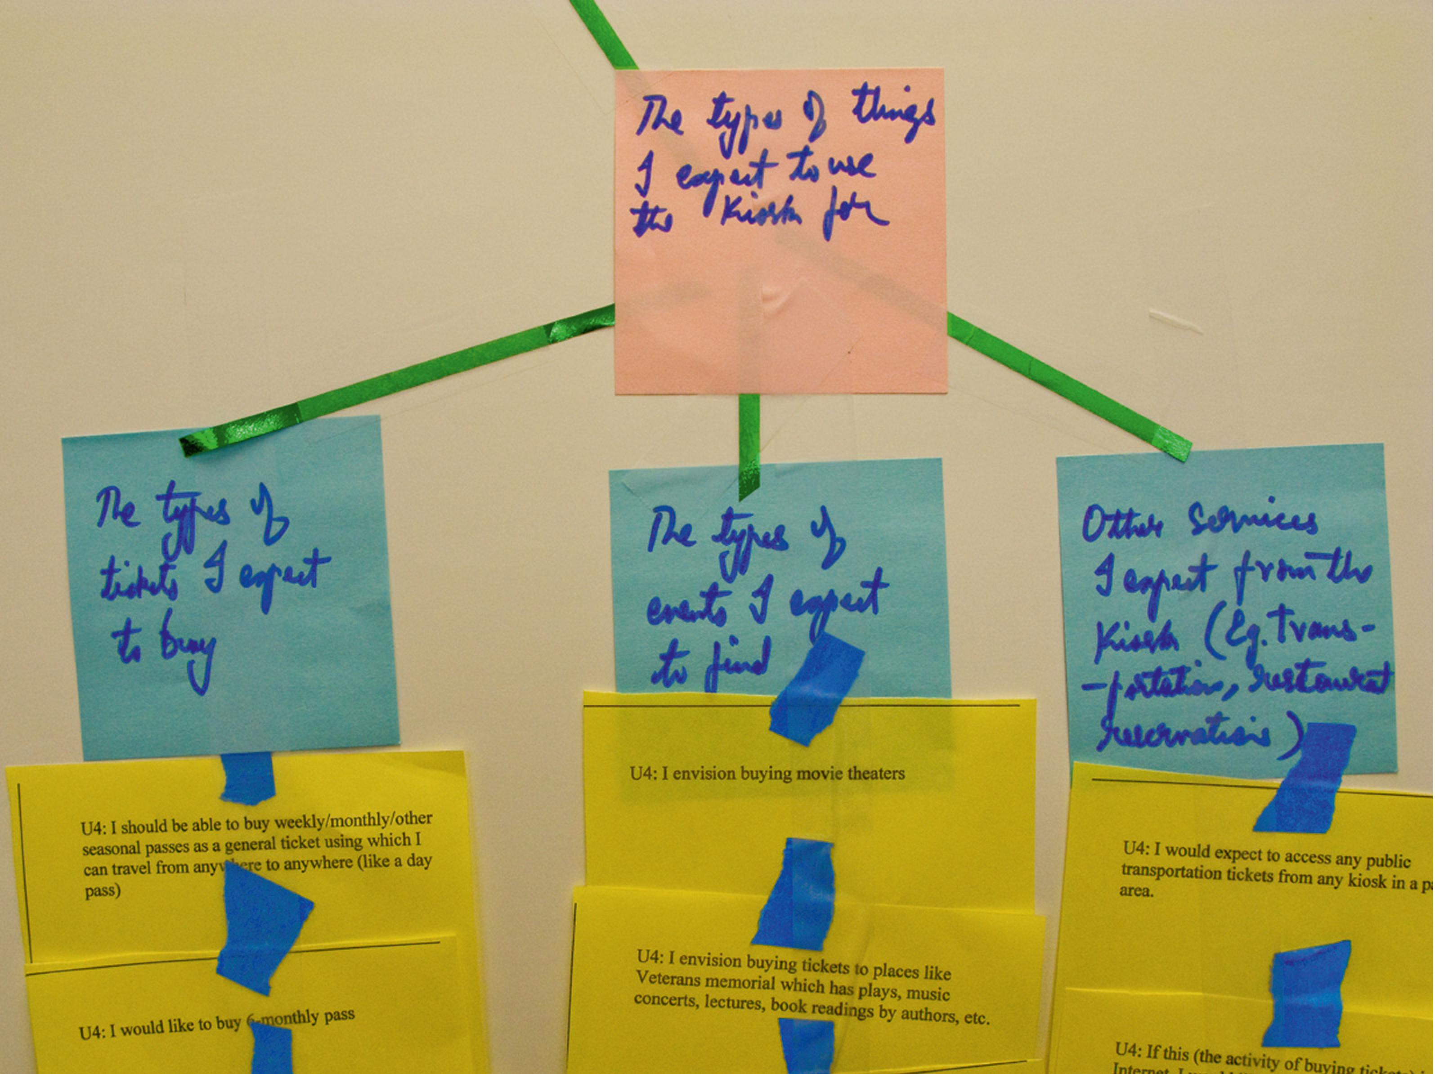
Combining groups
Find groups that are related
  Group together with higher-level label

Slide 34
Splitting groups
If a group gets to have more than about 10 work activity notes and topic is getting too broad
  Split into sub-groups, each with a narrower label
  Add “super-topic” label to a common parent node
  Example: The previous example label that grew to “Security, privacy, and trust” might now be split back into the three parts

Slide 35
Continue to refine, grow, and evolve your WAADs
Keep it moving; don’t drag it out
Don’t get side-tracked with details and side-bar discussions

Slide 36
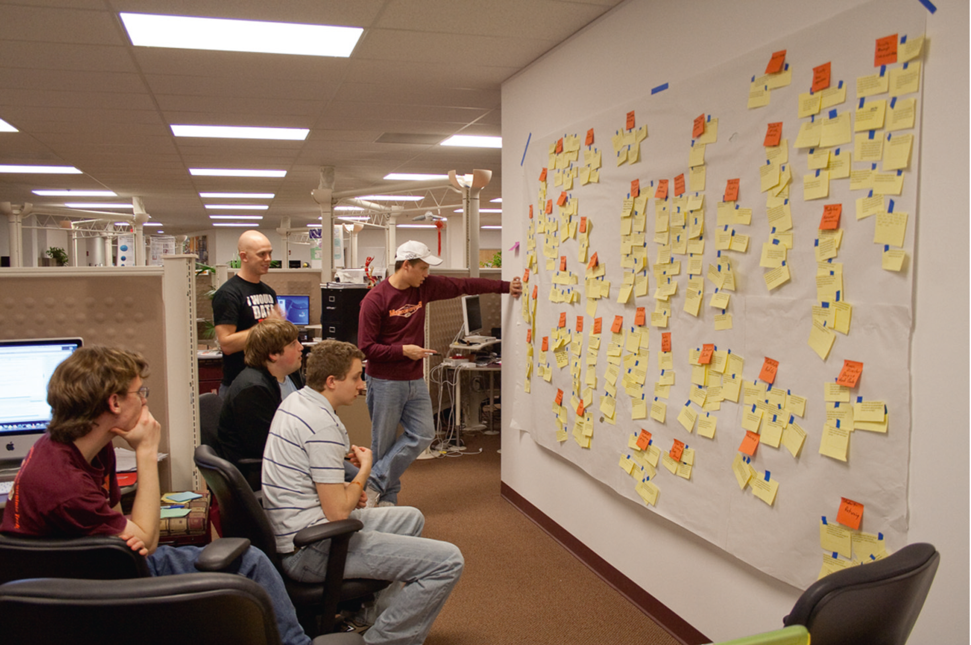
Example: Team studying clusters to form groups

Slide 37
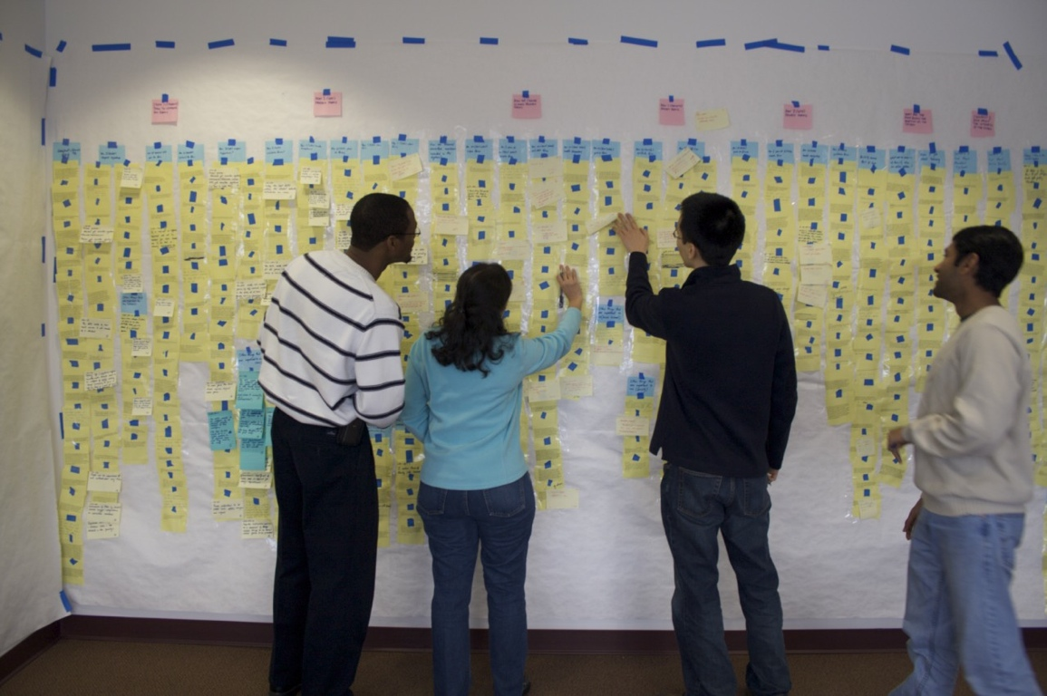
32

Slide 38
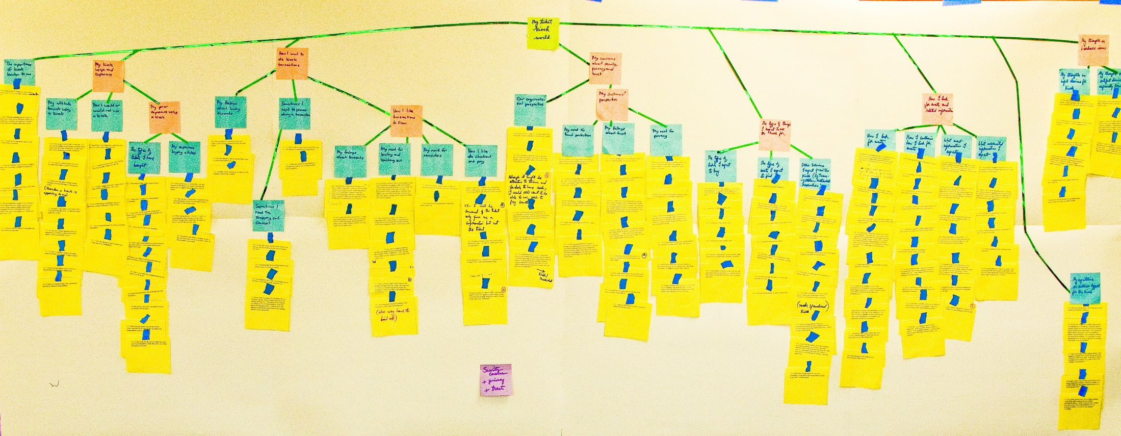
Example, WAAD FOR MUTTS

Slide 39
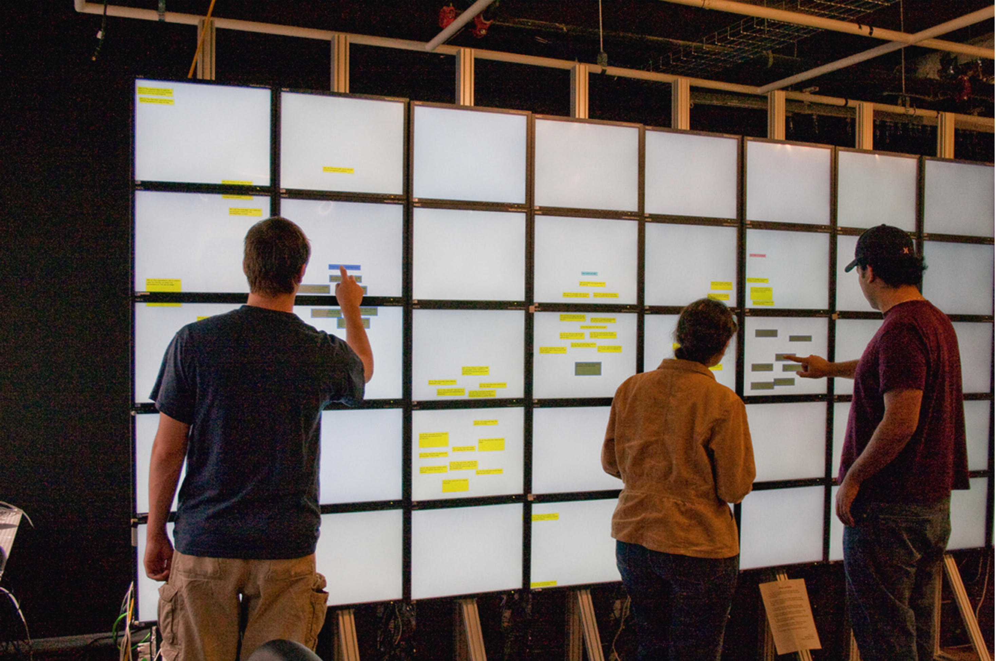
Building WAAD with software tool on large touchscreen
39

Slide 40
Walkthrough of WAAD
Consolidation and communication
Share understanding of user work activities, issues with all stakeholders
Explain your process in a nutshell

Slide 41
Walkthrough of WAAD
Show it to your client, customer, and/or users
Get feedback to:
  Fill in gaps
  Resolve misunderstandings
  Provide missing insights
Goals
  Garner more input, refine
  Achieve shared understanding of user work issues

Slide 42
Rapid usage research analysis
Extremely limited time: Get only the most important work activity notes
Include only the most important points in your WAAD
  Not deep structure in WAAD
  The WAAD can be just lists under each category

Slide 43
This assignment is meant to illustrate the gap between requirements analysis and design.
You've been asked to redesign your cell phone.
Make a Work Activity Affinity Diagram of the device.
If you do not have a cell phone, contact me at kdsecor@gmail.com for another option.
You may use https://docs.google.com/drawings/ (Links to an external site.) , https://trello.com/ (Links to an external site.) or any other mechanism.
To help you organize, your categories could be "Work", "Play" and "Communicate" or, if you wanted to take another angle to generate ideas, you could use more general categories like “Maintenance”, ”Product Quality”, “Equipment Maintenance”, “Manufacturing Cost”, “Production Volume”, ”Environmental”.
Please have at least 4 categories with at least 6 ideas for each category to help with a potential redesign.
In your submission, please tell me what model phone you have.

