Slide 1


Session #8: Wireframes/ Designing the Interaction

Slide 2
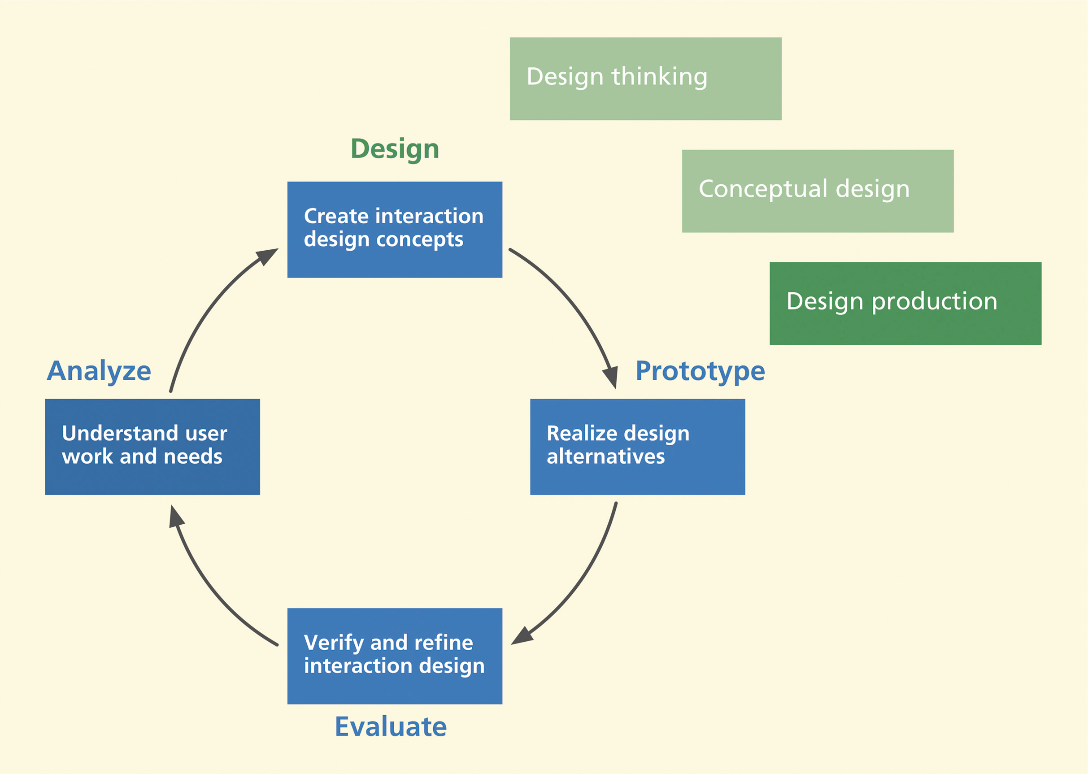
Introduction

Slide 3
Macro view of design iterations

Slide 4
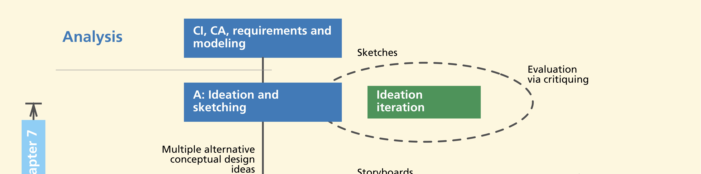
Ideation Iteration
Lightning-fast
Loosely structured iteration
For purpose of exploring design ideas
Role of prototype played by sketches

Slide 5
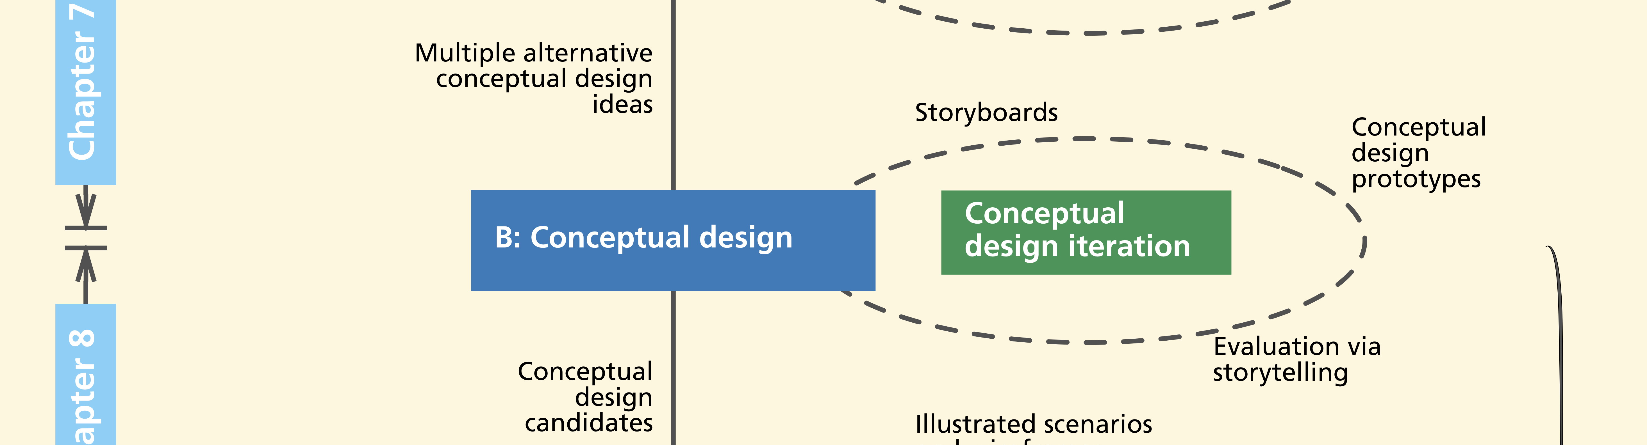
Conceptual Design Iteration
Critique and compare multiple design concepts
Sort out best one
Weigh concept feasibility
Prototypes: low-fidelity paper, storyboards

Slide 6
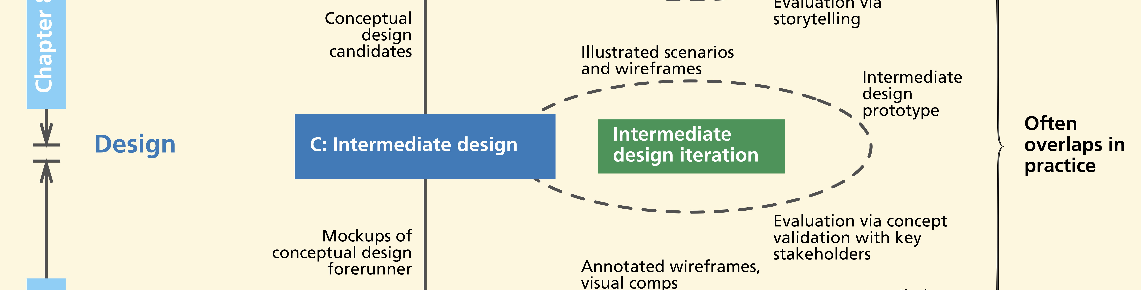
Intermediate design iteration
To arrive at one intermediate design for layout and navigation

Slide 7
Intermediate design iteration
Prototypes might evolve
From low-fidelity to wireframes (coming soon)
Fully interactive high-fidelity mockups as vehicle for demonstrations and design reviews

Slide 8
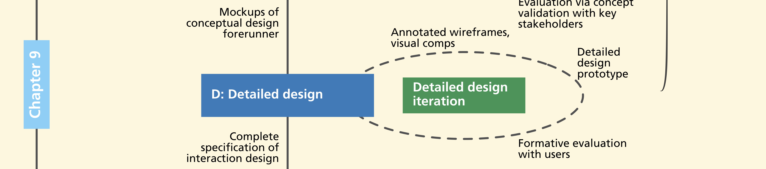
Detailed design iteration
To decide screen design and layout details
Includes “visual comps” (coming up soon) of “skin”
For look and feel appearance

Slide 9
Detailed design iteration
Design will be fully specified with complete descriptions of
Look and feel
Behavior
How all workflows, exception cases, and settings will be handled

Slide 10
Doing intermediate design
Screen layout and navigational structure
Represent key work flows with sequences of wireframes, click-through prototypes

Slide 11
Doing detailed design
Annotated wireframes
Evaluate and iterate detailed designs to refine wireframes
Include all user interface objects and data elements
Still represented abstractly but annotated with call-out text

Slide 12
Visual design and visual comps
Need visual designer who has been involved in
Ideation, sketching, and conceptual design
Now produces what we call visual “comps”

Slide 13
Visual comps
“Comprehensive” or “composite” layout
Very specific and detailed graphical look and feel
Pixel-perfect mockup of graphical “skin”

Slide 14
Visual comps
Consistent with
Company branding
Style guides
Best practices in visual design

Slide 15
Wireframes
The path to wireframes

Slide 16
Wireframes
De facto representation medium for interaction design at this stage
Prototyping
Documenting
Communicating to implementers

Slide 17
Wireframes
Major bread-and-butter tool of interaction designers
Made of lines and outlines
Hence the name “wire frame”

Slide 18
Wireframes to represent design objects
Boxes and other shapes to represent emerging design objects
Drawing is usually simple
Often just rectangular objects
Objects can be labeled, moved, and resized

Slide 19
Wireframes to represent navigation
Sequences of wireframes to show usage over time
Depict envisioned task flows
In terms of user actions on user interface objects and corresponding state (screen) changes

Slide 20
Example, wireframes
Web-based photo organizing and sharing application
Illustrates high-level conceptual design

Slide 21
Example, wireframes

Slide 22
Example, design further elaborated
Shows right-hand side information pane collapsed

Slide 23
Example, show behavior
What happens when a user clicks on vertical “Related information” bar

Slide 24
Example, show behavior
What happens when user clicks “one-up” icon in upper right hand corner

Slide 25
How are wireframes used?
Conversational props to discuss design alternatives
To elicit feedback from potential users and other stakeholders
Helps you keep your eye on information architecture on screen

Slide 26
How are wireframes used?
Designer can move through deck of wireframes
One slide at a time
Simulating potential scenario
Pretending to click on interaction widgets

Slide 27
Tools for wireframe mockups
Tools designed specifically for this purpose
OmniGraffle (for Mac)
Microsoft Visio (for PC)
Balsamiq
Adobe InDesign

Slide 28
How to build wireframes?
Templates available for many basic shapes and UI objects
Some parts of wireframe can be generic, others detailed
Can add color, graphics, real fonts

Slide 29
Hints and tips for wireframing
Be able to create multiple design representations quickly
Keep it modular—just as with any prototyping technique
Not too many concepts or details “hard coded” in any one frame
Build up using layers
Use separate layer for each repeating set of widgets on screen

Slide 30
Hints and tips for wireframing
Example, container “window” of an application with its different controls
Specify once as layer and reuse in subsequent screens
Use stencils, templates, and libraries of widgets
Avoid re-inventing widgets
Find shared objects in tool libraries

Slide 32
Designing the interaction (1)
It’s all about supporting user tasks
It’s where the user looks at displays and manipulates controls
Doing sensory, cognitive, and physical actions
iTunes example: signing up, logging in, searching, browsing for songs by artist, title, genres, rating music

Slide 33
Designing for interaction (2)
Possibly need different variation of interaction design for each device in the ecology
Establish good conceptual design for the interaction design
Example: Analogy of reading a book on device, using a calendar

Slide 34
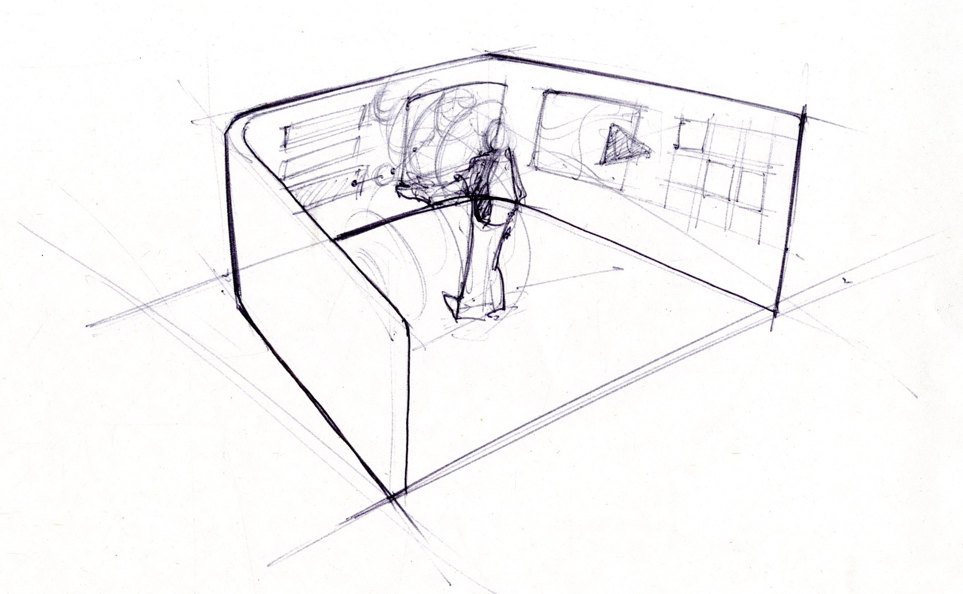
Conceptual design for TKS interaction
Three-panel design that surrounds and immerses the user

Slide 35
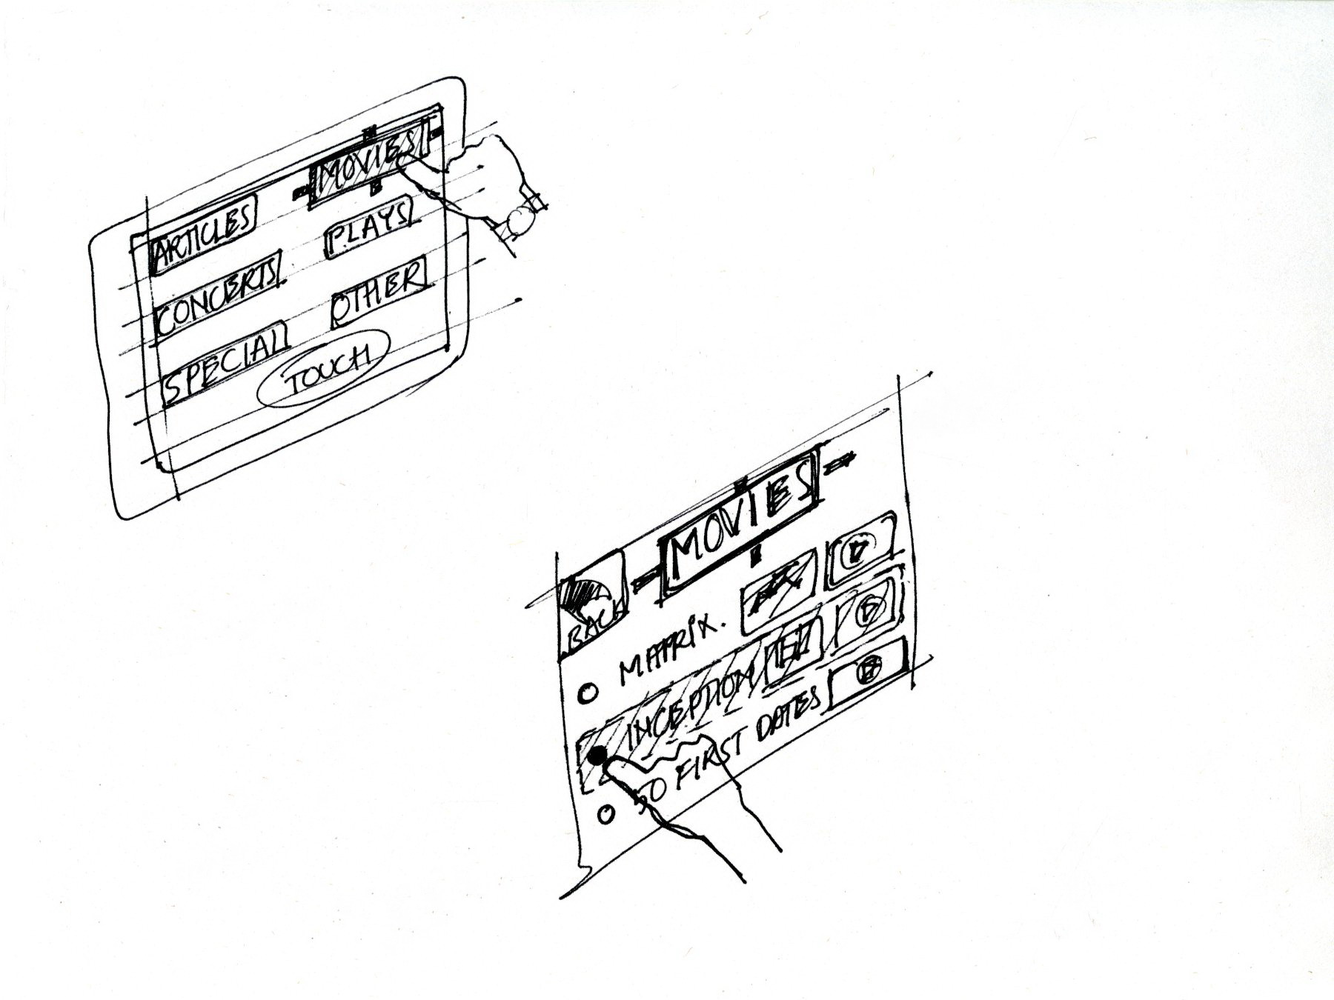
Example more specific to interaction

Slide 36
Storyboards in interaction design
Freeze-frame representations
Graphical clips
Hand-sketched pictures annotated with a few words
Stories of how people work with system

Slide 37
Things to include in storyboards
All work practice that is part of task, not just interaction with system
Example, include telephone conversations with agents outside system
Sketches of devices and screens
Any connections with system internals, for example, flow to and from a database
Extra-system activities, such as talking with a friend about what ticket to buy

Slide 38
Example: Interaction storyboard sketches for the Ticket Kiosk System

Slide 39
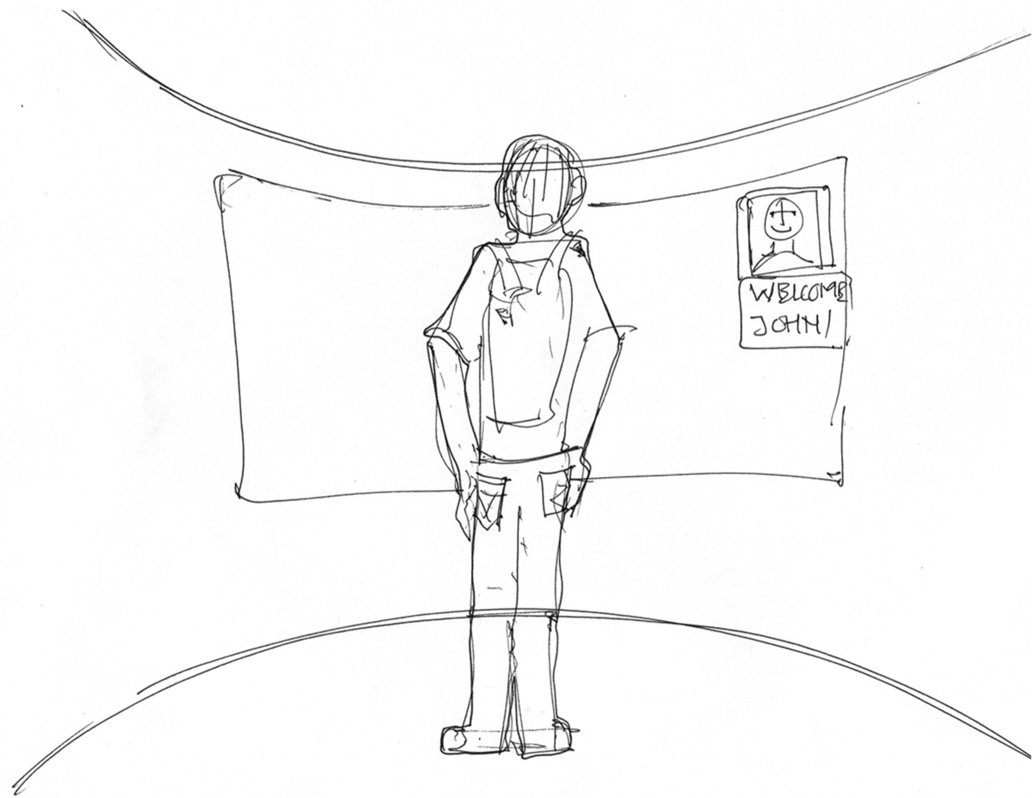
39

Slide 40
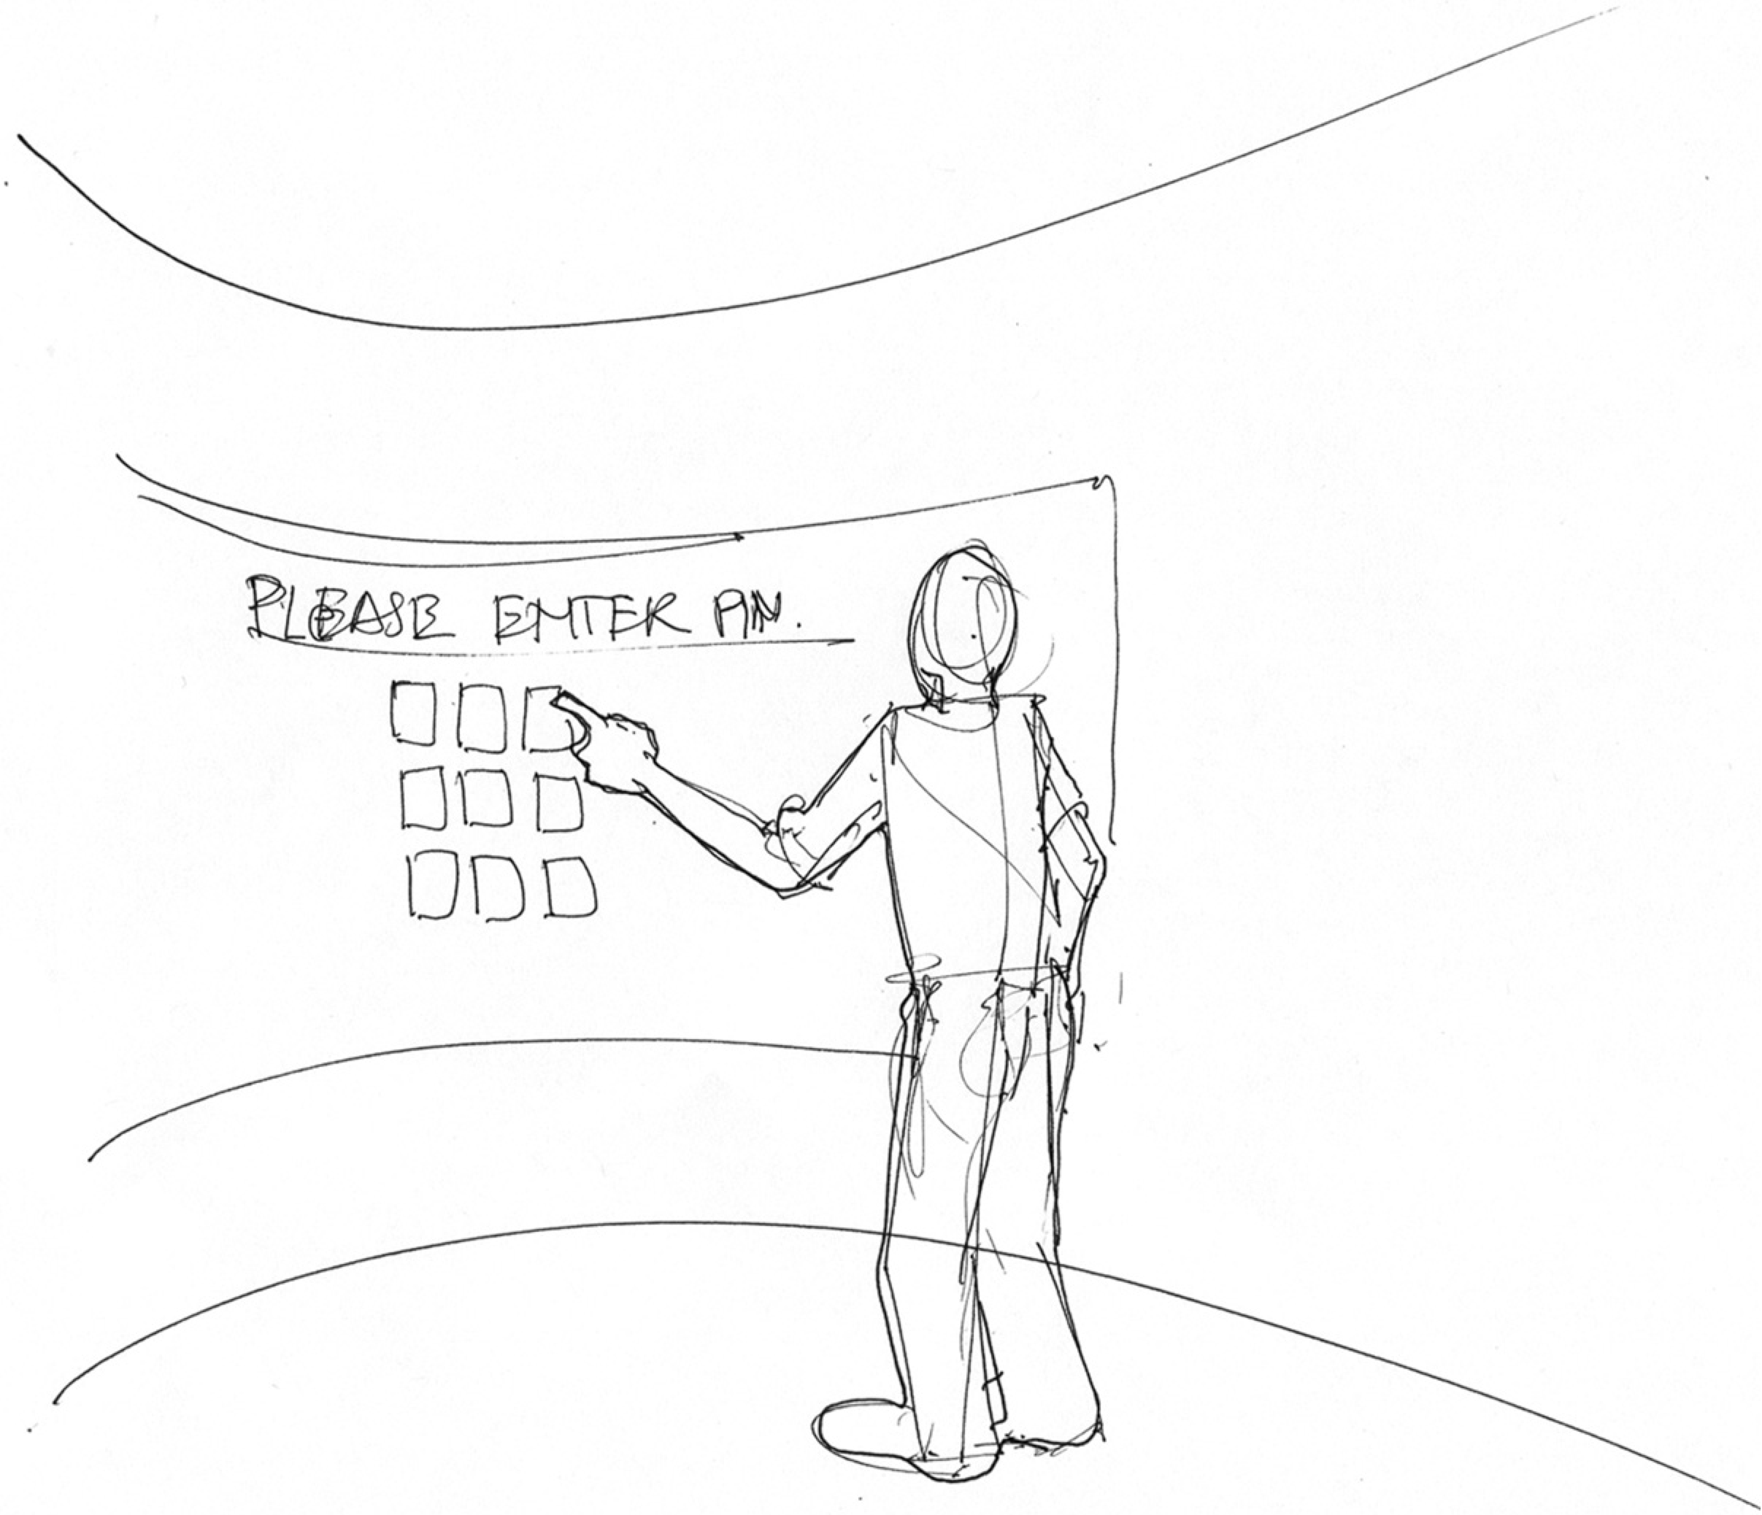
40

Slide 41
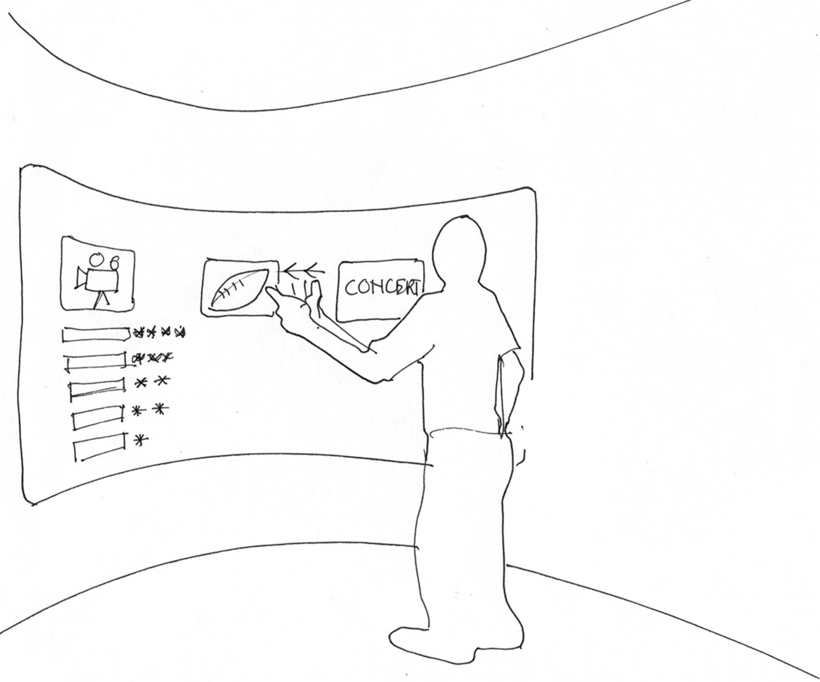

Slide 42
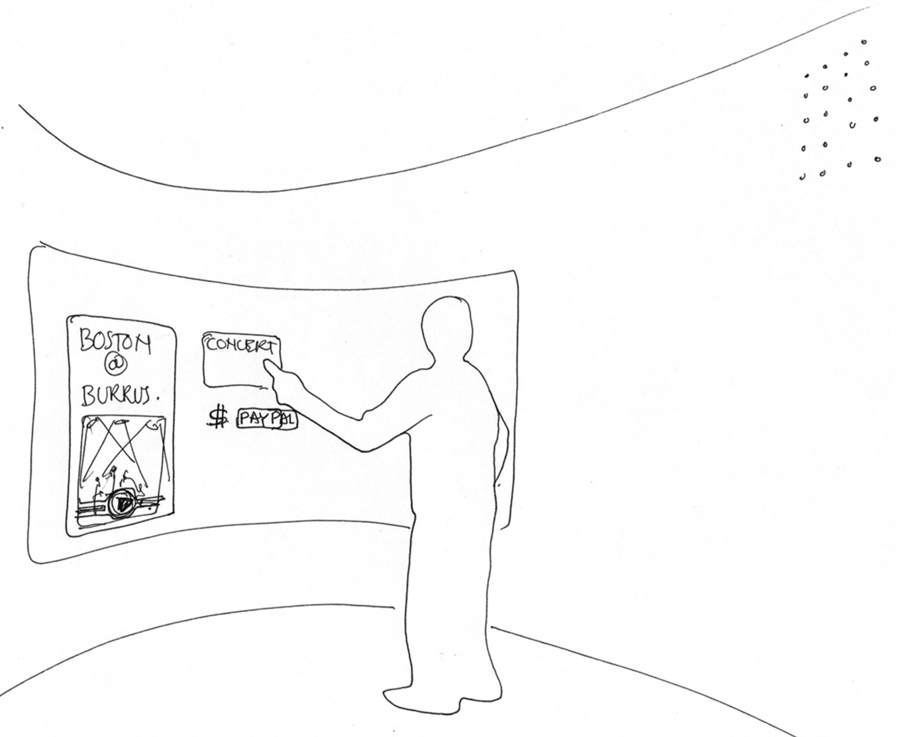
42

Slide 43
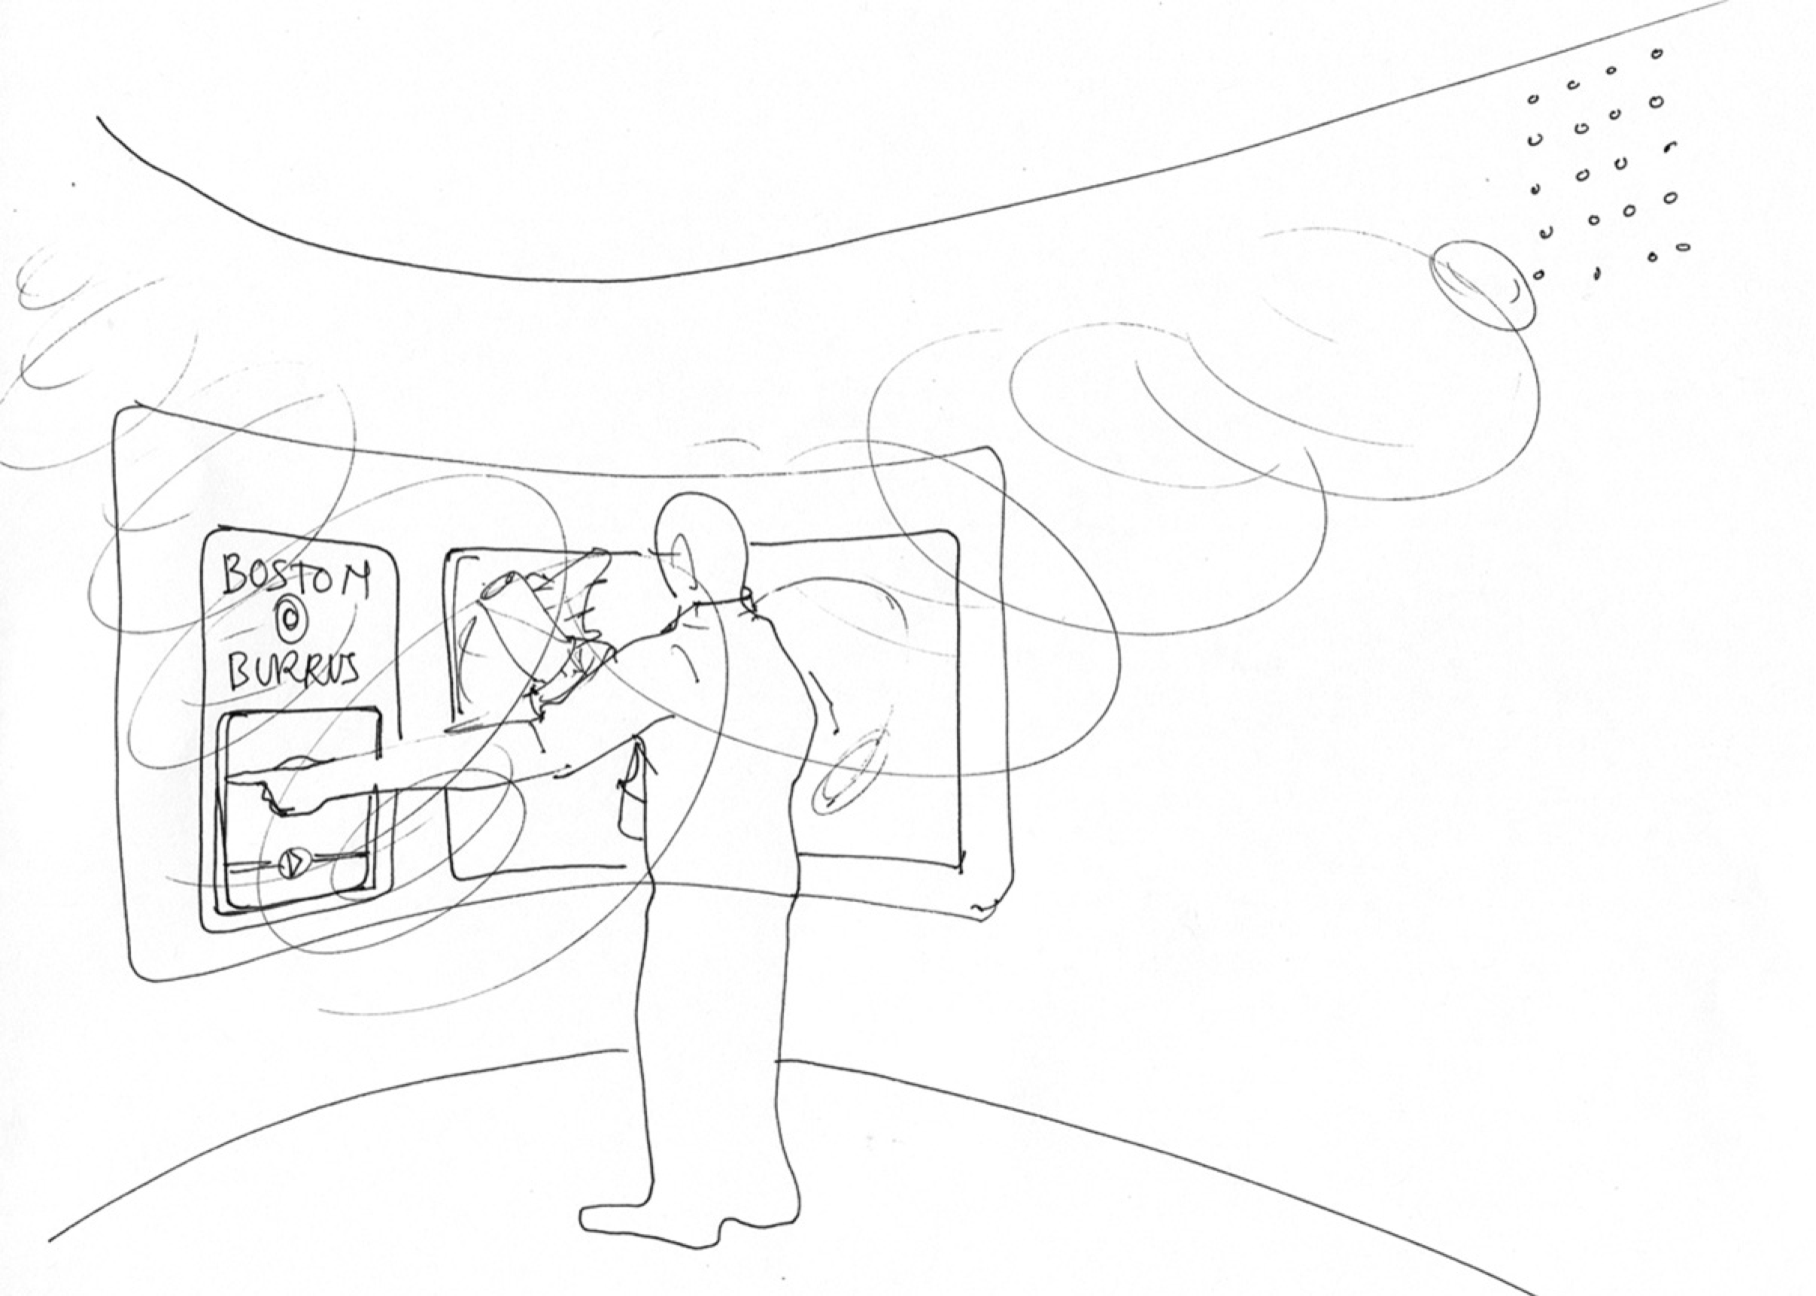

Slide 44
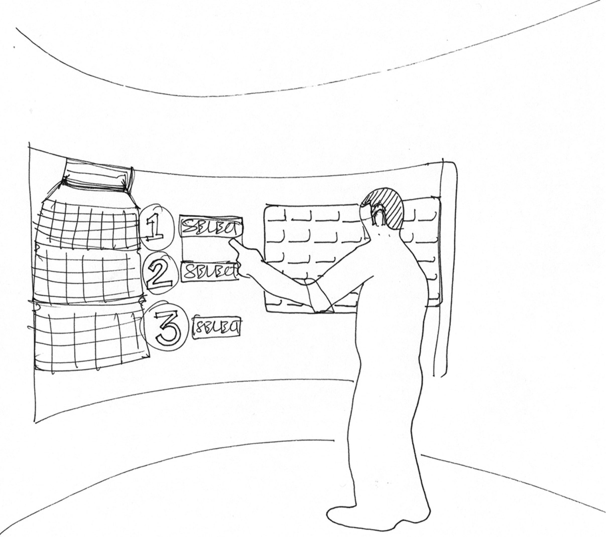

Slide 45
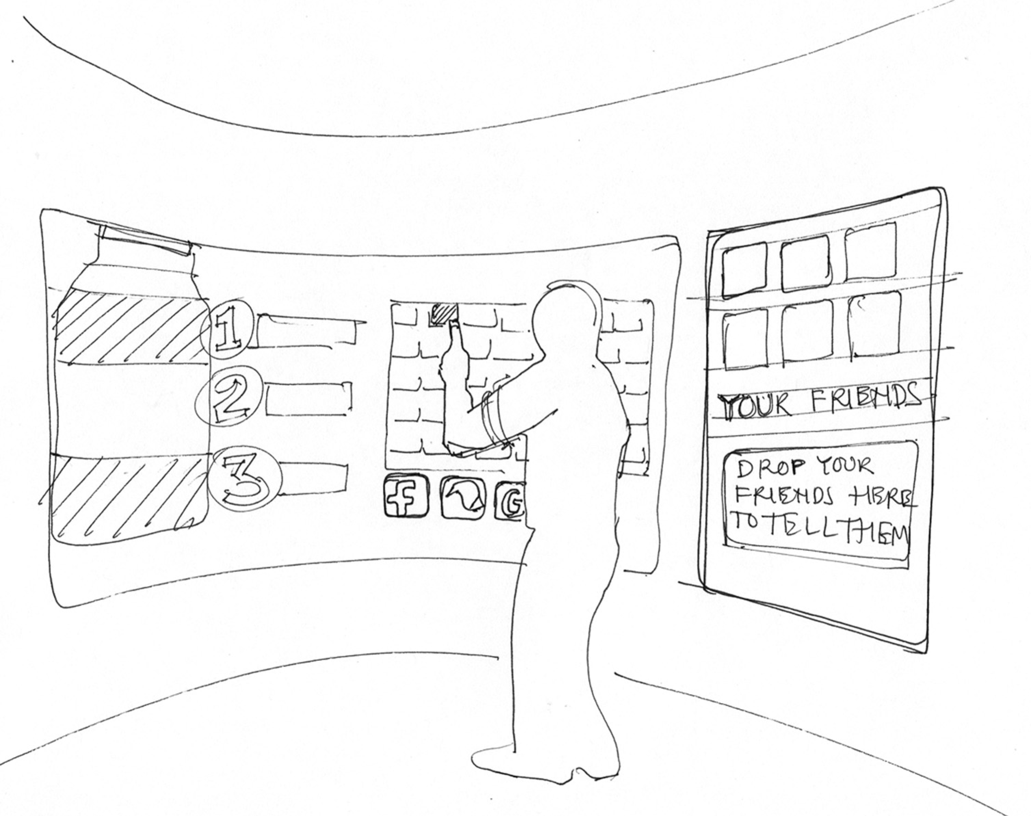

Slide 46
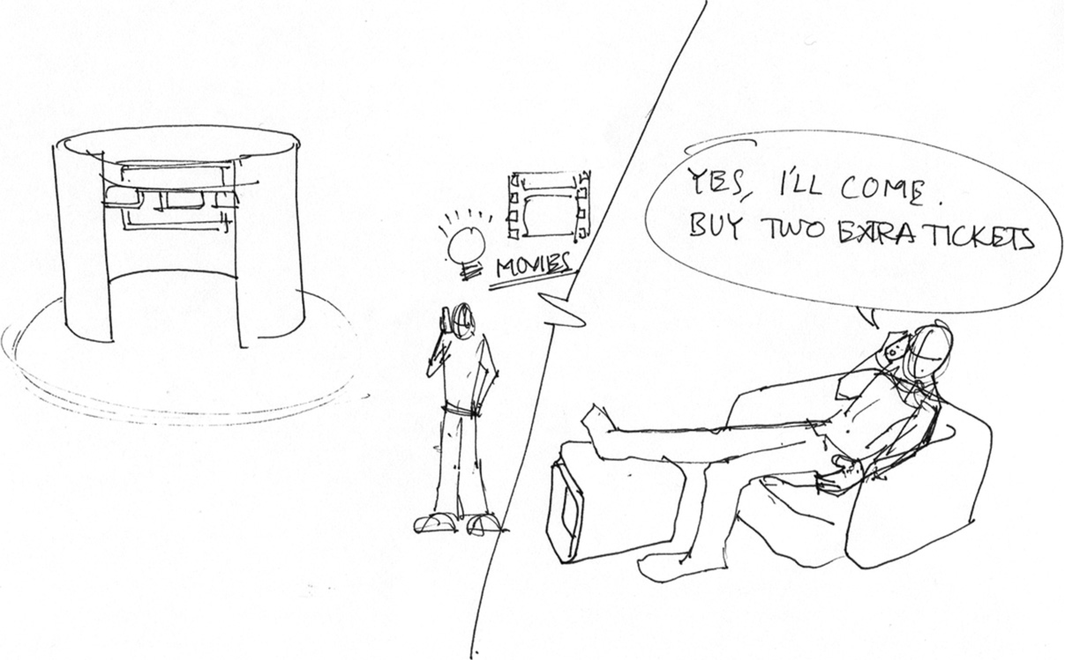

Slide 47
Importance of between-frame transitions (1)
Storyboard frames
Individual states
Static screenshots
Frame-to-frame progression of interaction over time

Slide 48
Importance of between-frame transitions (2)
The dynamics in transitions between frames is where user experience lives
Transitions are where users think
Cognitive affordances in your design earn their keep
Help users think about what to do next
Where most problems exist for users, challenges for designers

Slide 49
Importance of between-frame transitions (3)
Make actions between frames part of what is sketched
How?
Add frames that show circumstances that lead to transitions
User thought bubbles, gestures, reactions

Slide 50
Example, storyboard transition frame
Thought bubble explaining state change

Slide 51
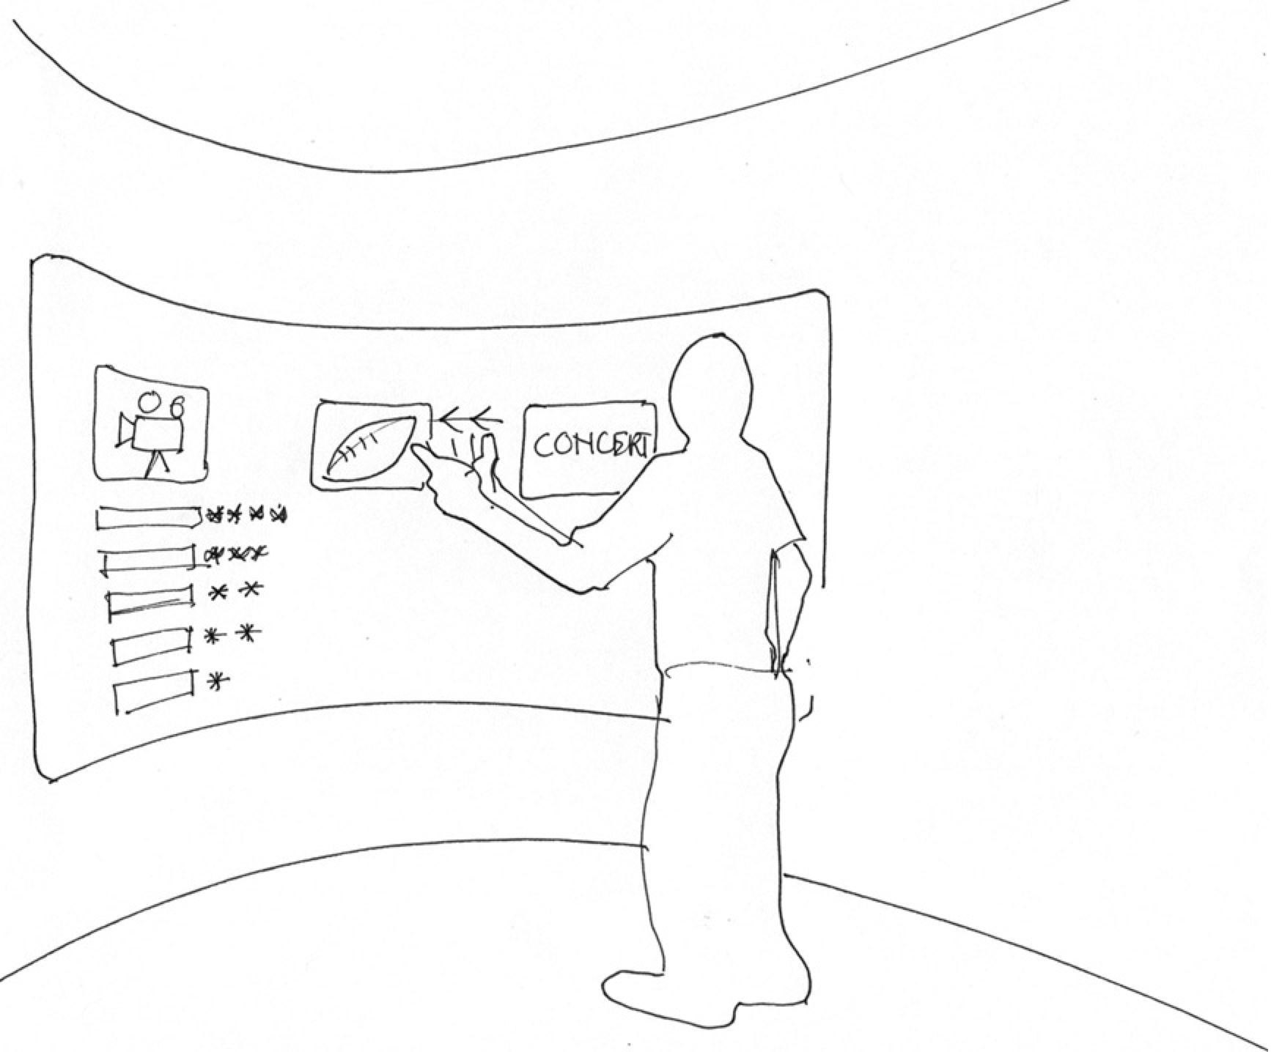

Slide 52
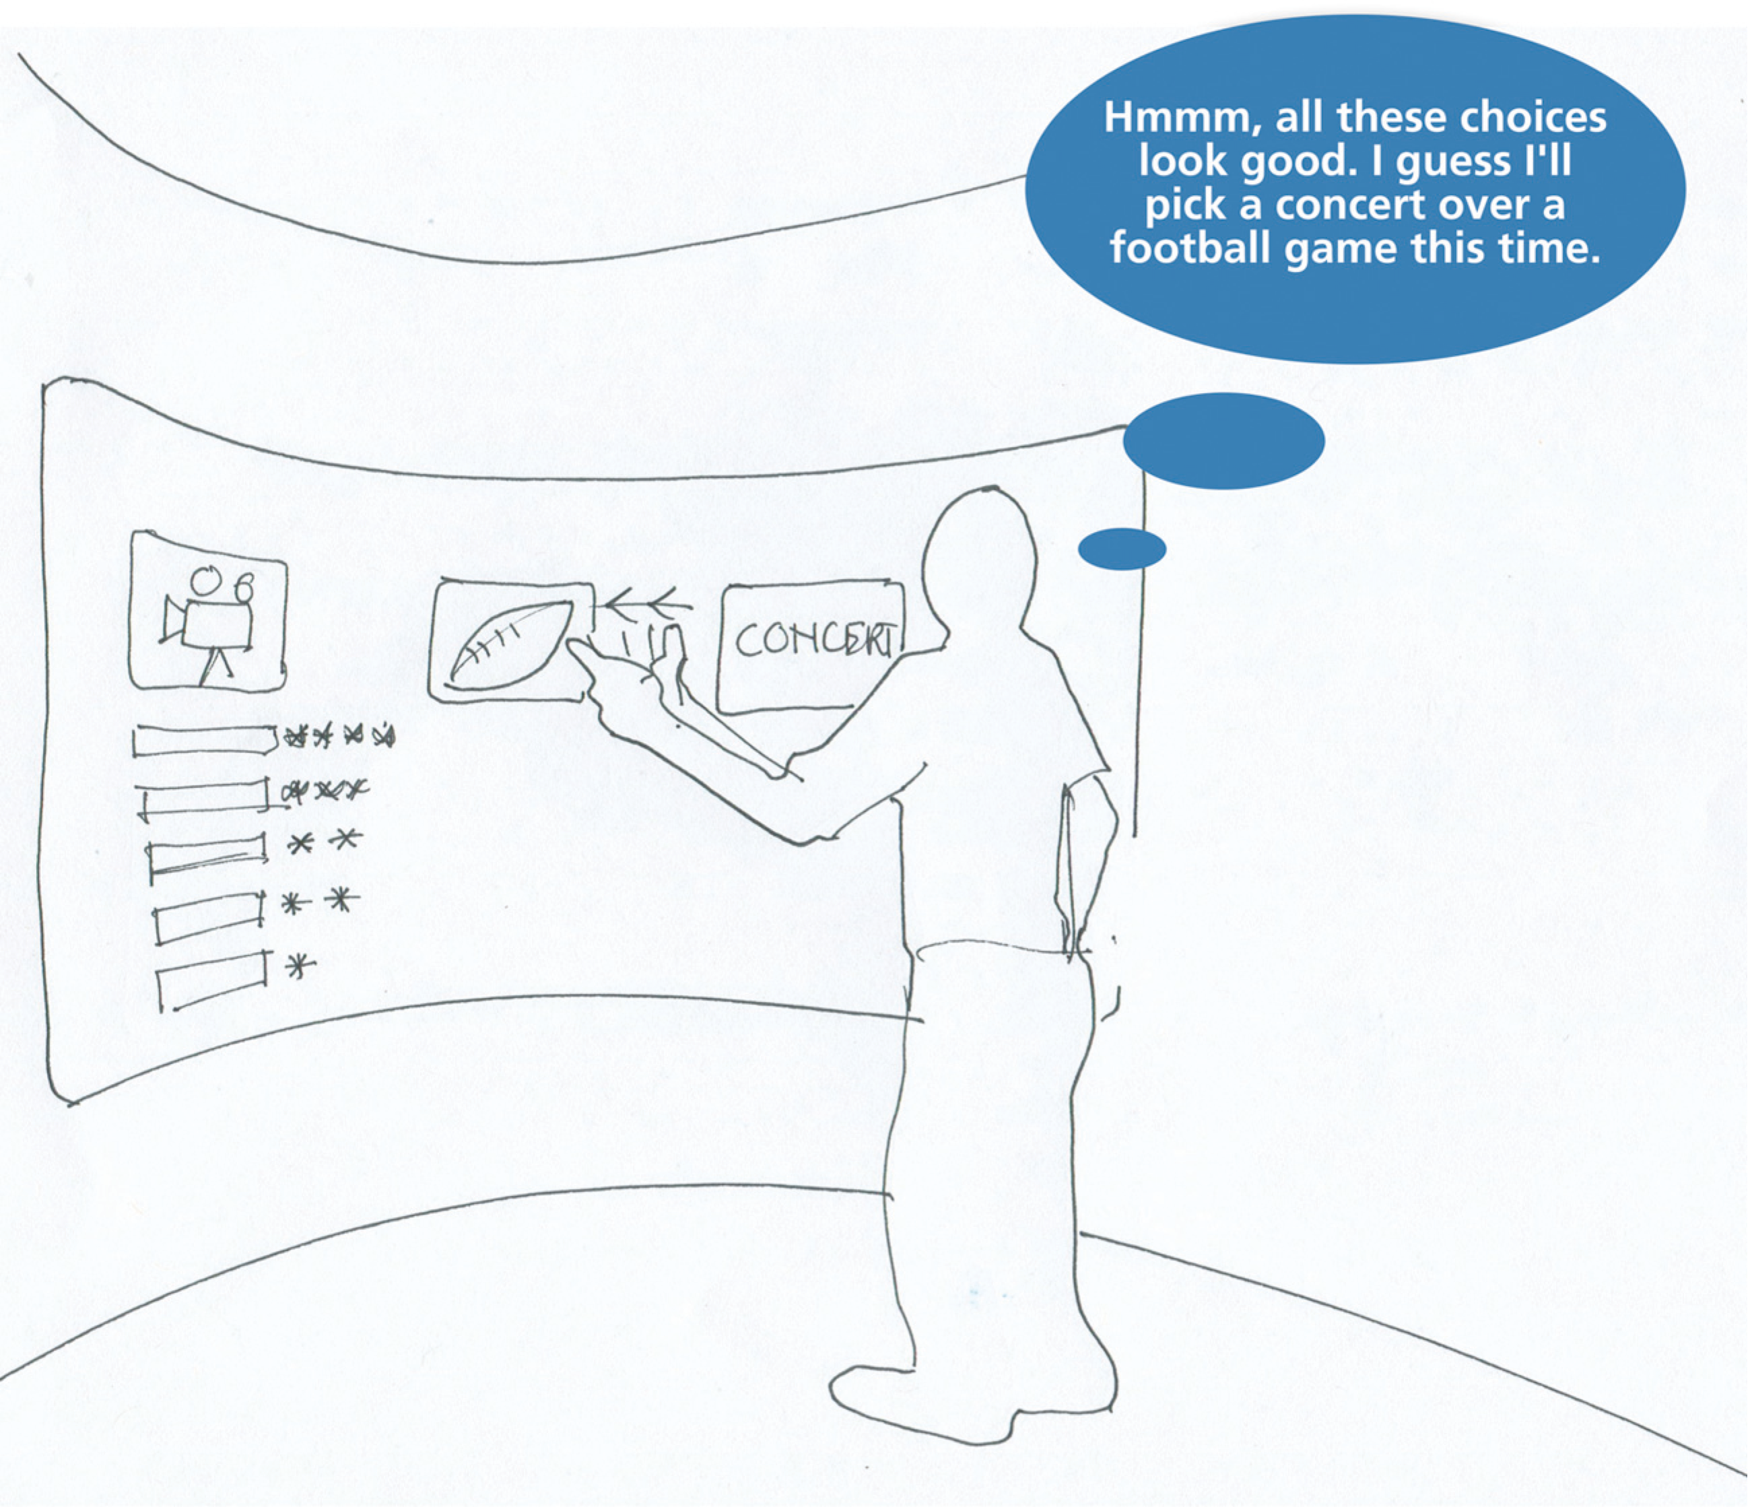

Slide 53


Slide 54
Outside-class exercise
As a team, get together outside class and brainstorm and sketch a few storyboard sequences for your envisioned SmartFridge usage

Slide 55
Wireframe prototypes for intermediate interaction design

Slide 56
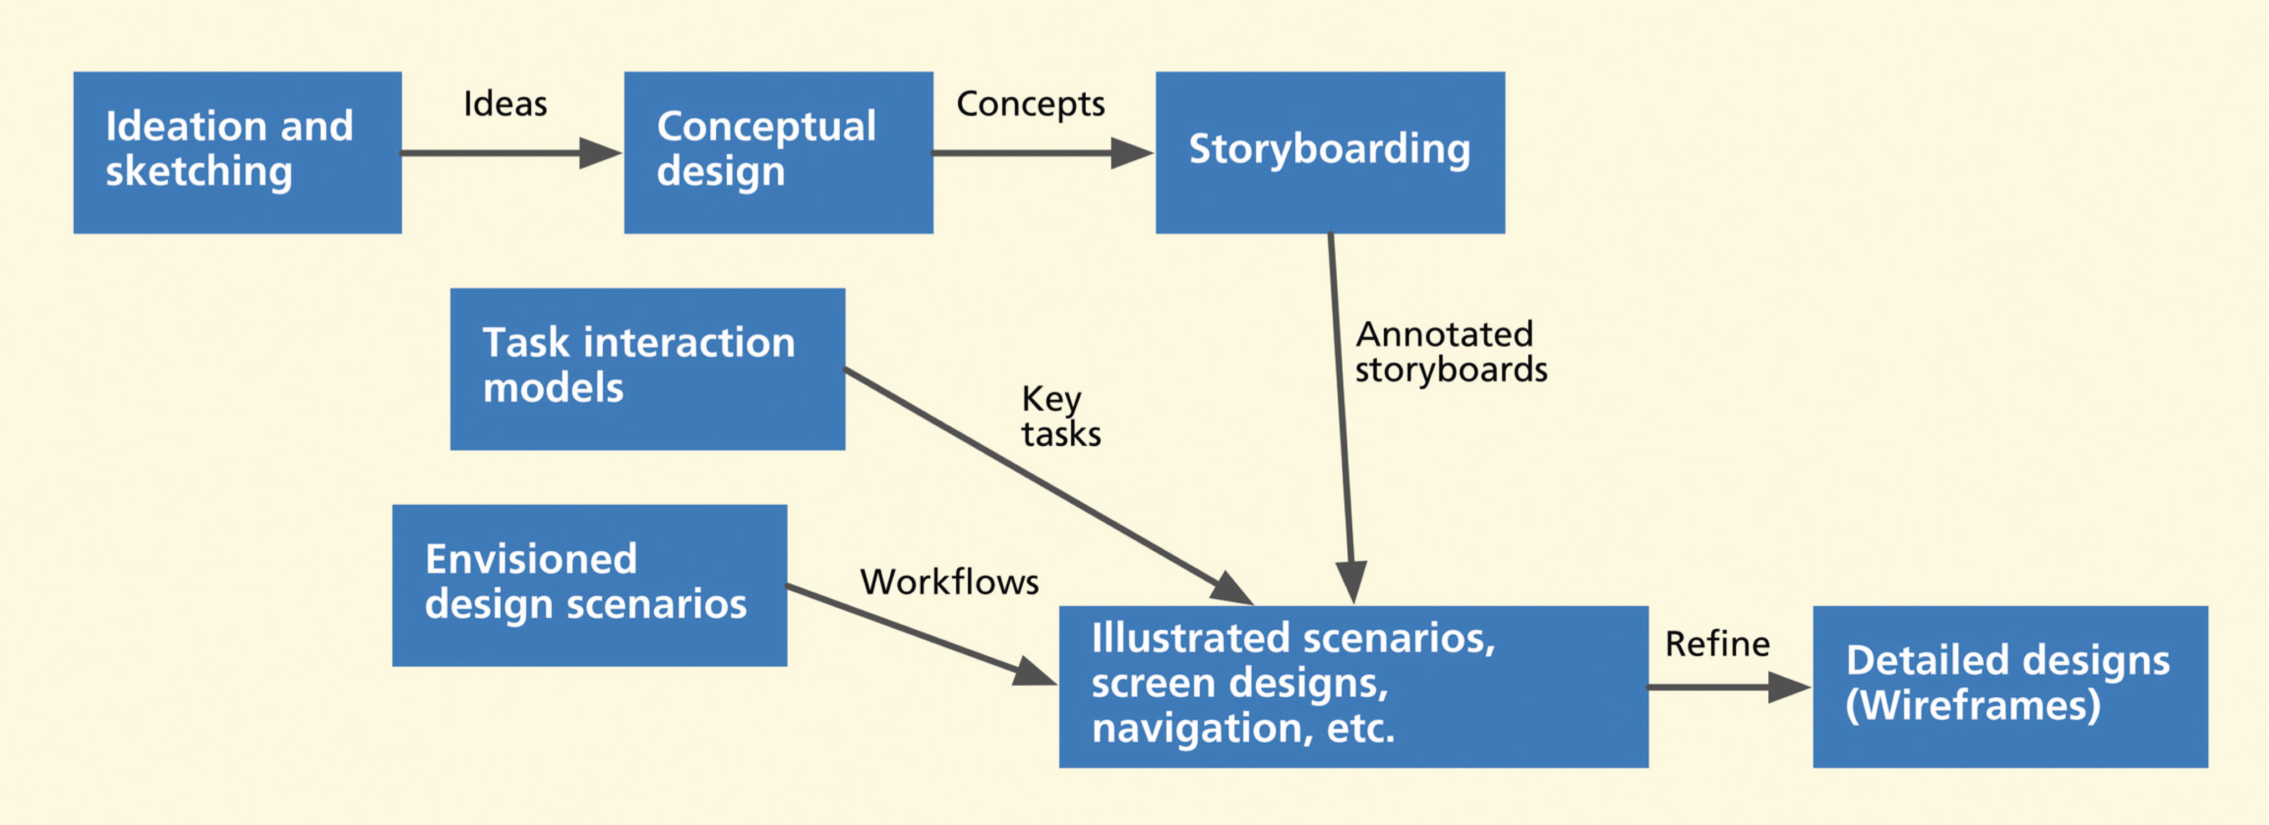
Wireframes (1)
The path to wireframes
56

Slide 57
Wireframes (2)
De facto representation medium for UX design at this stage
Prototyping
Documenting
Communicating to implementers

Slide 58
Wireframes (3)
Somewhat abstract schematic diagrams and “sketches”
Define Web page or screen content and navigational flow
Show approximate visual layout, behavior
Sometimes look and feel

Slide 59
Wireframes to represent design objects (1)
Major bread-and-butter tool of UX designers
Made of lines and outlines
Hence the name “wire frame”

Slide 60
Wireframes to represent design objects (2)
Boxes and other shapes to represent emerging design objects
Drawing is usually simple
Often just rectangular objects
Objects can be labeled, moved, and resized
Early wireframes should look simple, unfinished

Slide 61
Wireframes to represent navigation
Maps of screen or other state transitions during usage
Depict envisioned task flows
In terms of user actions on user interface objects

Slide 62
Example, wireframes
Web-based photo organizing and sharing application
Illustrates high-level conceptual design

Slide 63
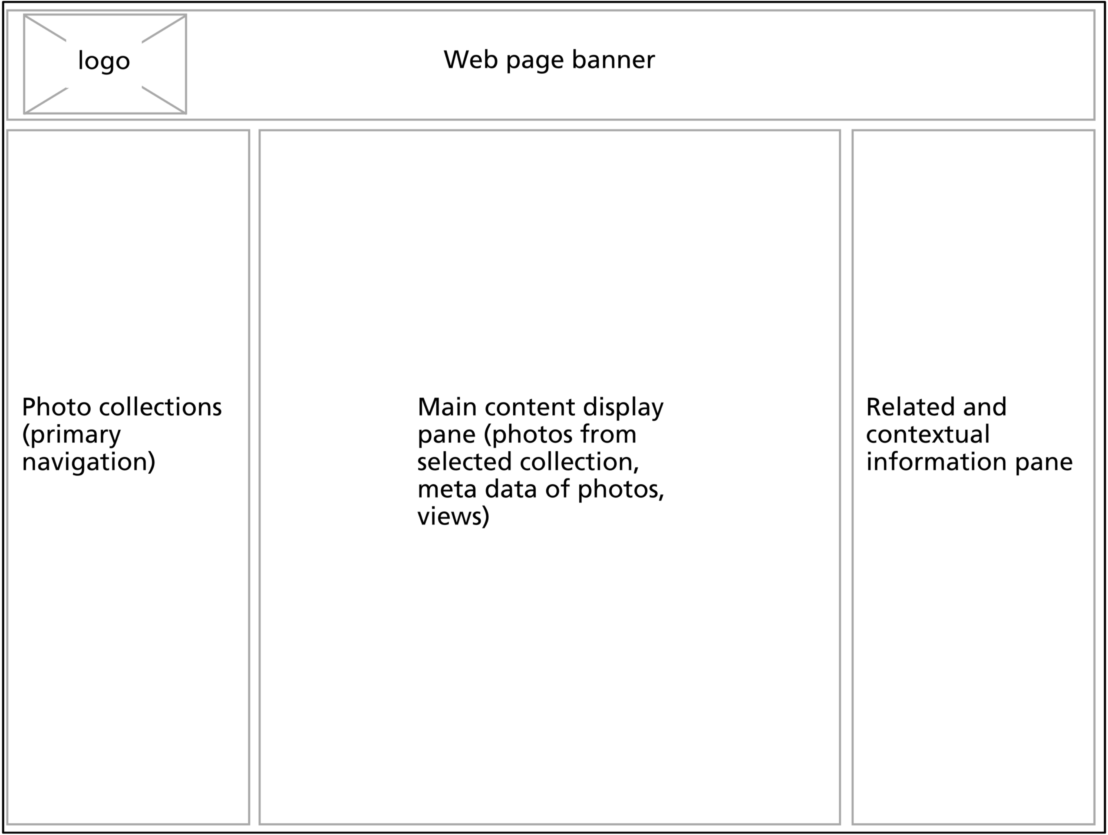

Slide 64
Nav-bar on left shows all user’s photo collections
Center pane is main photo display area
Thumbnails or individual photos
Right-hand pane shows detailed information about any selected photo

Slide 65
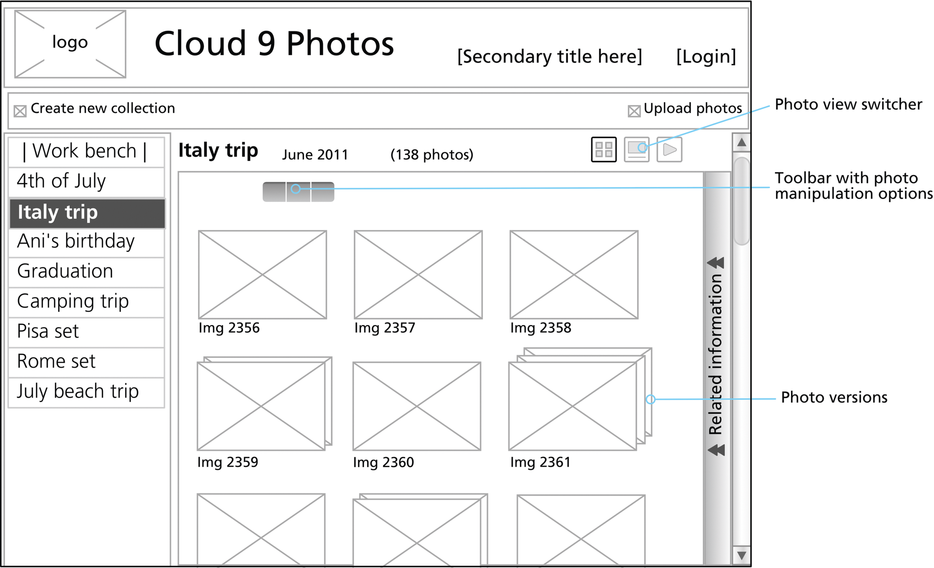
Design further elaborated: Shows right-hand side information pane collapsed

Slide 66
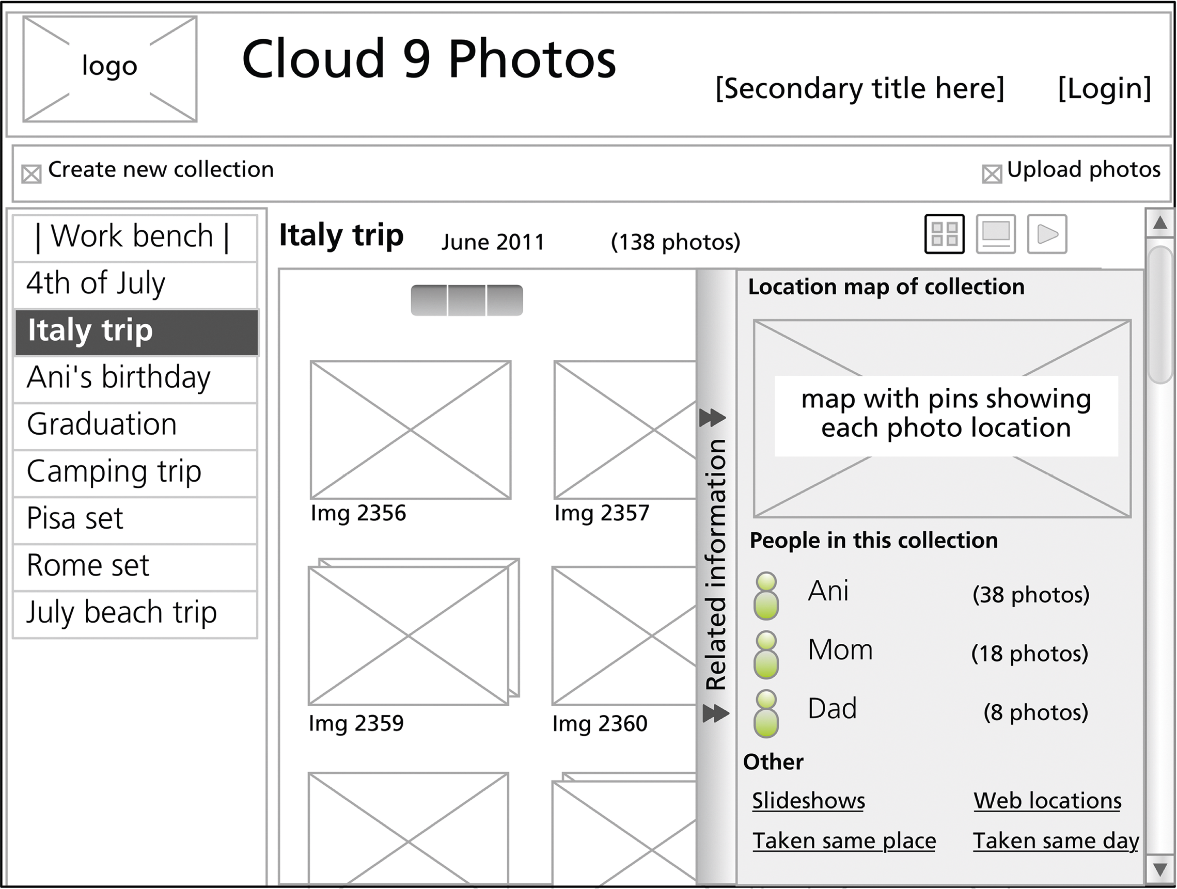
Show behavior: What happens when a user clicks on vertical “Related information” bar

Slide 67
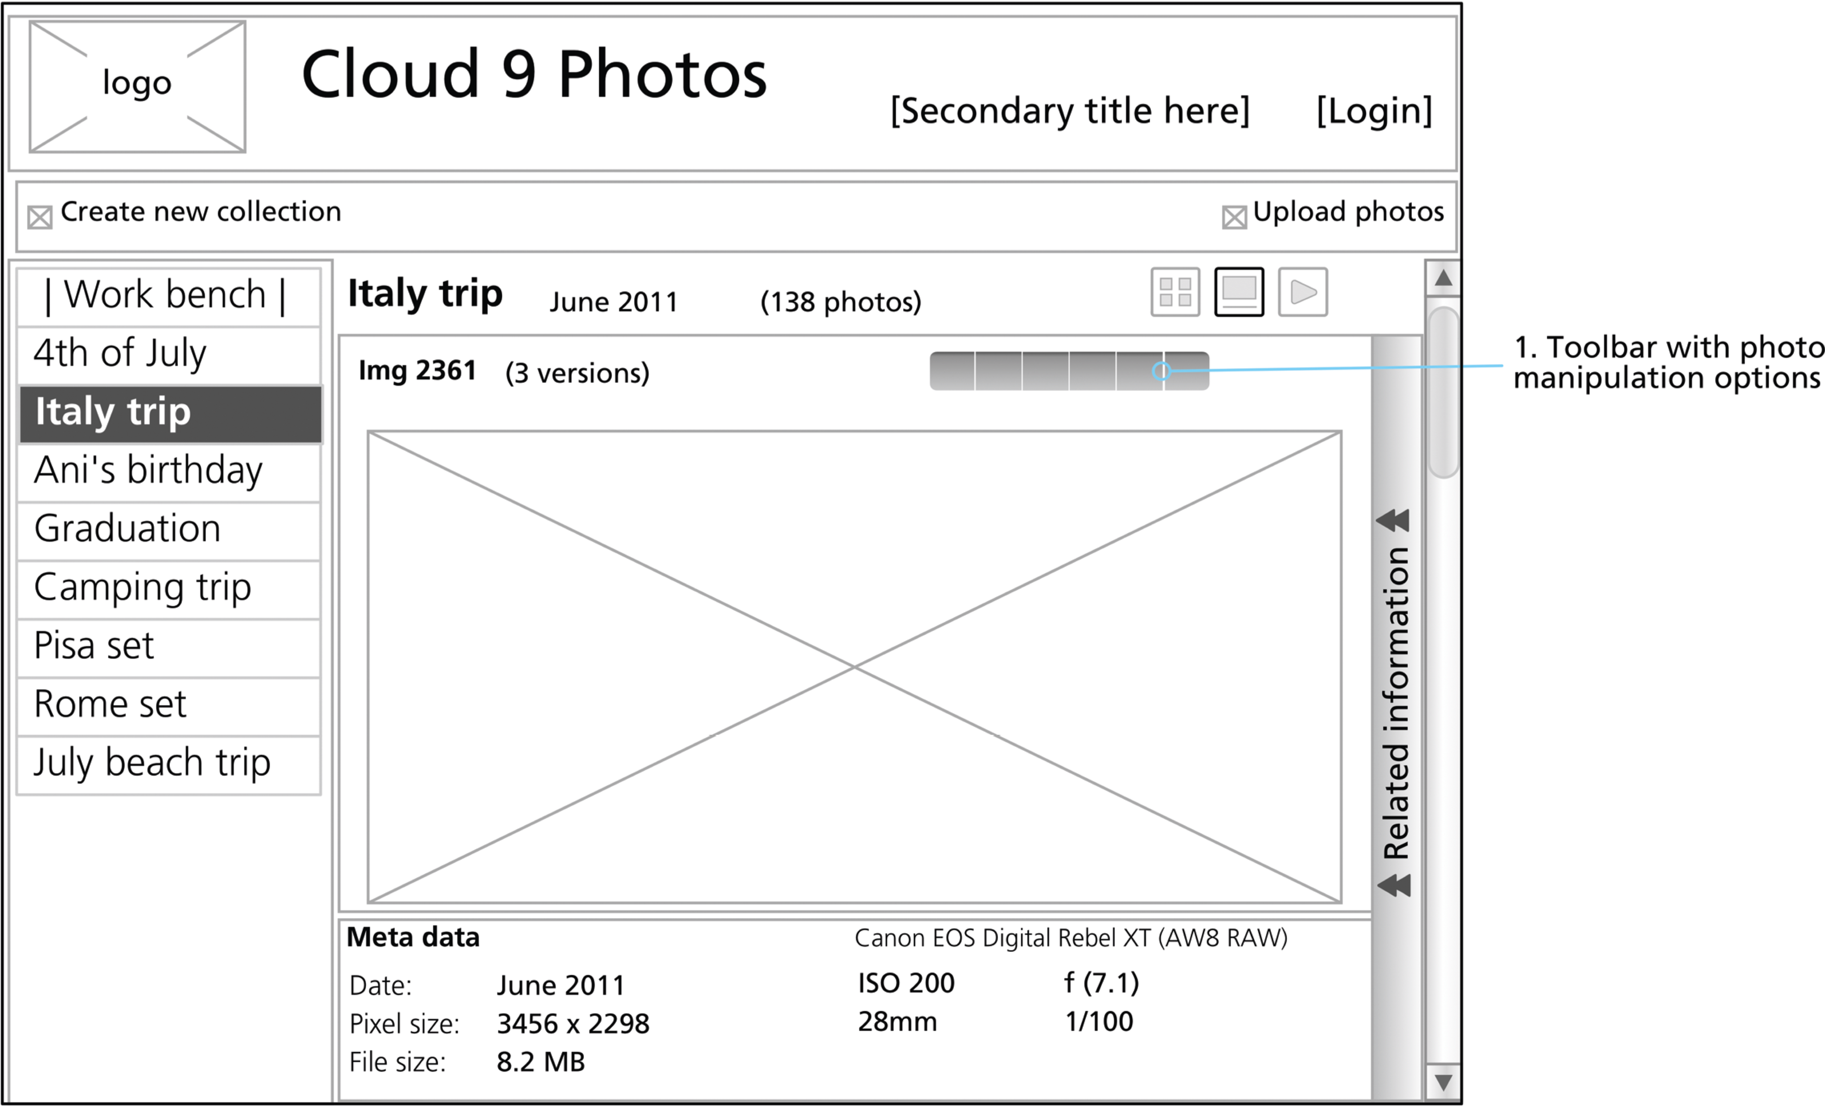
Show behavior: What happens when user clicks “one-up” icon in upper right hand corner

Slide 68
How are wireframes used? (1)
Conversational props to discuss design alternatives
To elicit feedback from potential users and other stakeholders
Helps you keep your eye on information architecture on screen

Slide 69
How are wireframes used? (2)
Designer can move through deck of wireframes
One slide at a time
Simulating potential scenario
Pretending to click on interaction widgets

Slide 70
How to build wireframes? (1)
Any drawing or word processing software
To support creating and manipulating shapes
Best: Tools designed specifically for this purpose
Sketch (for Mac)
OmniGraffle (for Mac)
Microsoft Visio (for PC)

Slide 71
How to build wireframes? (2)
Templates available for many basic shapes and UI objects
Some parts of wireframe can be generic, others detailed
Can add color, graphics, real fonts

Slide 72
Hints and tips for wireframing (1)
Be able to create multiple design representations quickly
Keep it modular—just as with any prototyping technique
Not too many concepts or details “hard coded” in any one frame
Build up using layers
Use separate layer for each repeating set of widgets on screen

Slide 73
Hints and tips for wireframing (2)
Example, container “window” of an application with its different controls
Specify once as layer and reuse in subsequent screens
Use stencils, templates, and libraries of widgets
Avoid re-inventing widgets
Find shared objects in tool libraries

Slide 74
Example: Wireframes for a National Park Website
Browse attractions, activities
Reserve campsites
Intermediate interaction design
Wireflow for exploring campsites
Courtesy of Ame Wongsa, Christina Janczak

Slide 75
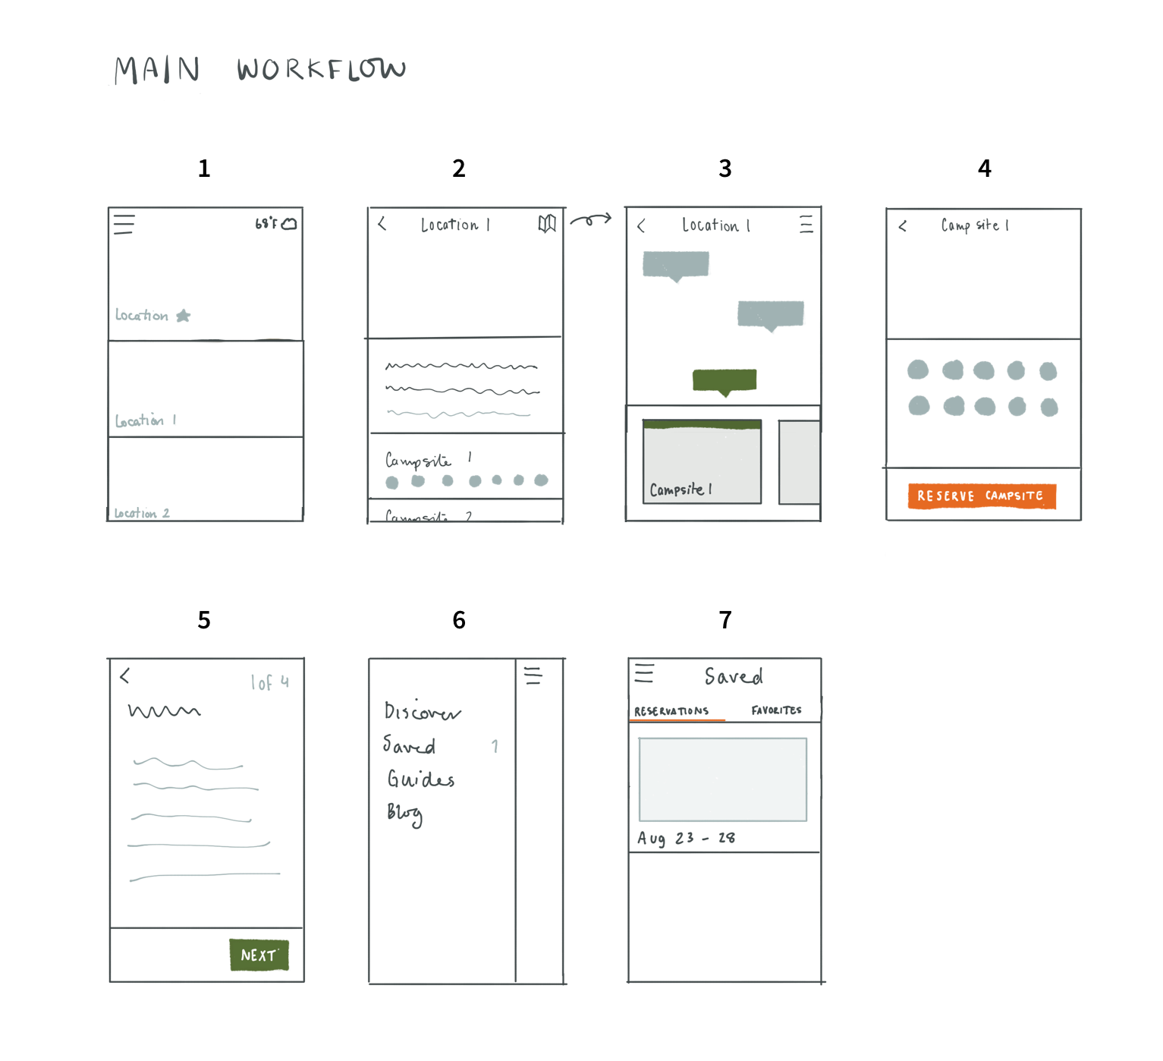

Slide 76
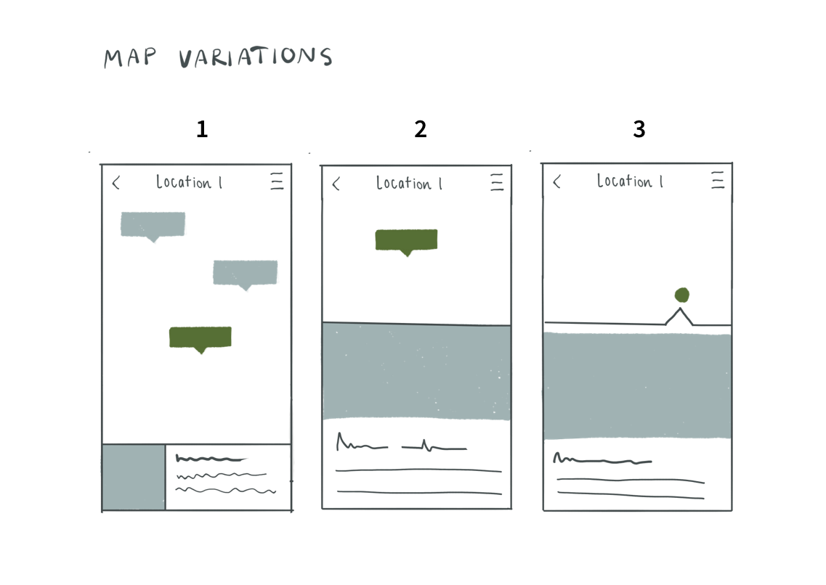
Intermediate design for seeing details of a campsite

Slide 77
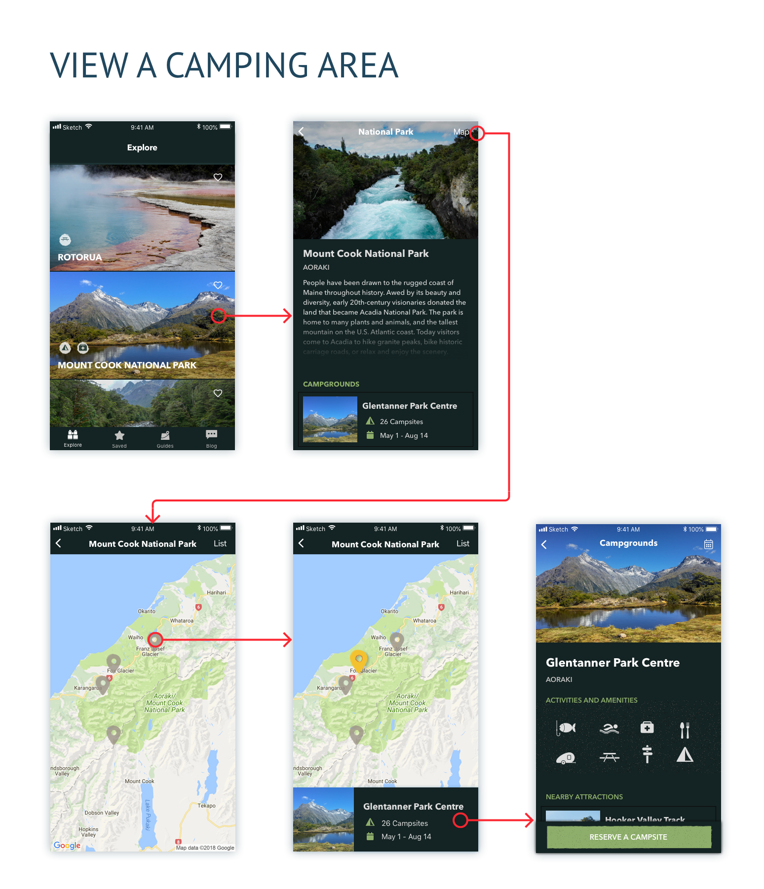
Design production (1)
Design for viewing camping areas on a phone
Note emerging importance of graphic design

Slide 78
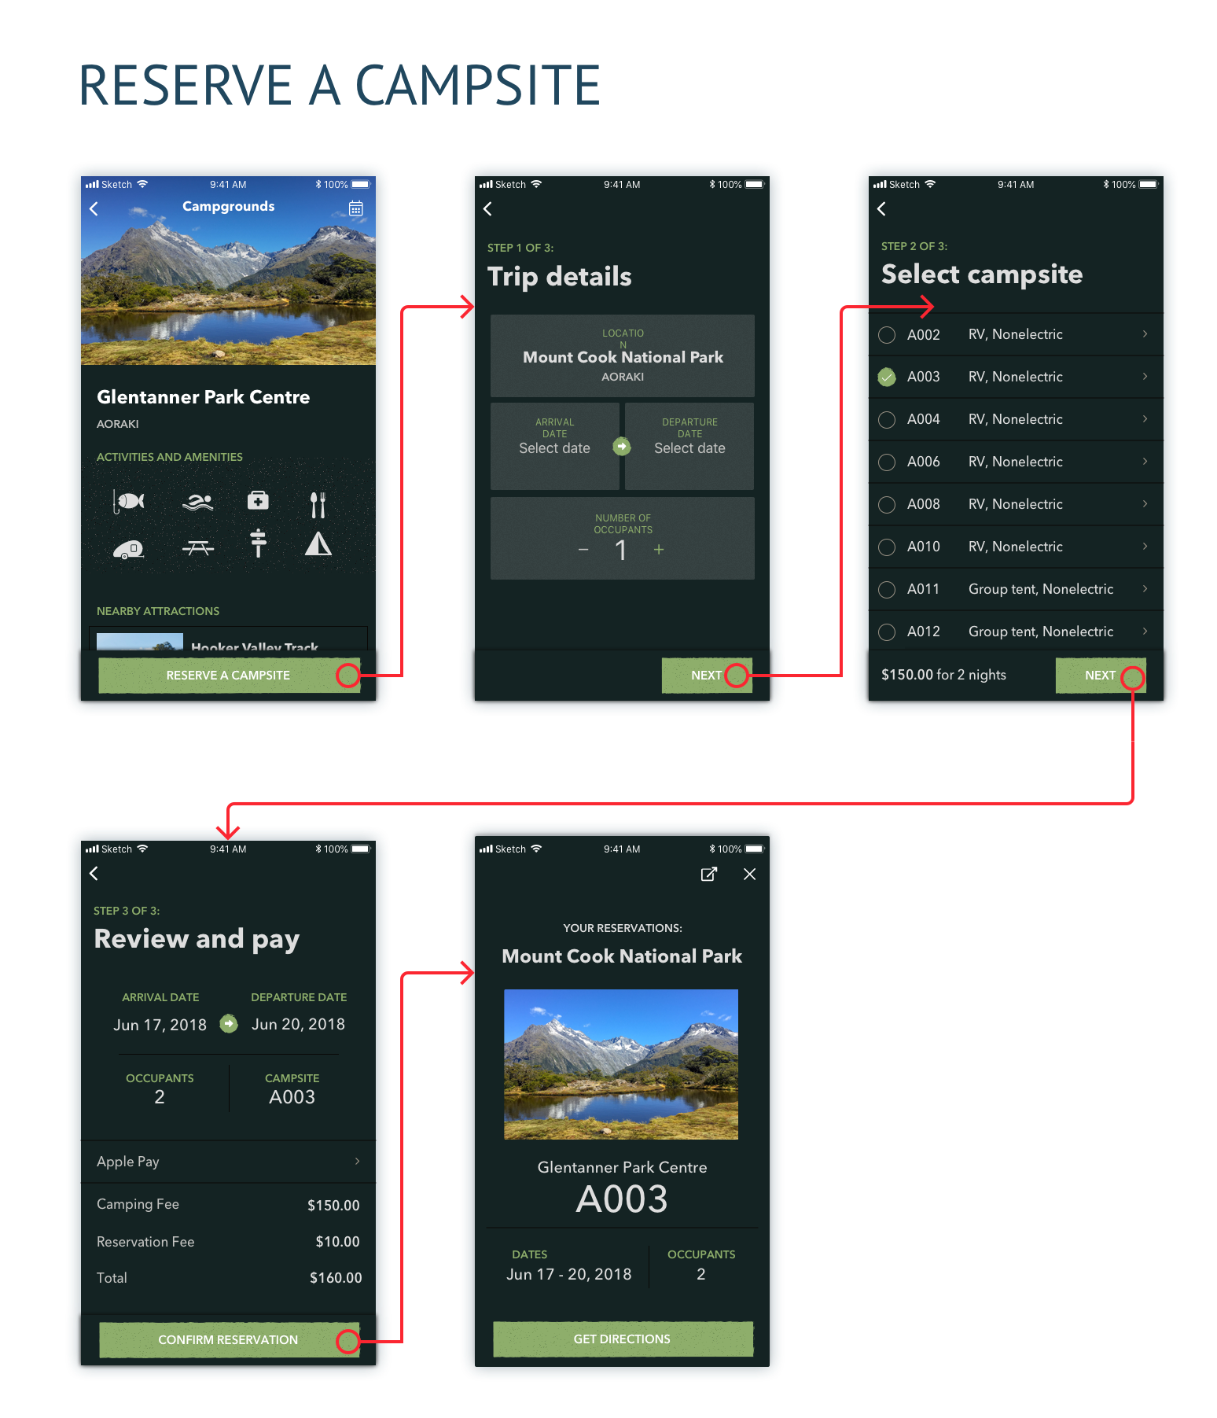
Design production (2)
Design for reserving a camping site

Slide 79
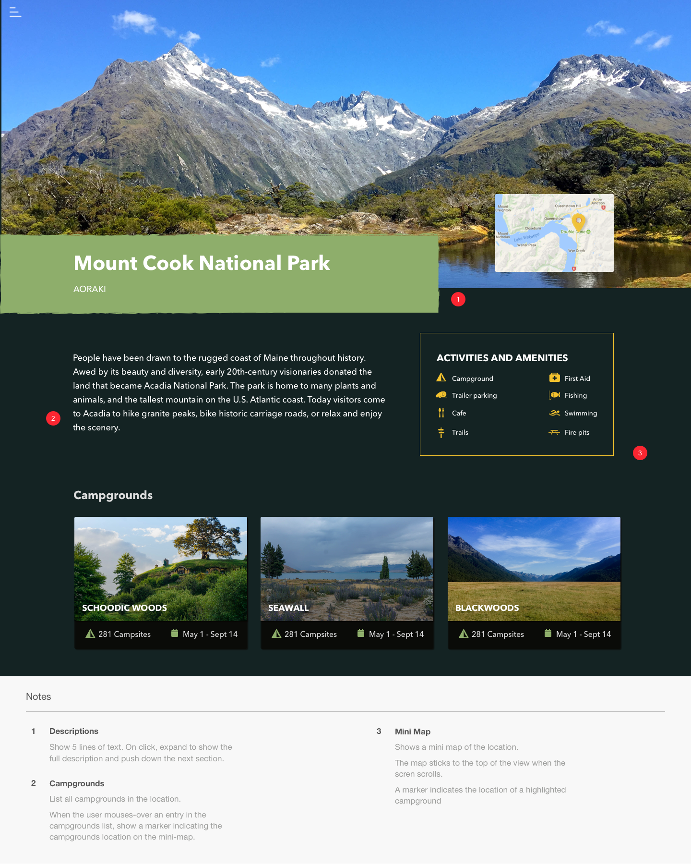
Design production (3)
Design for a park page

Slide 80
Maintain a custom style guide for each project
Documents design decisions
To avoid re-inventing
For consistency

Slide 81
Custom style guide
Everything you need standardized in design
Include all your wireframe elements:
Headers and footers
Content areas
Labeling
Menus, tabs, buttons, icons
Pop-ups
Messages
Navigation bar, navigation links
Placeholders for logos, branding
Search fields
Use of color and typography

Slide 82
Natural Parks Website example style guide

Slide 83
In-class exercise: Wireframing (1)
You will definitely need some kind of interaction interface, probably both on the product itself and on a PC connected to the product
For that interaction, make wireframes for some of the screens to illustrate your intentions for that part of the UX design
Examples: Setup work flow for new SmartFridge, customization work flow

Slide 84
In-class exercise: Wireframing (2)
Be creative and try to provide enough detail so that you have something to use with a physical mockup to evaluate in a later in-class exercise

Slide 85
Outside-class exercise: Preparation for prototyping (1)
Obtain a large cardboard box or something similar for building a physical mockup as a prototype of your SmartFridge product design
Bring it to class (we’ll talk about when we’re ready for the boxes)

Slide 86
Outside-class exercise: Preparation for prototyping (2)
Also bring any other materials and tools you might need, including marking pens straight-edge, tape, blank paper, scissors
We’ll have some box cutters

