Slide 1
Chapter 5

Slide 2
Objectives

Slide 3
The syntax for creating an array

Slide 4
The syntax for creating an array and assigning values in one statement

Slide 5
The syntax for referring to an element of an array

Slide 6
One property and one operator for an array
length – the number of elements in the array
delete – deletes the contents of an element and sets the
element to undefined, but doesn’t remove the element
from the array.

Slide 7
How to add an element to an array

Slide 8
How to delete an element at a specific index

Slide 9
Code that puts 1 through 10 into an array

Slide 10
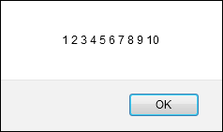
The message that’s displayed

Slide 11
Code that gets the sum and average of an array

Slide 12
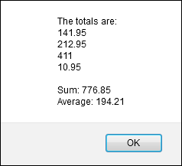
The message that’s displayed

Slide 13
The syntax of a for-in loop

Slide 14

The message that’s displayed

Slide 15
The difference between for and for-in loops

Slide 16
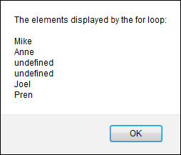
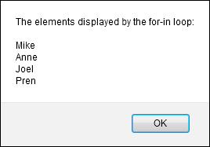
The messages that are created by the loops

Slide 17
Terms

Slide 18
Six of the methods of an Array object
Push(element_list) – Adds one or more elements to the end of the array, and
returns the new length of the array.
Pop() – removes the last element in the array, decrements the length, and
the element that it removed
Unshift(elements_list) – adds one or more elements to the beginning of the
array and returns the new length of the array
Shift() – Removes the first element in the array, decrements the array length,
and returns the element that it removed
Join(seperator) – when no parameter is passed, this method converts all the
elements of the array to strings and concatenates them seperated by commas. To
change the seperator, you can pass this method a string literal
toString() – Same as the join method without any parameter passed to it.

Slide 19
How to use the push and pop methods

Slide 20
How to use the unshift and shift methods

Slide 21
How to use the join and toString methods

Slide 22
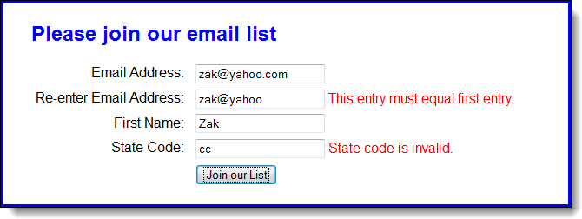
The Email List app with state code validation

Slide 23
The HTML file for the page

Slide 24
The JavaScript for the application

Slide 25
The JavaScript for the application (continued)

Slide 26
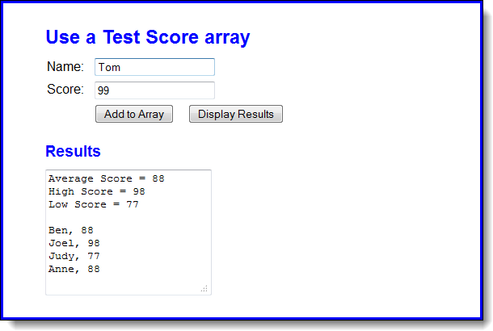
Extra 5-1: Use a Test Score array

Slide 27
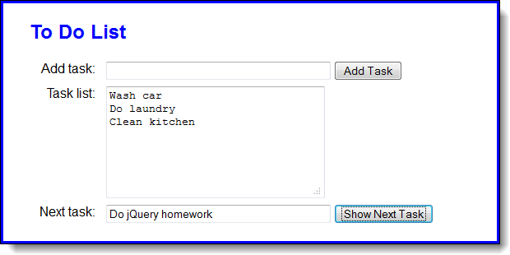
Extra 5-2: Develop a To Do List application

Slide 28
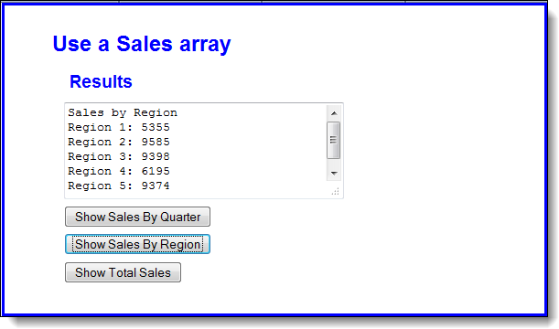
Extra 5-3: Use Sales arrays

Slide 29
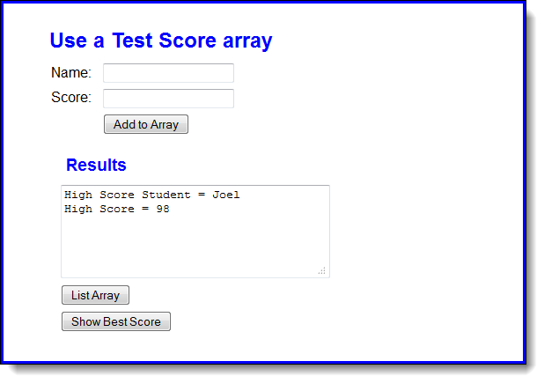
Short 5-1: Use Test Score arrays

