Slide 1


Session #7: Overview
© Kristian Secor 2021 UC San Diego Extension Online Learning Course: Intro to JavaScript

Slide 2
Using HTML5 Storage
Limitations in current browsers:
5 MB of storage from each origin.
Can not ask user for more
localStorage is permanent (Unless they know how to clear it)
sessionStorage is temporary (Based on the user session)
© Kristian Secor 2021 UC San Diego Extension Online Learning Course: Intro to JavaScript
2

Slide 3
Examples
How to set a localStorage token: localStorage.setItem(‘language’,’English’);
How to retrieve that a token:
var language = localStorage.getItem(‘language’);
© Kristian Secor 2021 UC San Diego Extension Online Learning Course: Intro to JavaScript
3

Slide 4
The same works for sessionStorage
sessionStorage.setItem(‘loggedin’,true); var status = sessionStorage.getItem(‘loggedin’);
if (status === true) {
//show password protected content
}
© Kristian Secor 2021 UC San Diego Extension Online Learning Course: Intro to JavaScript
4

Slide 5
We can clear these tokens
sessionStorage.removeItem(‘loggedin’);
…or clear all tokens
sessionStorage.clear();
..and of course localStorage has the same methods.
© Kristian Secor 2021 UC San Diego Extension Online Learning Course: Intro to JavaScript
5

Slide 6
Debugging Javascript
Recognize error types
Trace errors with dialog boxes and the console
Use comments to locate bugs
Trace errors with debugging tools
Write code to respond to exceptions and errors
© Kristian Secor 2021 UC San Diego Extension Online Learning Course: Intro to JavaScript
7

Slide 7
Understanding Syntax Errors
Syntax errors
  Occur when interpreter fails to recognize code ir: var kris = “teacher;
  Causes
    Incorrect use of JavaScript code
    References to non-existent objects, methods, variables

Slide 8
Handling Run-Time Errors
Run-time errors
  Occur when interpreter encounters a problem while program executing
    Not necessarily JavaScript language errors
  Occur when interpreter encounters code it cannot execute
  Run-time error can be caused by a syntax error

Slide 9
Logic Errors
Logic errors
  Program’s design is flawed
    Prevents program from running as anticipated
  “Logic” reference
    Execution of program statements and procedures in the correct order to produce the desired results

Slide 10
Logic Errors Example
Example: infinite loop
for (var count = 10; count >= 0; count) { console.log("We have liftoff in " + count);
}
Example: infinite loop corrected
for (var count = 10; count >= 0; count--) {
console.log("We have liftoff in " + count);
}

Slide 11
Interpreting Error Messages
First line of defense in locating bugs
  Browser console displays
    Line number where error occurred
    Error description
Run-time errors
  Error messages generated by a web browser
    Can be caused by syntax errors but not by logic errors
  Example:test.html:4 Uncaught SyntaxError: Unexpected end of input
function missingClosingBrace() {
var message = "This function is missing a closing brace.";
window.alert(message);
© Kristian Secor 2021 UC San Diego Extension Online Learning Course: Intro to JavaScript
12

Slide 12
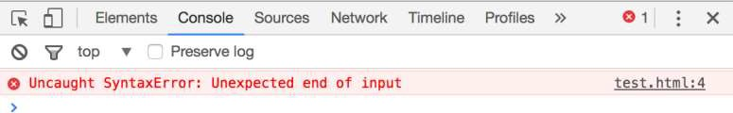
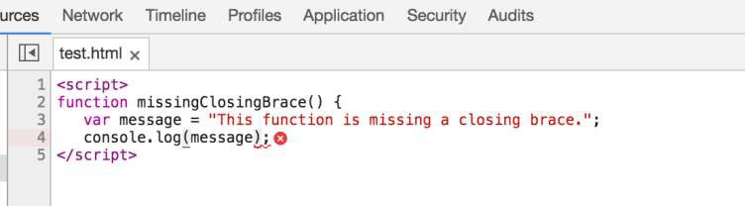
Interpreting Error Messages
© Kristian Secor 2021 UC San Diego Extension Online Learning Course: Intro to JavaScript

Slide 13
Interpreting Error Messages
Error message
  Displays error’s general location in a program
    Not always accurate
Browsers do not strictly enforce JavaScript syntax
How to reduce bugs in JavaScript programs:
  Always use good syntax
  Thoroughly test with every browser type, version
    Test browser if used by more than one percent of the market
© Kristian Secor 2021 UC San Diego Extension Online Learning Course: Intro to JavaScript

Slide 14
Tracing Errors with the console.log() Method
Trace a bug by analyzing a list of values
Logging
  writing values directly to the console using the console.log() method
  syntax: console.log(value);
  can log string literal, variable value, or combination
Example
  calculateInterest() function
© Kristian Secor 2021 UC San Diego Extension Online Learning Course: Intro to JavaScript
15

Slide 15
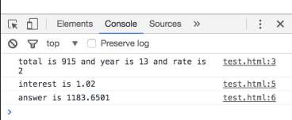
Tracing Errors (cont’d.)
var calculateInterest = function (total,year,rate) {
console.log("total is " + total + " and year is " + year + " and rate is " + rate);
var interest = rate/100+1; console.log("interest is " + interest);
var answer = parseFloat((total*Math.pow(interest,year)).toFixed(4))) ; console.log("answer is " + answer);
return answer;
}
var interestaccrued = calculateInterest(915,13,2);
© Kristian Secor 2021 UC San Diego Extension Online Learning Course: Intro to JavaScript

Slide 16
Using Comments to Locate Bugs
Another method of locating bugs
  “Comment out” problematic lines
Helps isolate statement causing the error
When error message first received
  Start by commenting out only the statement specified by the line number in the error message
  Continue commenting lines until error eliminated

Slide 17
Tracing Errors with Debugging Tools
Examining code manually
  Usually first step taken with a logic error
  Works fine with smaller programs
Debugging tools
  Help trace each line of code
  More efficient method of finding and resolving logic errors
© Kristian Secor 2021 UC San Diego Extension Online Learning Course: Intro to JavaScript

Slide 18
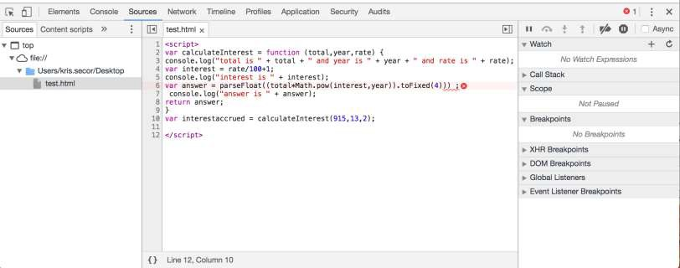
Understanding the Chrome Debugger
© Kristian Secor 2021 UC San Diego Extension Online Learning Course: Intro to JavaScript

Slide 19
Setting Breakpoints
Break mode
  Temporary suspension of program execution
  Used to monitor values and trace program execution
Breakpoint
  Statement where execution enters break mode
When program paused at a breakpoint
  Use debug tools to trace program execution
© Kristian Secor 2021 UC San Diego Extension Online Learning Course: Intro to JavaScript

Slide 20
Throwing Exceptions
Execute code containing an exception in a try statement
throw statement
  Specifies an error message in case an error that occurs within a try block
try {
var lastName = document.getElementById("lName").value; if (lastName === "") {
throw "Please enter your last name.";
}
}
© Kristian Secor 2021 UC San Diego Extension Online Learning Course: Intro to JavaScript

Slide 21
Catching Exceptions
Use a catch statement
  Handles, or “catches” the error
Syntax:
catch(error) {
statements;
}
Example:
catch(lNameError) {
window.alert(lNameError); return false;
}
© Kristian Secor 2021 UC San Diego Extension Online Learning Course: Intro to JavaScript

Slide 22
Executing Final Exception Handling Tasks
finally statement
  Executes regardless of whether its associated try block throws an exception
  Used to perform some type of cleanup
    Or any necessary tasks after code evaluated with a try statement

Slide 23
Checking HTML Elements
If a bug cannot be located using methods described
here
  Perform a line-by-line analysis of the HTML code
  Ensure all necessary opening and closing tags included
Use code editor specialized for web development
  Highlights syntax errors as you type
Use the W3C Markup Validation Service to validate a Web page: https://validator.w3.org/
© Kristian Secor 2021 UC San Diego Extension Online Learning Course: Intro to JavaScript

Slide 24
Using Strict Mode
Strict mode
  Removes some features from JavaScript
  Requires more stringent syntax for other features
    Example: must always use var to declare variables
Include statement "use strict";
  Including at start of script section requests strict mode for all code in that section
  Including at start of code block in function requests
strict mode just for that function
© Kristian Secor 2021 UC San Diego Extension Online Learning Course: Intro to JavaScript

Slide 25
Reloading a Web Page/Clear Cache
Usually click the browser Reload or Refresh button
Web browser cannot always completely clear its memory
  Remnants of an old bug may remain
  Force web page reload
    Hold Shift key and click the browser’s Reload or Refresh button
May need to close browser window completely
May need to delete frequently visited web pages
© Kristian Secor 2021 UC San Diego Extension Online Learning Course: Intro to JavaScript

Slide 26
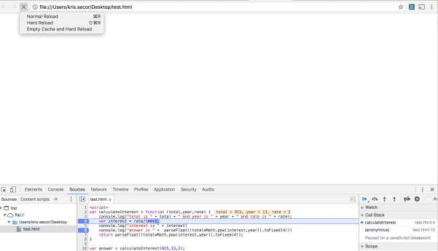
Clearing Cache
In Chrome, if you have your dev tools open, you can:
© Kristian Secor 2021 UC San Diego Extension Online Learning Course: Intro to JavaScript

Slide 27
Linting
Running code through a program that flags some common issues that may affect code quality
jslint is a commonly used linting program
Similar result to using strict mode, but generates a report containing line numbers
jslint.com
© Kristian Secor 2021 UC San Diego Extension Online Learning Course: Intro to JavaScript
28

