Slide 1

Session #9: User Testing/Critiques

Slide 2
Choose your subjects
Results are only as good as your testers
Try not to use friends, family or coworkers due to external limitations and delimitations (yes I know many of us did this during the semester)
Be on the look out for anything that might cloud judgment

Slide 3
Before Testing
Users must be relaxed
Instructions must be clear, brief and in layman’s terms
Do not use terms like “usability testing” or “market research”
Release forms need to worded simply, without confusion

Slide 4
How to Begin
Before testing, get the user familiar with the environment.
Get initial feedback before interaction
Note the users terms and phraseology
Make sure they know they are not what is being tested.

Slide 5
Choosing Tasks
Choose Critical Tasks to perform
Check your ego at the door
Ask the user to suggest tasks to test as this will add importance to the user and might change your perception as to what about the site or software the layman sees as important.
Has it changed your priorities?

Slide 6
Wording Tasks
Use scenarios instead of directions
This will add a real life aspect
For example, “find a telephone number” is more natural than “find the contact page”
Use “purchase a large blue collared shirt” instead of “use the search function to buy a shirt”

Slide 7
One task at a time.
Too many complicated tasks can intimidate and alter how a user approaches tasks. Given two tasks, the user may rush through the first, corrupting our data.
External functions, like reset passwords must be presented to avoid delay or mix- ups

Slide 8
Your Behavior:Keep Quiet!!!
After setting up the user, back away
Better to be silent and out of site
The same goes for a client who wants to watch the testing.

Slide 9
Post Test
Time to gather as much info as possible
Ask for suggestions, it’s your last chance
Ask the user what they remember

Slide 10
Some basic closing topics
Fulfillment: Do users feel satisfied after interacting with
the website?
Usefulness: Does the user feel like he's obtained value from using the website?
Enjoyment: Is the experience of being on the website fun and not burdensome?
Positive Emotions: Do users feel happy, excited, pleased, etc. when they interact with the site?

Slide 11
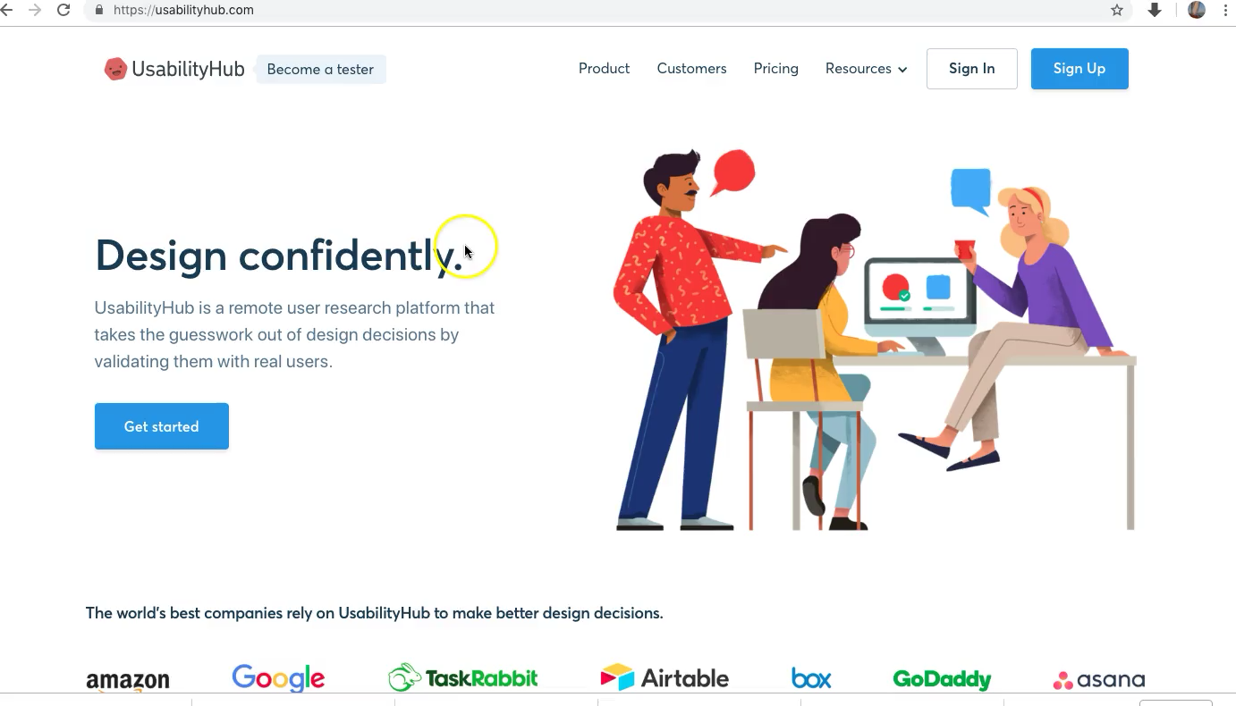
Some useful tools

Slide 12
Summary
We can also use Questionaires and Interviews, but Observation is the best.
As we review your prototypes, we need to make sure you can read through false data as our opinions are obscured by the course material. Better to have a real test, but it’s the best we can do at this point.

