Slide 1

Waste free near me Final design Presentation
Birgit Pilve
Principles of User Experience
Professor Secor
23 March 2020

Slide 2

Use Case
Environmental awareness is on the rise. With the prevalence of the internet, information about how to make your lifestyle more environmentally friendly is readily available and sustainability as a whole is growing in popularity
However, many people interested in making the switch have no idea where to begin
A solution to this? An app that would allow users to explore and recommend businesses that offer environmentally friendly services in their neighborhoods

Slide 3
Use Case
Through this app, users would be able to use their location to pull up a local map with recommendations based on what they are looking for
After an initial search, users would be able to see what products the business offers and what fellow users have to say about them
Then, a simple click would redirect them into their preferred Maps application for directions

Slide 4

User Persona
Meet Melissa Brooks, an ideal user persona for Waste Free Near Me
Melissa is a twenty-two-year-old university graduate
She recently moved into her first apartment with two roommates
Works full time as a research assistant, driving her Honda Civic to work five days per week (it’s affordable and still gets great gas mileage!)
Aware of the current climate crisis and wants to know how she can do her part through making subtle changes to her lifestyle
Active on social media, following many eco-friendly and zero-waste influencers
Looking primarily for package-free products and groceries, refill stations, and composting locations
Driven, tech-savvy, curious, conscientious.

Slide 5
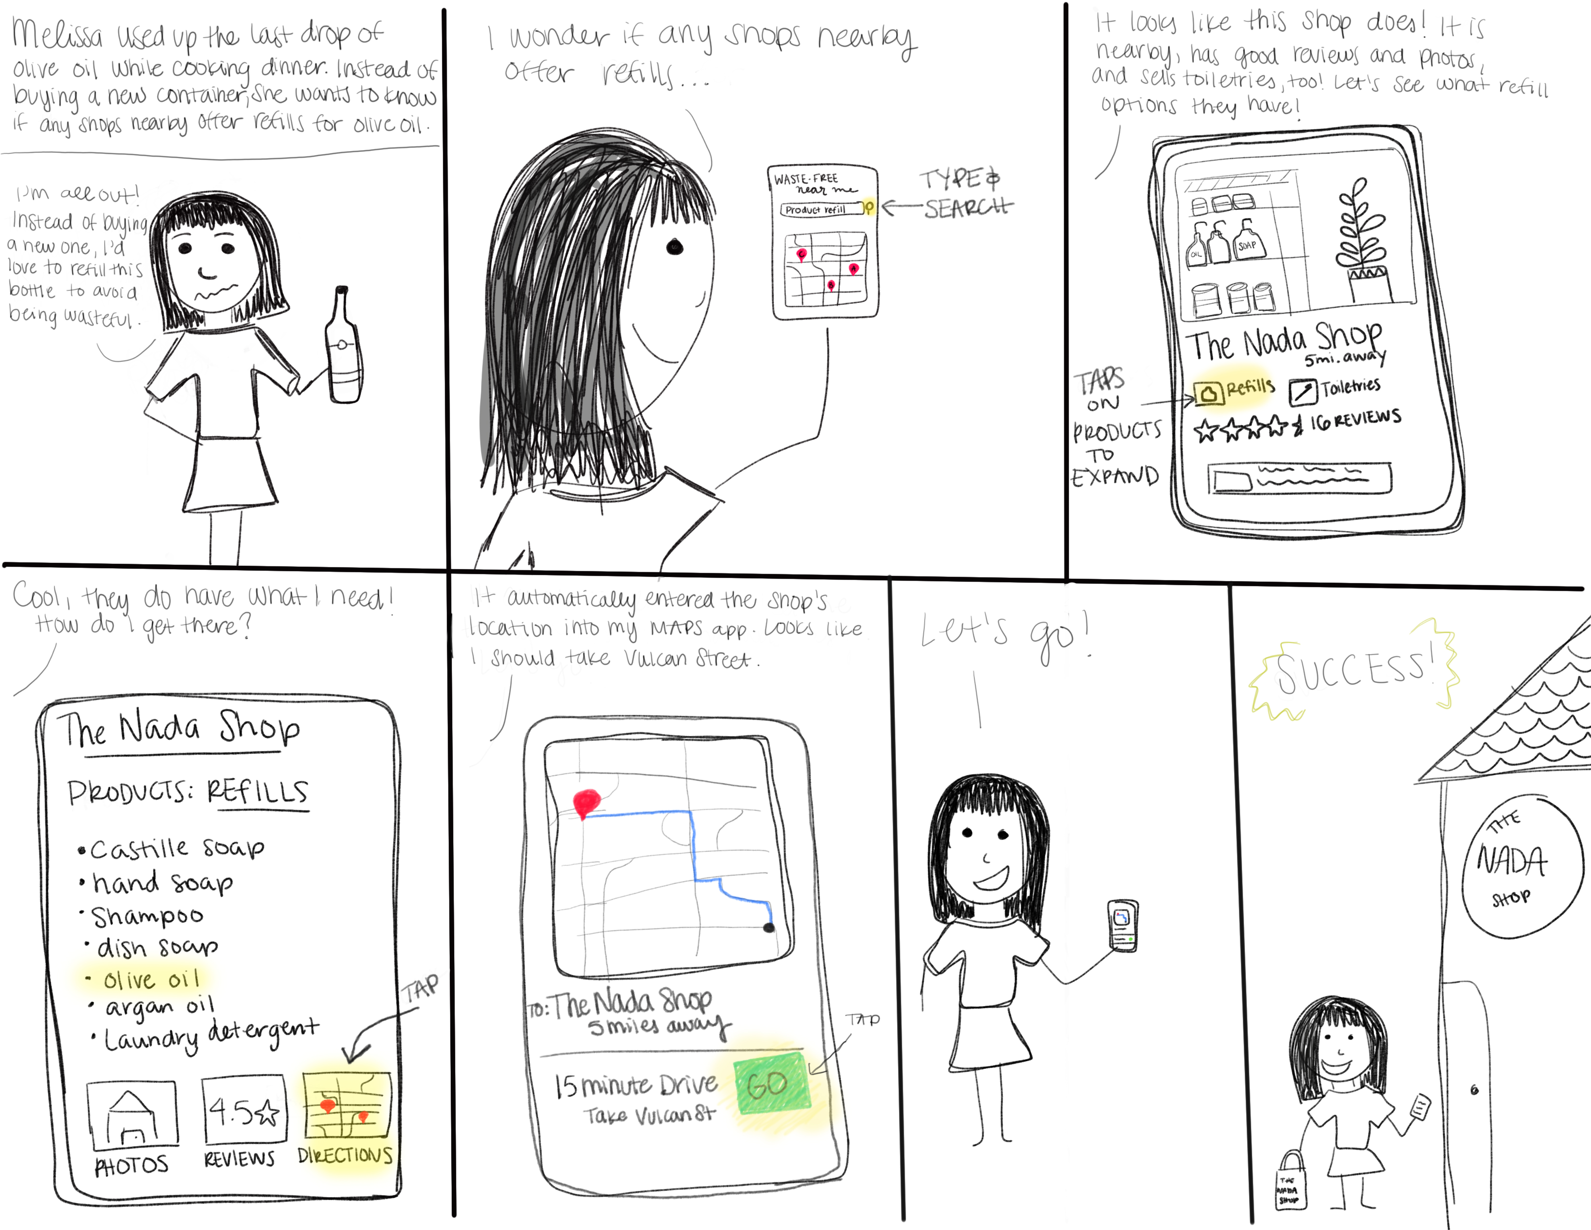
Storyboard
Through creating a storyboard, we can take a scenario in which Melissa would benefit from an app of this nature. In this case, she is looking for a place nearby that offers product refills

Slide 6
Wireframe
Through creating a wireframe for the app, we can get a rough idea of what the app’s general layout and features will be
In my initial design, I had many more added features that I planned on adding into the application, such as the option to add photos, include links to the company’s website, and over 6 categories of products and services to choose from
In order to make the project a bit more manageable, I referred back to the user persona to prioritize what was most important to them and what should primarily be featured (moving back from the “design” step of the wheel to “re-analyze” the user’s priorities)

Slide 7
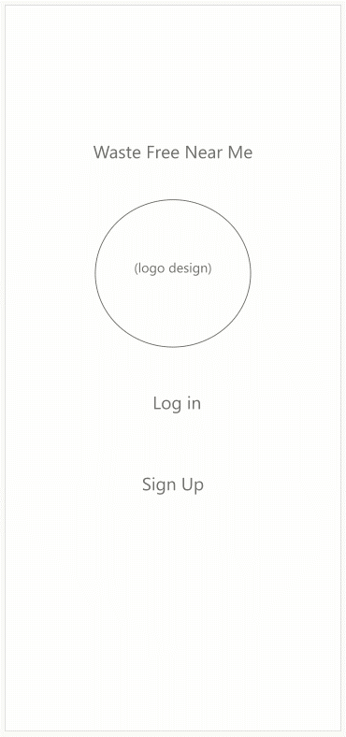
Wireframe
Key Points:
Maintain minimalism
Incorporate search, favorite, and review features
Moderate account personalization
Incorporate map view, ability to receive directions, and switch between navigation apps with ease
Wireframe is available here.
Click “play” to see a walkthrough of the wireframe.

Slide 8
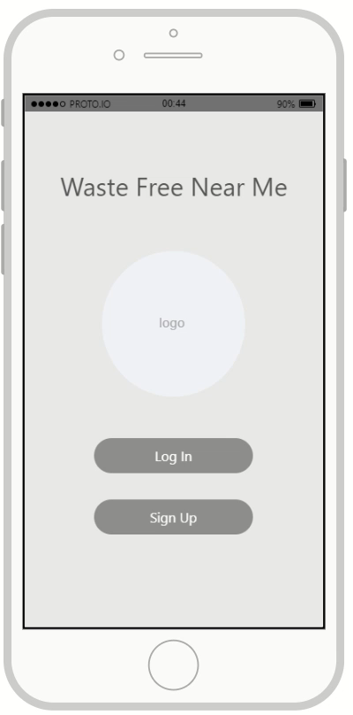
Prototype
Using the wireframe as a guideline, a prototype is created to add user interactivity and bring life into the app
Prototype is available here.
Key Points:
Incorporate easy-to-navigate commands
Smooth transitions and interactivity
Click “play” to see a walkthrough of the prototype.

Slide 9
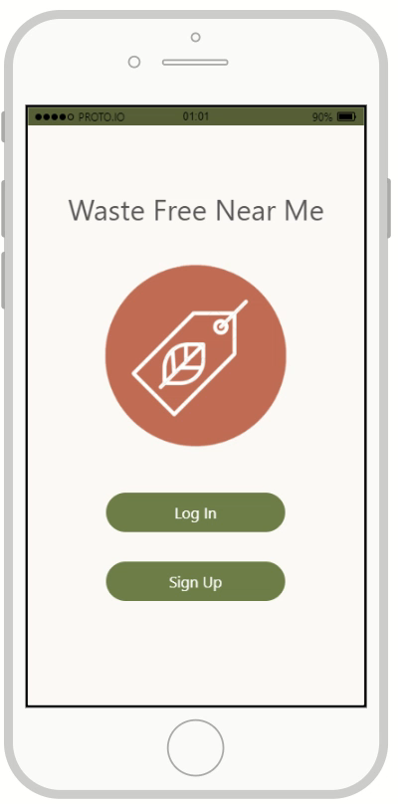
Final Design
The design is finalized through the addition of aesthetics, pictures, and personal touches
A neutral color palette with an olive green emphasis matches and encourages the environmental focus of the app
Final design is available here.
Click “play” to see a walkthrough of the final design.

Slide 10
Final Thoughts
Looking back on this project from start to finish, everything was completed fairly smoothly. I did overcome some hurdles, including learning which features to prioritize when it comes to importance and my current skillset.
Although most of the programs I used throughout this project were new to me, I consider learning how to use them and create a finished product a major success in my UX journey.
Overall, I am pleased with the outcome of Waste Free Near Me and would love to see it created in its full capacity someday.

