Slide 1
WDM3315 Week 3
Eclipse, Android and Java

Slide 3
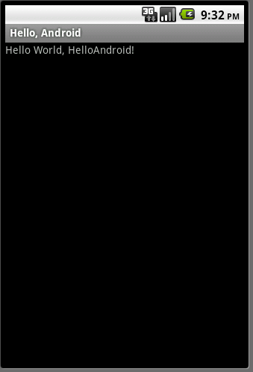
Goal
Create a very simple application
Run it on a real device
Run it on the emulator
Examine its structure

Slide 4
Google Tutorial
We will follow the tutorial at:
http://developer.android.com/resources/tutorials/hello-world.html
Start Eclipse (Start -> All Programs -> Eclipse)
Create an Android Virtual Device (AVD)
Create a New Android Project

Slide 5
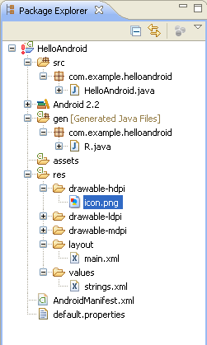
Package Content
All source code here
Java code for our activity
All non-code
resources
Generated Java code
Helps link resources to
Java code
Images
Layout of the activity
Strings used in the
program
Android Manifest

Slide 6
Android Manifest
<?xml version="1.0" encoding="utf-8"?>
<manifest xmlns:android="http://schemas.android.com/apk/res/android"
package="com.example.helloandroid"
android:versionCode="1"
android:versionName="1.0">
<application android:icon="@drawable/icon" android:label="@string/app_name">
<activity android:name=".HelloAndroid"
android:label="@string/app_name">
<intent-filter>
<action android:name="android.intent.action.MAIN" />
<category android:name="android.intent.category.LAUNCHER" />
</intent-filter>
</activity>
</application>
</manifest>

Slide 7
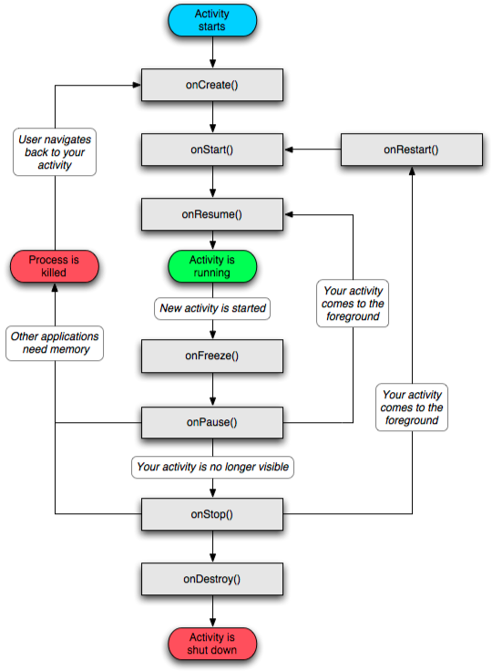
Activity
An Android activity is focused on a single thing a user can do.
Most applications have multiple activities

Slide 8
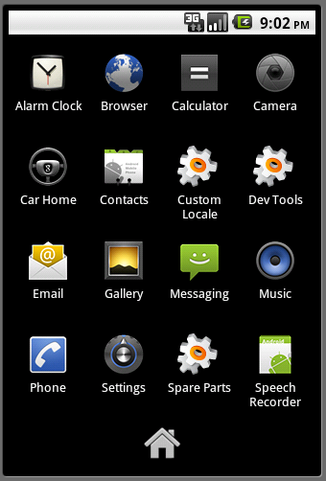
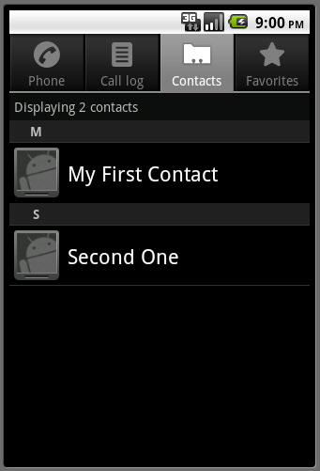
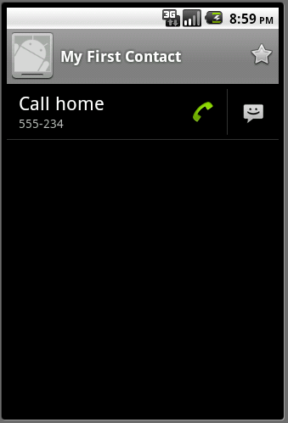
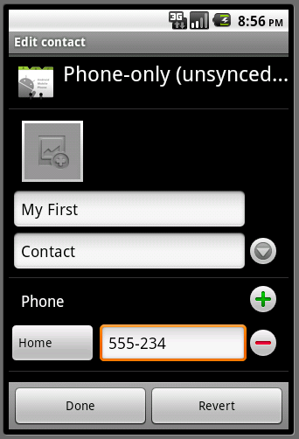
Activities start each other

Slide 9
Revised HelloAndroid.java
package com.example.helloandroid; import android.app.Activity; import android.os.Bundle; import android.widget.TextView; public class HelloAndroid extends Activity { /** Called when the activity is first created. */ @Override public void onCreate(Bundle savedInstanceState) { super.onCreate(savedInstanceState); TextView tv = new TextView(this); tv.setText("Hello, Android – by hand"); setContentView(tv); } }
Inherit from the Activity Class
Set the view “by hand” – from the program

Slide 10
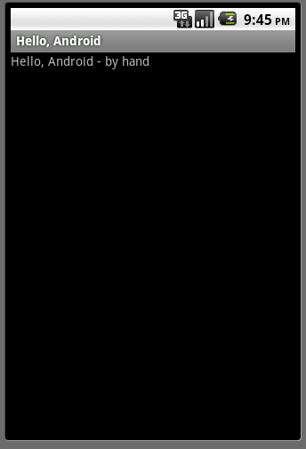
Run it!

Slide 11
/res/layout/main.xml
<?xml version="1.0" encoding="utf-8"?>
<LinearLayout xmlns:android="http://schemas.android.com/apk/res/android"
android:orientation="vertical"
android:layout_width="fill_parent"
android:layout_height="fill_parent"
>
<TextView
android:layout_width="fill_parent"
android:layout_height="wrap_content"
android:text="@string/hello"
/>
</LinearLayout>
Further redirection to /res/values/strings.xml

Slide 12
/res/values/strings.xml
<?xml version="1.0" encoding="utf-8"?>
<resources>
<string name="hello">Hello World, HelloAndroid – by resources!</string>
<string name="app_name">Hello, Android</string>
</resources>

Slide 13
HelloAndroid.java
package com.example.helloandroid;
import android.app.Activity;
import android.os.Bundle;
public class HelloAndroid extends Activity {
/** Called when the activity is first created. */
@Override
public void onCreate(Bundle savedInstanceState) {
super.onCreate(savedInstanceState); setContentView(R.layout.main);
}
}
Set the layout of the view as described in the main.xml layout

Slide 14
/gen/R.java
package com.example.helloandroid; public final class R { public static final class attr { } public static final class drawable { public static final int icon=0x7f020000; } public static final class id { public static final int textview=0x7f050000; } public static final class layout { public static final int main=0x7f030000; } public static final class string { public static final int app_name=0x7f040001; public static final int hello=0x7f040000; } }

Slide 15
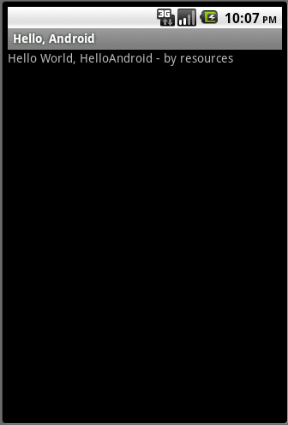
Run it!

Slide 16
Introduce a bug
package com.example.helloandroid; import android.app.Activity; import android.os.Bundle; public class HelloAndroid extends Activity { /** Called when the activity is first created. */ @Override public void onCreate(Bundle savedInstanceState) { super.onCreate(savedInstanceState); Object o = null; o.toString(); setContentView(R.layout.main); } }

Slide 17
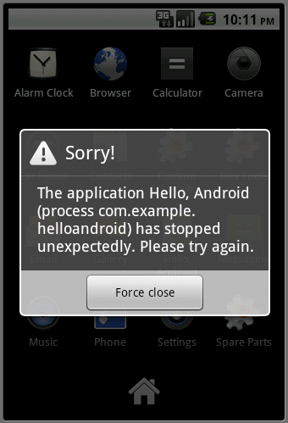
Run it!

Slide 18
Java
Java is an object-oriented language, with a syntax similar to C
Structured around objects and methods
A method is an action or something you do with the object
Avoid those overly complicated features of C++:
Operator overloading, pointer, templates, friend class, etc.

Slide 19
How it works…!
Compile-time
Run-time
Class Loader
Java Class
Libraries
Java
Source
(.java)
Java
Bytecodes
move locally
or through
network
Java
Interpreter
Just in Time
Compiler
Java
Compiler
Java
Virtual
machine
Java
Bytecode
(.class )
Runtime System
Operating System
Hardware

Slide 20
Getting and using java
JDK freely download from http://www.oracle.com
All text editors support java
Vi/vim, emacs, notepad, wordpad
Just save to .java file
Eclipse IDE
Eclipse
http://www.eclipse.org
Android Development Tools (ADT) is a plugin for Eclipse

Slide 21
Compile and run an application
Write java class HolaWorld containing a main() method and save in file ”HolaWorld.java”
The file name MUST be the same as class name
Compile with: javac HolaWorld.java
Creates compiled .class file: HolaWorld.class
Run the program: java HolaWorld
Notice: use the class name directly, no .class!

Slide 22
Hola World!
File name: HolaWorld.java
/* Our first Java program – HolaWorld.java */
public class HolaWorld {
//main()
public static void main ( String[] args ) {
System.out.println( ”Hola world!" );
}
}
Command line arguments
Standard output, print with new line

Slide 23
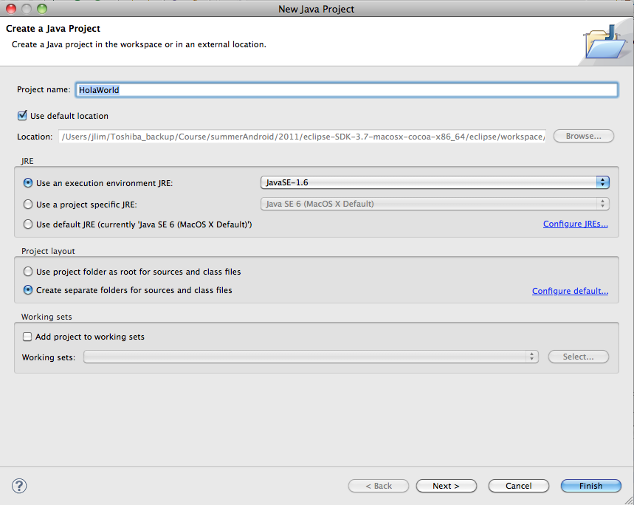
HolaWorld in Eclipse - create a new project
File > New > Java Project
Project Name : HolaWorld

Slide 24
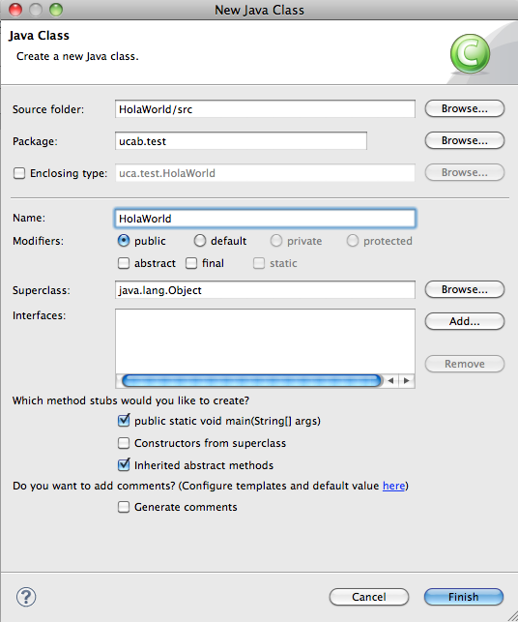
HolaWorld in Eclipse – add a new class
File > New > Class
source folder : HolaWorld/src
Package : ucab.test
Name : HolaWorld
check "public static void main (String[] args)

Slide 25
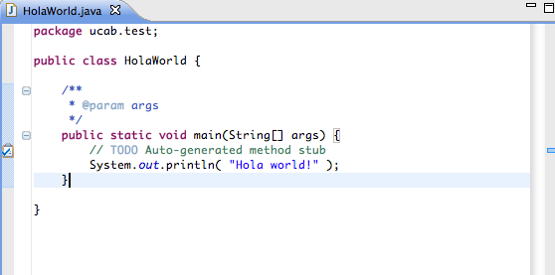
HolaWorld in Eclipse – write your code
Add your code
System.out.println(“Hola world!”);

Slide 26
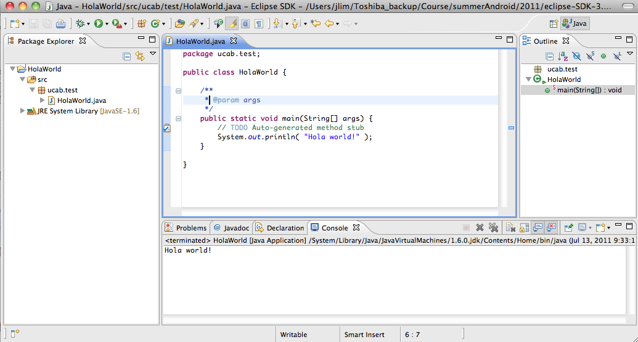
HolaWorld in Eclipse – run your program
Run > Run As > Java Application

Slide 27
Object-Oriented
Java supports OOP
Polymorphism
Inheritance
Encapsulation
Java programs contain nothing but definitions and instantiations of classes
Everything is encapsulated in a class!

Slide 28
The three principles of OOP
Encapsulation
Objects hide their functions (methods) and data (instance variables)
Inheritance
Each subclass inherits all variables of its superclass
Polymorphism
Interface same despite different data types
car
Super class
manual
auto-
matic
Subclasses
draw()
draw()

Slide 29
About class
Fundamental unit of Java program
All java programs are classes
A class is a template or blueprint for objects
A class describes a set of objects that have identical characteristics (data elements) and behaviors (methods).
Existing classes provided by JRE
User defined classes
Each class defines a set of fields (variables), methods or other classes

Slide 30
What is an object?
An object is an instance of a class
An object has state, behavior and identity
Internal variable: store state
Method: produce behavior
Unique address in memory: identity

Slide 31
What does it mean to create an object?
An object is a chunk of memory:
holds field values
holds an associated object type
All objects of the same type share code
they all have same object type, but can have different field values.

Slide 32
Class Person: definition
class Person {
String name;
int height; //in inches
int weight; //in pounds
public void printInfo(){
System.out.println(name+" with height="+height+", weight="+weight);
}
}
Variables
Method
class ClassName{
/* class body goes here */
}
class: keyword

Slide 33
Class Person: usage
Person john; //declaration
john = new Person();//create an object of Person
john.name= “John Kim”;//access its field
Person sam = new Person();
sam.name=“Sam George”;
john.printInfo(); // call method
sam.printInfo();

Slide 34
Class Person: reference
Name: John Kim
height: 0
weight: 0
john
Name: Sam George
height: 0
weight: 0
sam
References
Objects allocated in memory

Slide 35
Reference
Person john;
//only created the reference, not an object. It points to nothing now (null).
john = new Person();
//create the object (allocate storage in memory), and john is initialized.
john.name=“John”;
//access the object through the reference

Slide 36
Primitive types
Primitive type | Size | Minimum | Maximum | Wrapper type
boolean | 1-bit | — | — | Boolean
char | 16-bit | Unicode 0 | Unicode 2¹⁶- 1 | Character
byte | 8-bit | -128 | +127 | Byte
short | 16-bit | -2¹⁵ | +2¹⁵-1 | Short
int | 32-bit | -2³¹ | +2³¹-1 | Integer
long | 64-bit | -2⁶³ | +2⁶³-1 | Long
float | 32-bit | IEEE754 | IEEE754 | Float
double | 64-bit | IEEE754 | IEEE754 | Double

Slide 37
Reference vs. primitive
Java handle objects and arrays always by reference.
classes and arrays are known as reference types.
Class and array are composite type, don’t have standard size
Java always handle values of the primitive types directly
Primitive types have standard size, can be stored in a fixed amount of memory
Because of how the primitive types and objects are handles, they behave different in two areas: copy value and compare for equality

Slide 38
Copy
Primitive types get copied directly by =
int x= 10; int y=x;
Objects and arrays just copy the reference, still only one copy of the object existing.
john
Name: John
height: 0
weight: 0
Person john = new Person();
john.name=”John";
Person x=john;
x.name="Sam";
System.out.println(john.name); // print Sam!
x

Slide 39
Scoping: in a class
public class VisibilityDemo {
private int classVar1;
private int classVar2;
public int method1(int x) {
int local = 0;
for (int i = 0; i < x; i++){
local += i;
}
return local;
}
public void method2 ( int x) {
classVar1 = x + 10;
classVar2 = method1(classVar2);
}
}
The red identifiers denote class varialbes and methods. They have visibility anywhere inside the outermost pair of red curly brackets
The blue identifiers are local to a single block (identified by blue brackets). They are not visible to anything outside of their block, but are visible inside blocks nested inside of the blue bracketed block.
The gray identifiers are found inside the for-loop. The gray variable i is visible only inside the loop.
Parameters are denoted by green. They are visible everywhere inside the method in which they appear, but only in that method

Slide 40
Access control
Access to packages
Java offers no control mechanisms for packages.
If you can find and read the package you can access it
Access to classes
All top level classes in package P are accessible anywhere in P
All public top-level classes in P are accessible anywhere
Access to class members (in class C in package P)
Public: accessible anywhere C is accessible
Protected: accessible in P and to any of C’s subclasses
Private: only accessible within class C
Package: only accessible in P (the default)

Slide 41
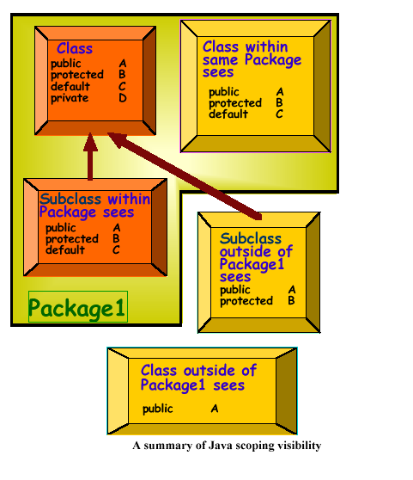
Scoping: visibility between classes

Slide 42
The static keyword
Java methods and variables can be declared static
These exist independent of any object
This means that a Class’s
static methods can be called even if no objects of that class have been created and
static data is “shared” by all instances (i.e., one rvalue per class instead of one per instance
class StaticTest {static int i = 47;}
StaticTest st1 = new StaticTest();
StaticTest st2 = new StaticTest();
// st1.i == st2.I == 47
StaticTest.i++; // or st1.I++ or st2.I++
// st1.i == st2.I == 48

Slide 43

Questions?

